Slide 1
USA Learns Citizenship
2.10 Loyalty to the US

Slide 2
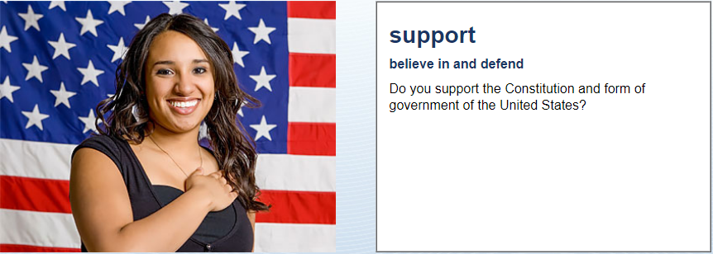
Loyalty to the US
Yes, I do!

Slide 3
Loyalty to the US

Slide 4
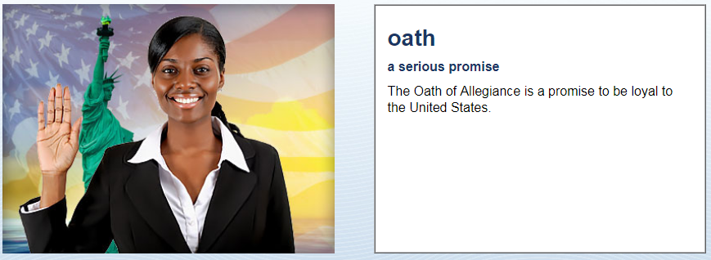
Loyalty to the US
Are you willing to take the
Oath of Allegiance?
Yes, I am!

Slide 5
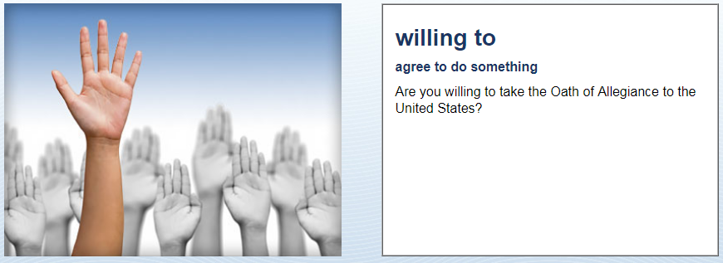
Loyalty to the US
Yes!

Slide 6
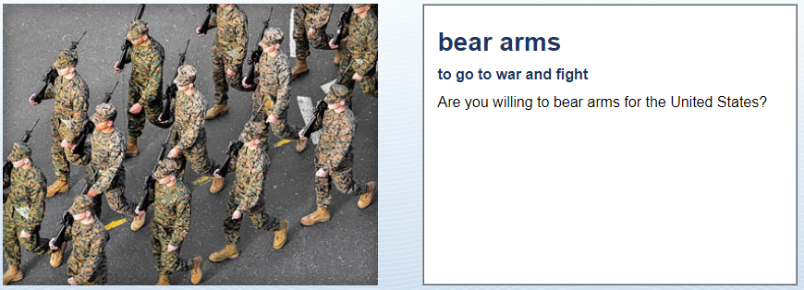
Loyalty to the US
Yes!

Slide 7
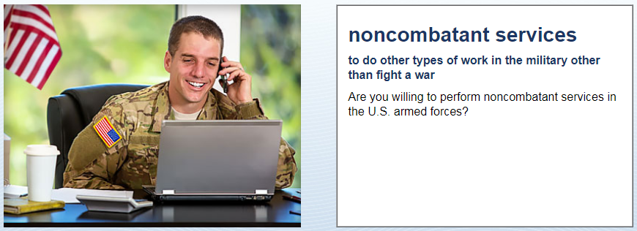
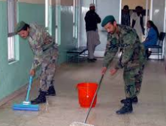
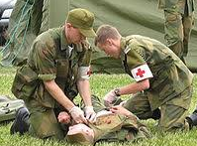
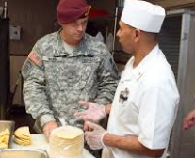
Loyalty to the US
Yes!!

Slide 8
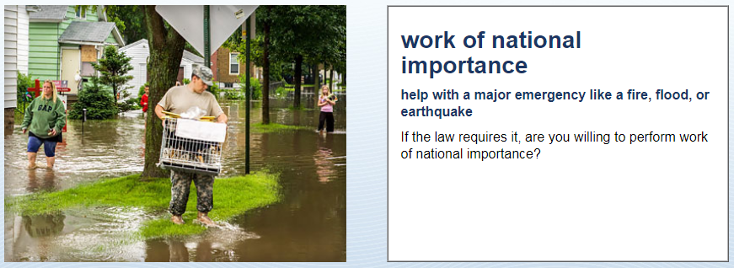
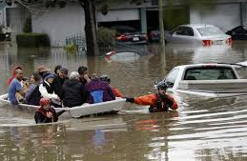
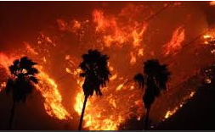
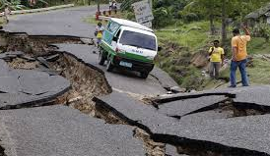
Loyalty to the US
Yes!

Slide 9
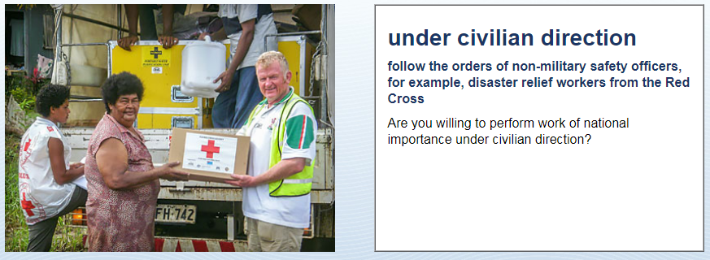
Loyalty to the US
Yes!!

Slide 10
The Oath of Allegiance

Slide 11
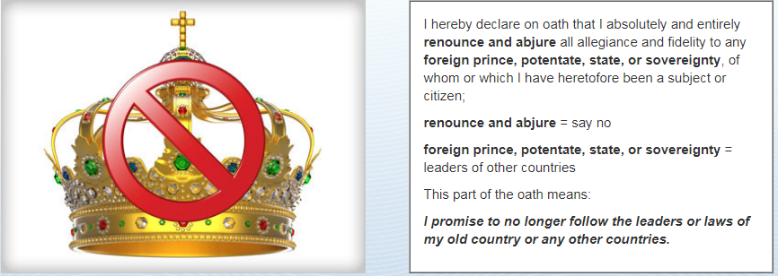
The Oath of Allegiance

Slide 12
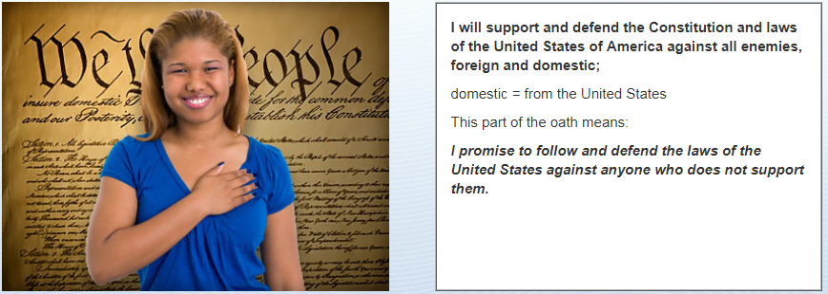
The Oath of Allegiance

Slide 13
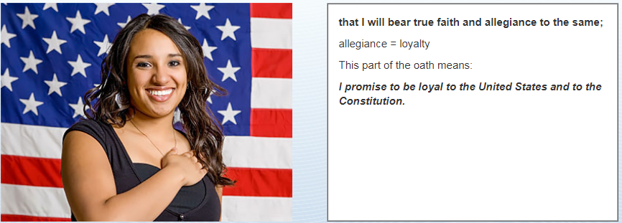
The Oath of Allegiance

Slide 14
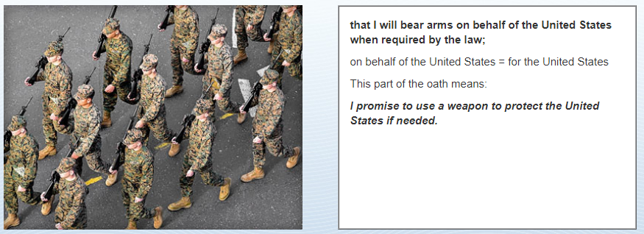
The Oath of Allegiance

Slide 15
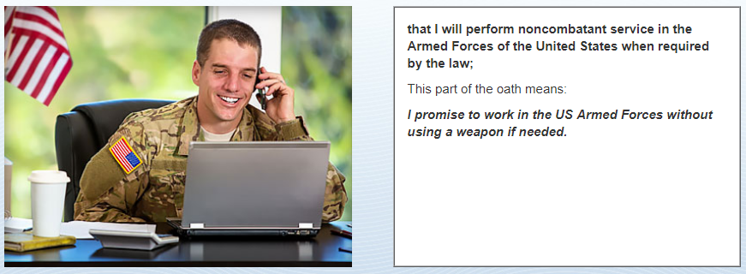
The Oath of Allegiance

Slide 16
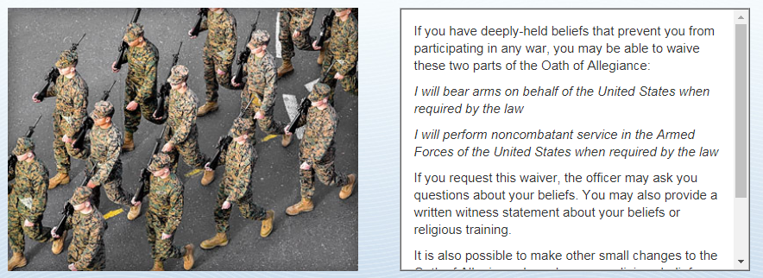
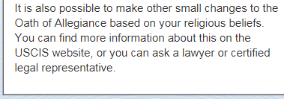
The Oath of Allegiance

Slide 17
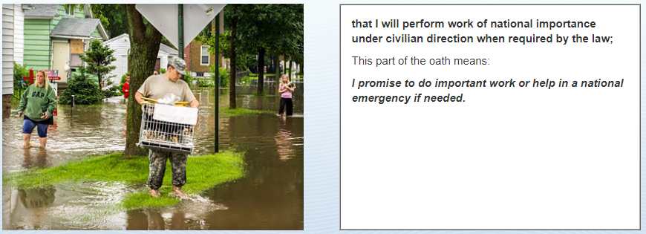
The Oath of Allegiance

Slide 18
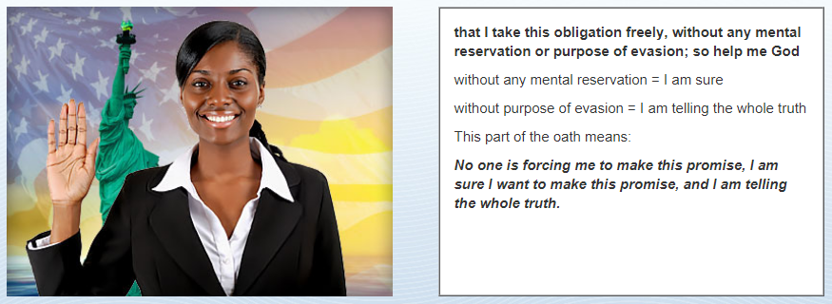
The Oath of Allegiance

Slide 19
The Oath of Allegiance
I swear that I will not be loyal to any other country.
I will support and defend the Constitution and laws of the US.
I will defend the US from enemies outside and inside the US.
I will bear arms, carry a gun or fight for the United States if asked.
I will do non-fighting work for the military if asked.
I will do important work for the country if asked.
I take this oath freely and without any doubts.

Slide 20
"I hereby declare, on oath …
that I absolutely and entirely renounce and abjure all allegiance and fidelity to any foreign prince, potentate, state, or sovereignty of whom or which I have heretofore been a subject or citizen;
that I will support and defend the Constitution and laws of the United States of America against all enemies, foreign and domestic;
that I will bear true faith and allegiance to the same;
that I will bear arms on behalf of the United States when required by the law;
that I will perform noncombatant service in the Armed Forces of the United States when required by the law;
that I will perform work of national importance under civilian direction when required by the law; and
that I take this obligation freely without any mental reservation or purpose of evasion; so help me God."

Slide 21
To Finish:
Listen to the Oath:
Citizenship Ceremony:

