Slide 1
USA Learns Citizenship
2.3 Information About You

Slide 3
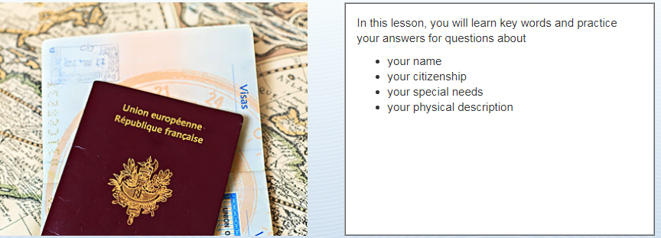
Learning Goals

Slide 4
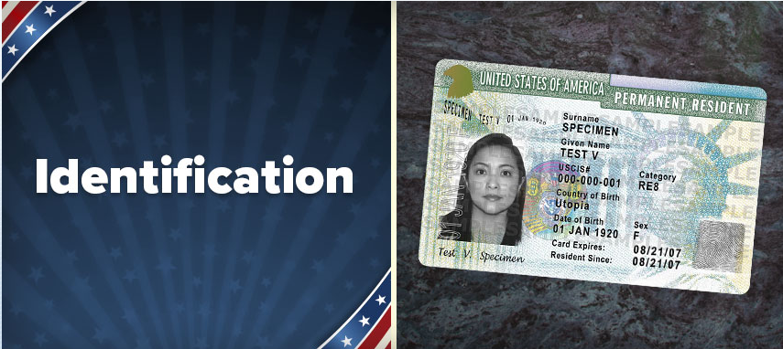

Slide 5
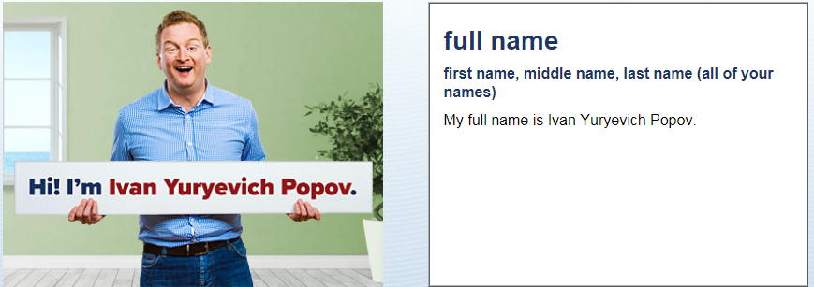
Identification
What is your full name?
My full name is …

Slide 6
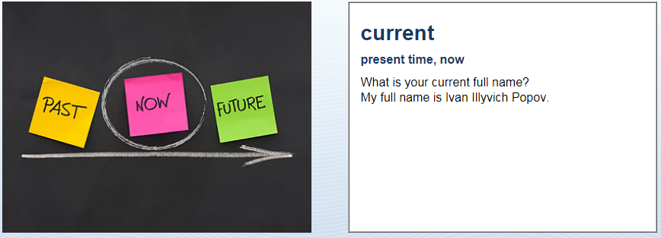
Identification
My current full name is …

Slide 7
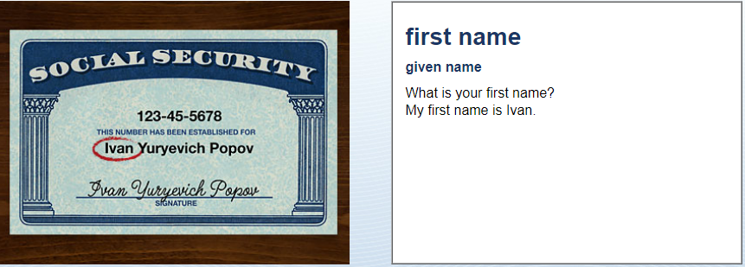
Identification
My first name is …

Slide 8
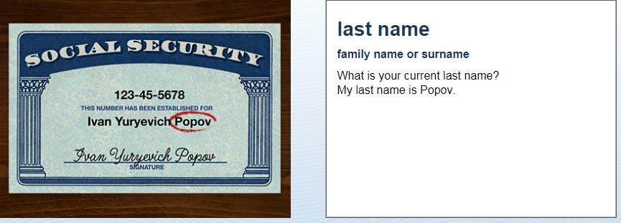
Identification
My last name is …

Slide 9
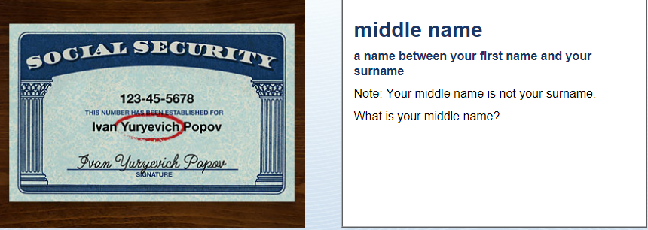
Identification
My middle name is …
OR I don’t have a middle name

Slide 10
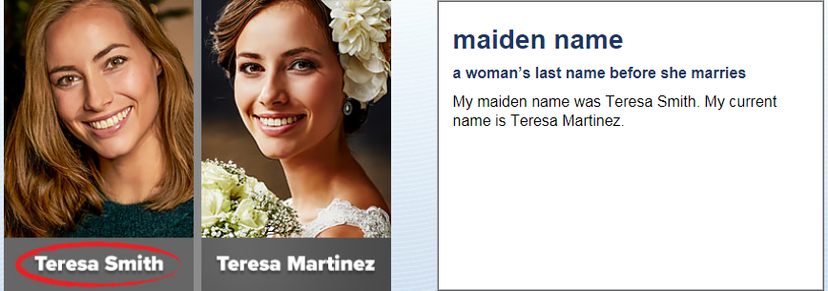
Identification
My maiden name was …

Slide 11
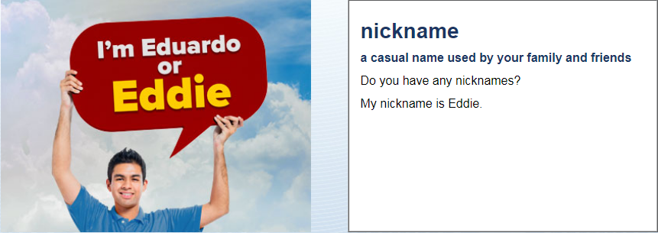
Identification
My nick name is …
OR I don’t have a nick name

Slide 12
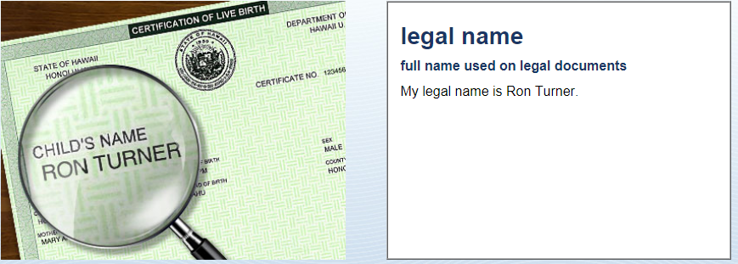
Identification
The name on your passport
My legal name is …

Slide 13
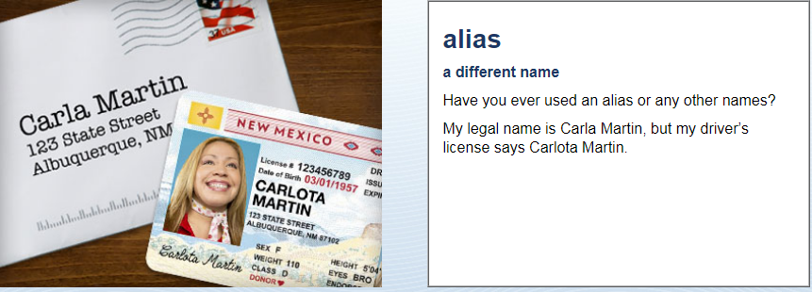
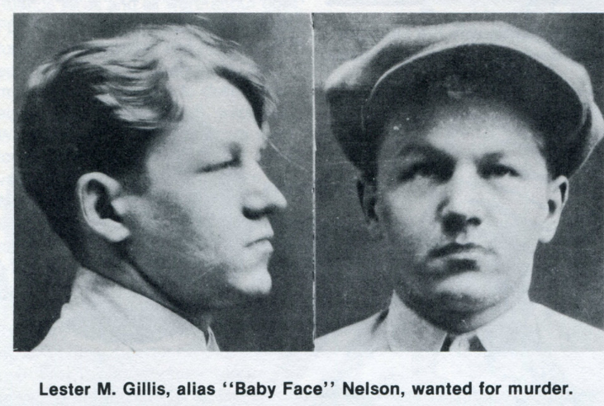
Identification
My alias is …
OR I don’t have an alias

Slide 14
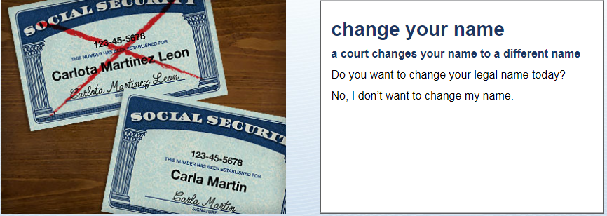
Identification
No, I don’t want to change my name.
OR Yes, I would like to change my name to …

Slide 15
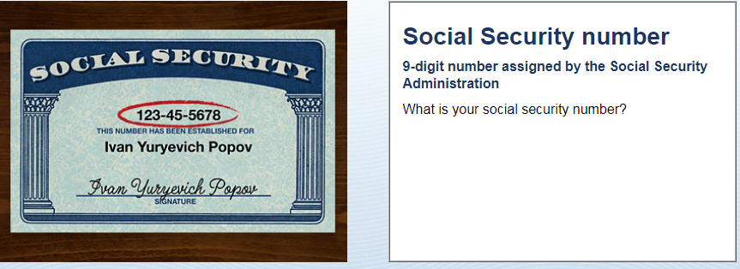
Identification
My social security number is XXX-XX-XXXX

Slide 16
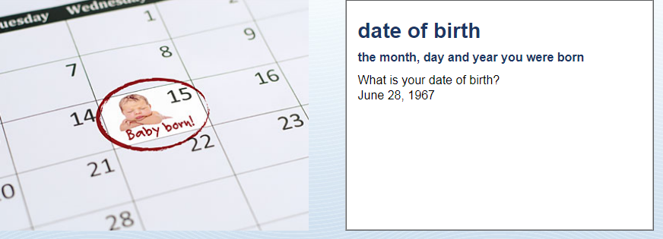
Identification
My date of birth is (month, day, year)

Slide 17
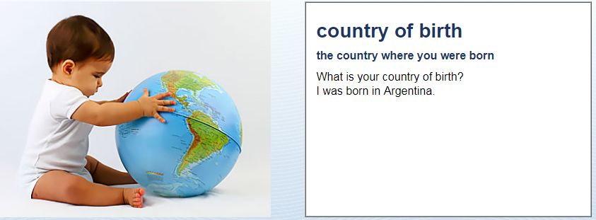
Identification
I was born in …

Slide 18
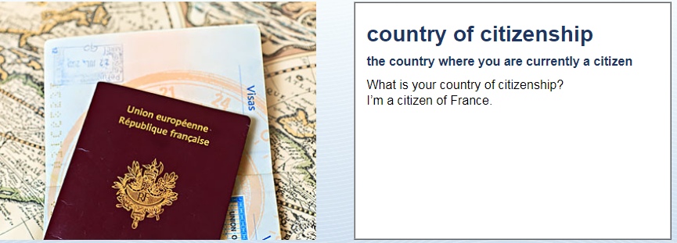
Identification
You have a passport for this country
I’m a citizen of (country)…

Slide 19
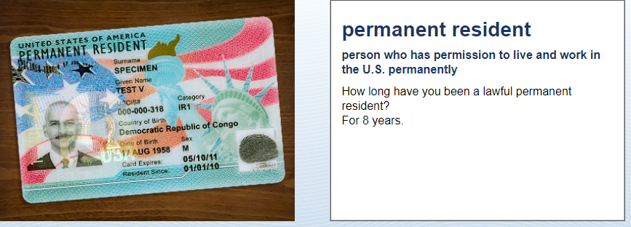
Identification
I have been a permanent resident for (number) years.

Slide 20
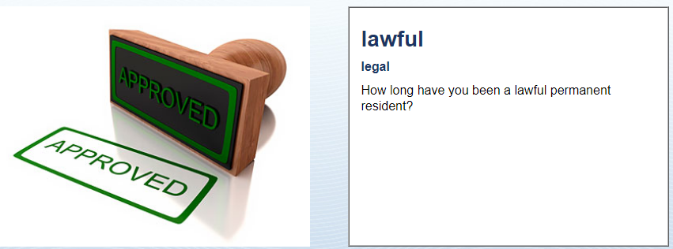
Identification
I have been a lawful permanent resident since (month, day, year).

Slide 21
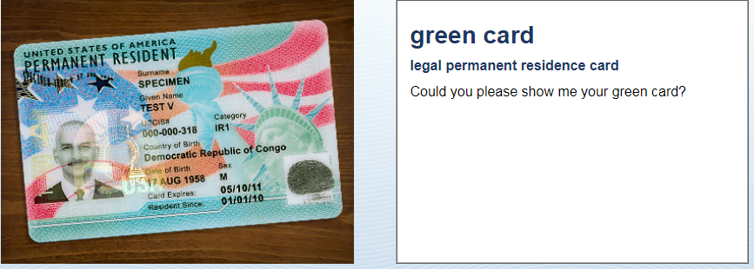
Identification
Yes, here it is.

Slide 22
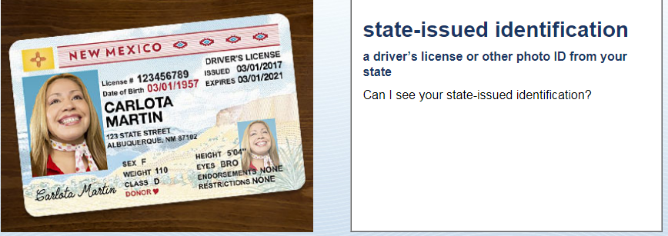
Identification
Photo ID
Here are my driver’s license, green card and passport.

