Slide 1
USA Learns Citizenship
2.4 Contact Information

Slide 3
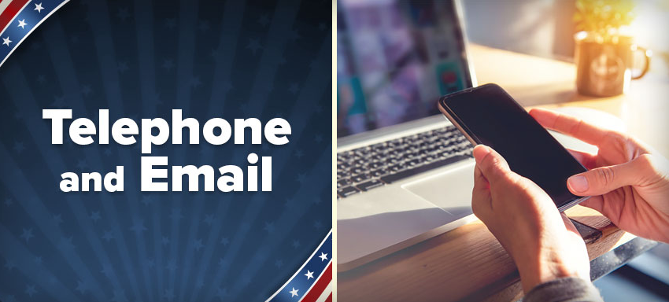

Slide 4
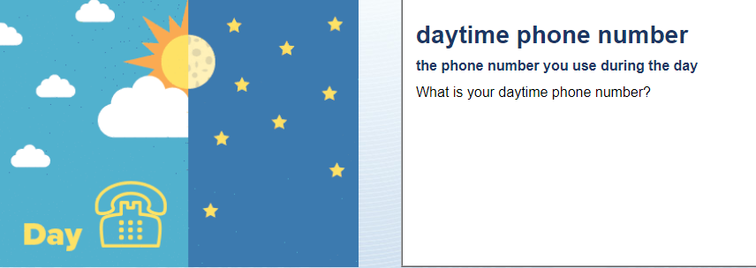
Telephone and Email
My number is (408) 123 4567

Slide 5
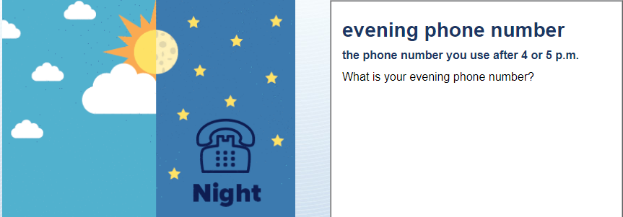
Telephone and Email
My evening number is (408) 123 4567
My evening number is the same as my daytime number.
Same number.

Slide 6
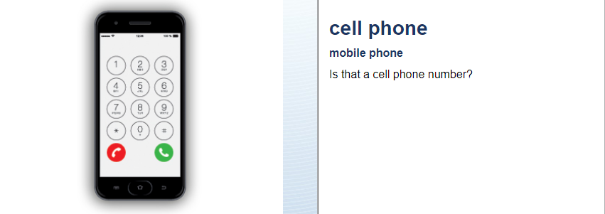
Telephone and Email
Yes, it is.
No, my cell phone number is (xxx) xxx xxxx

Slide 7
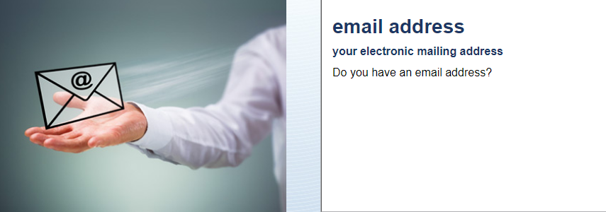
Telephone and Email
Yes - My email address is joe12@yahoo.com
No – I don’t have an email.

Slide 8
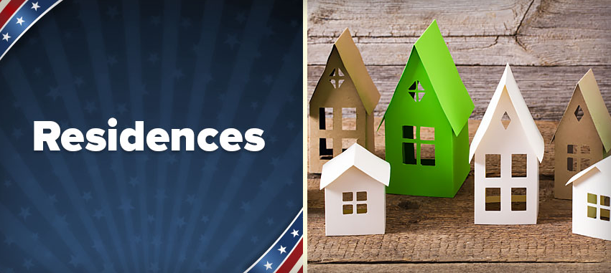

Slide 9
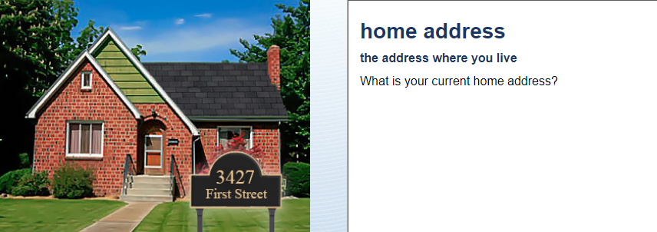
Residences
My current home address is 26 Dot Avenue, Campbell, CA 95008

Slide 10
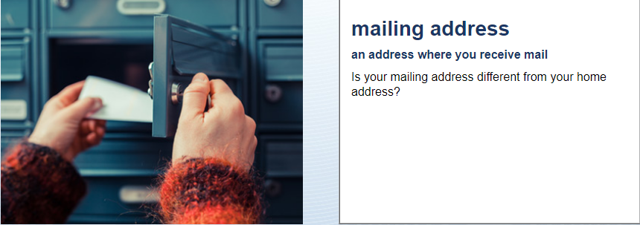
Residences
No.
Yes, my mailing address is PO Box 30, 10 Main Street, Los Gatos, CA 95030

Slide 11
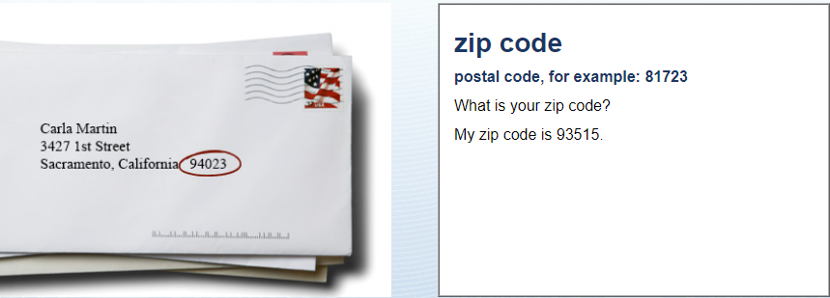
Residences
My zip code is 95008

Slide 12
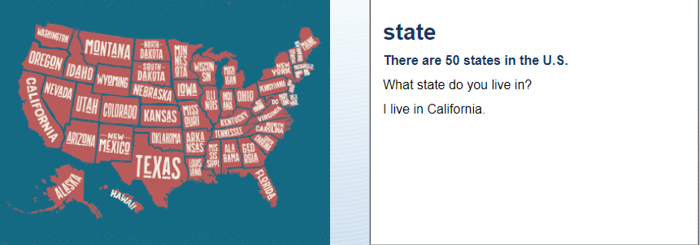
Residences
I live in California

Slide 13
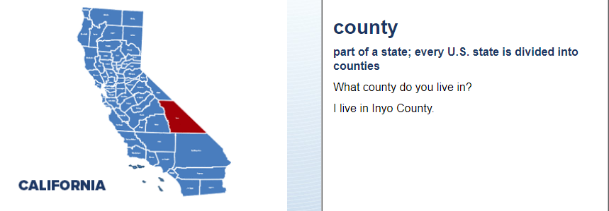
Residences
I live in Santa Clara county.

Slide 14
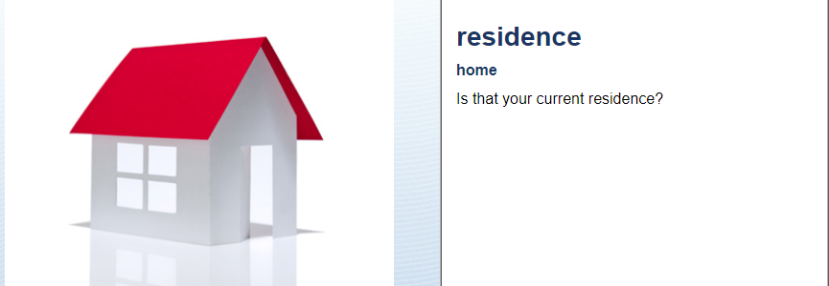
Residences
Yes, it is.

Slide 15
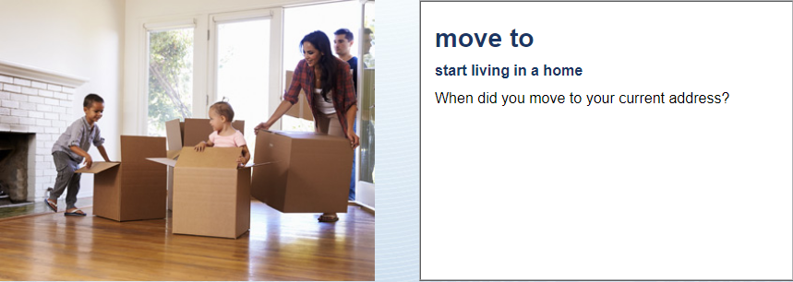
Residences
I moved there in July 2017

Slide 16
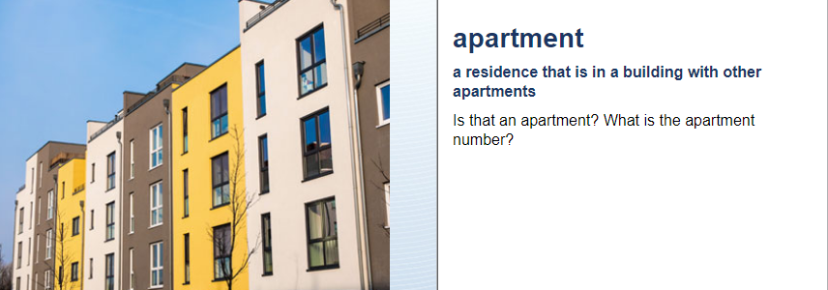
Residences
No, it is not an apartment.
Yes, it is apartment number 28

Slide 17
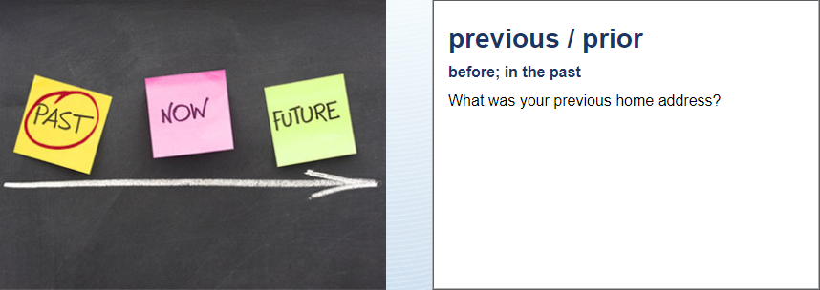
Residences
My previous address was 1068 Winchester Boulevard, Campbell, CA 95008

