Slide 1
USA Learns Citizenship
2.5 Employment, Schools, and Travel

Slide 3
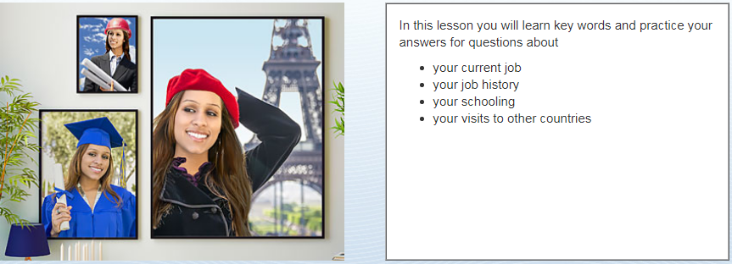
Objectives

Slide 5
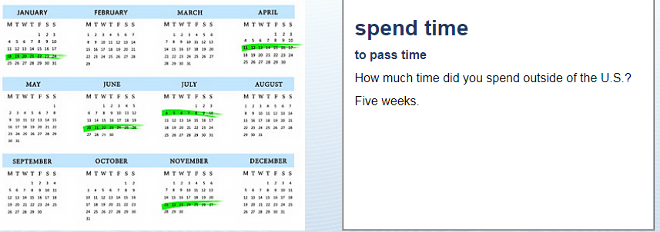
Time Outside the US
How much time did you spend
outside the US?
I spent 20 days outside the US

Slide 6
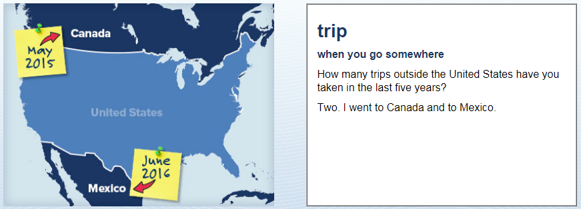
Time Outside the US
How many trips outside the US
have you taken in the last 5
years?
2. I went to Mexico and Canada

Slide 7
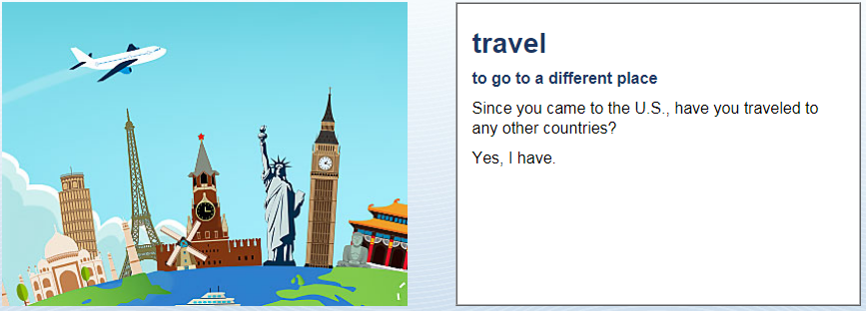
Time Outside the US
Since you came to the US,
have you travelled to another
country?
Yes, I have. I went to Iran.
No, I have not

Slide 8
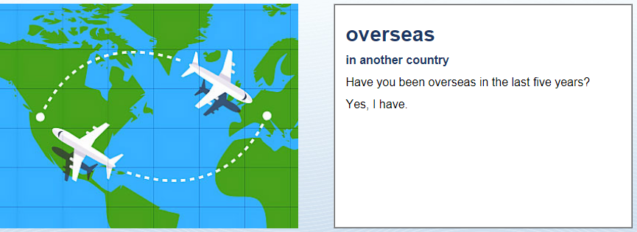
Time Outside the US
Have you been overseas in the
last 5 years?
Yes, I have. I went to (Taiwan) for (3 weeks)
No, I have not.

Slide 9
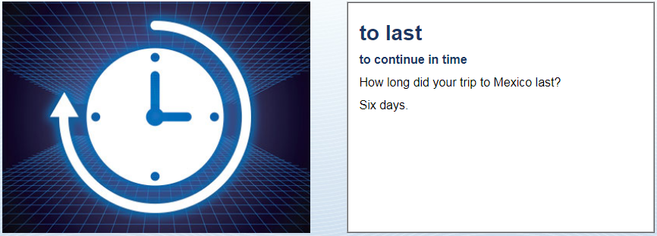
Time Outside the US
How long did your trip to
Mexico last?
My trip lasted 10 days.
10 days

Slide 10
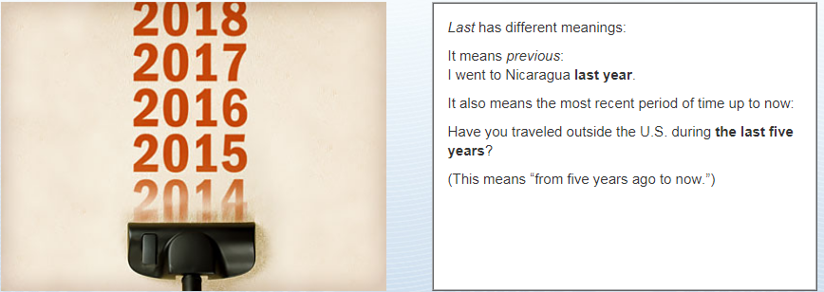
Time Outside the US

Slide 11
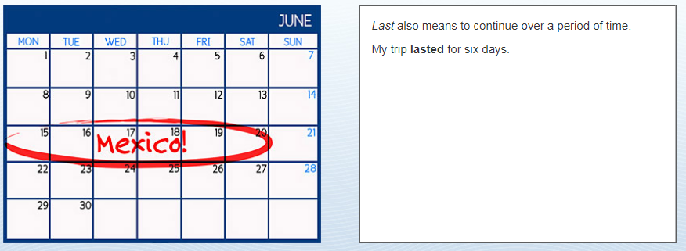
Time Outside the US

