Slide 1
USA Learns Citizenship
2.6 Family Relationships

Slide 3
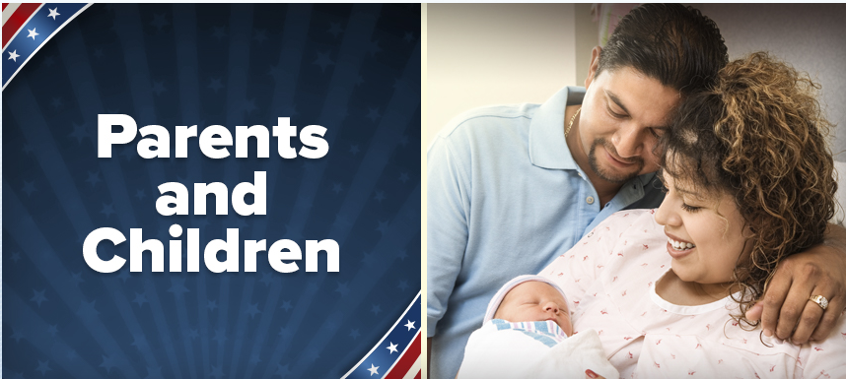

Slide 4
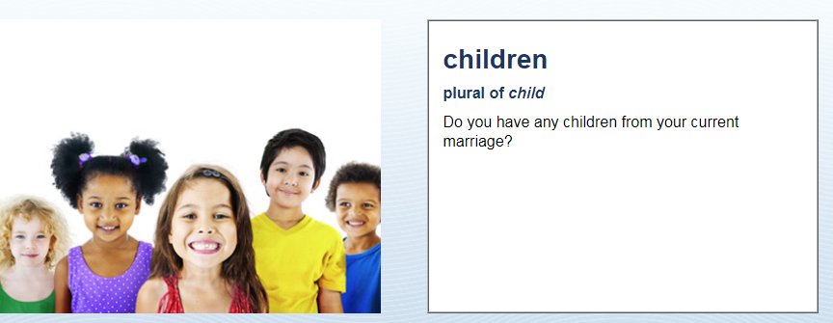
Parents & Children
Yes, I have one child.
Yes, I have (number) children
No, I don’t have any children.

Slide 5
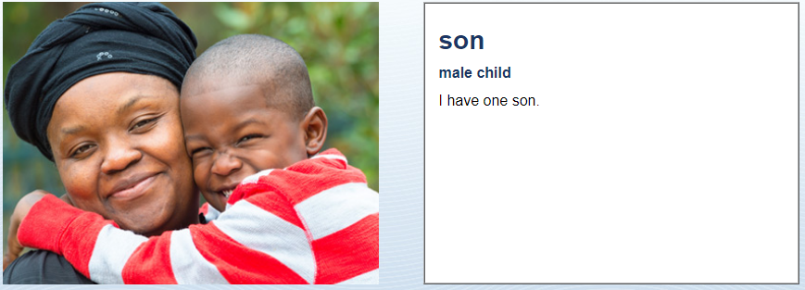
Parents & Children
How many sons do you have?
I have (number) sons.
I don’t have any sons.

Slide 6
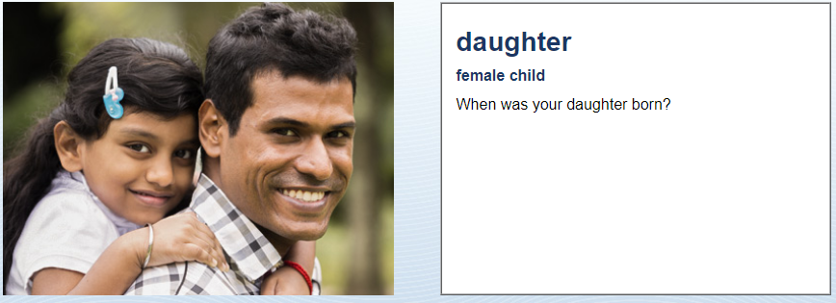
Parents & Children
She was born in (date)…

Slide 7
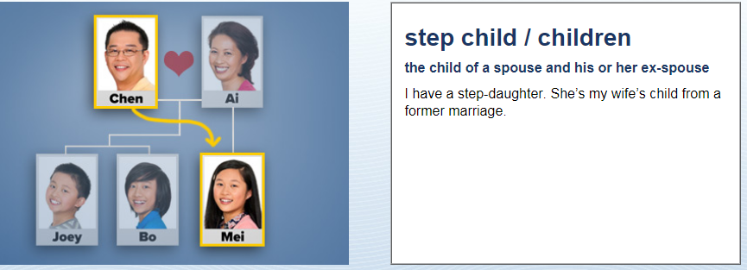
Parents & Children
Do you have any step-children?
Step-child
Step-children
Step-son/s
Step-daughter/s
I have (a step-daughter)
OR: No, I don’t (have any step-children)

Slide 8
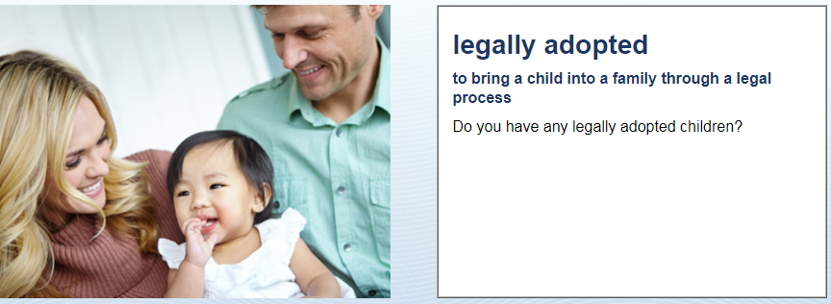
Parents & Children
Yes, I have a legally adopted (son)
No, I don’t

Slide 9
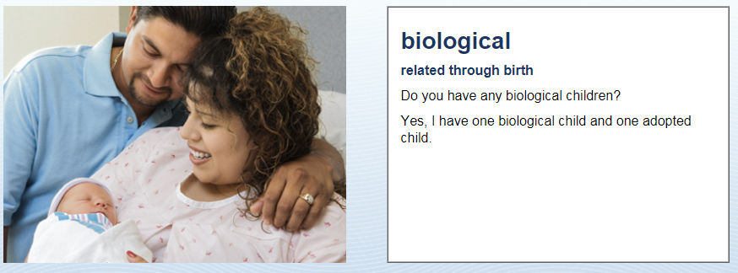
Parents & Children
Yes, I have 2 biological (daughters)

Slide 10
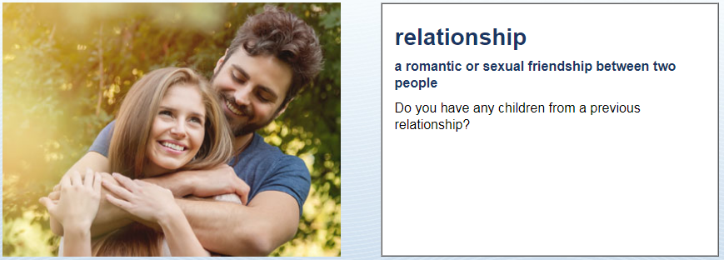
Parents & Children
Yes, I have (a son) from a previous relationship.
No, I don’t.

