Slide 1
USA Learns Citizenship
2.7 Civic Responsibility

Slide 3
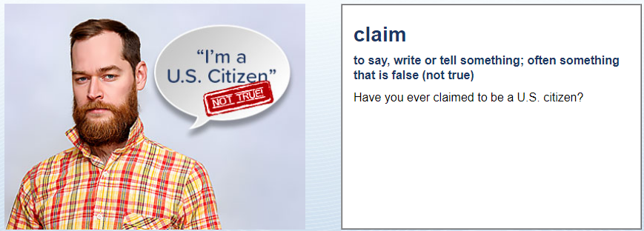
Civic Responsibility
No, never
What does “claim to be a US citizen” mean?
To say that you are a US citizen when you are not.

Slide 4
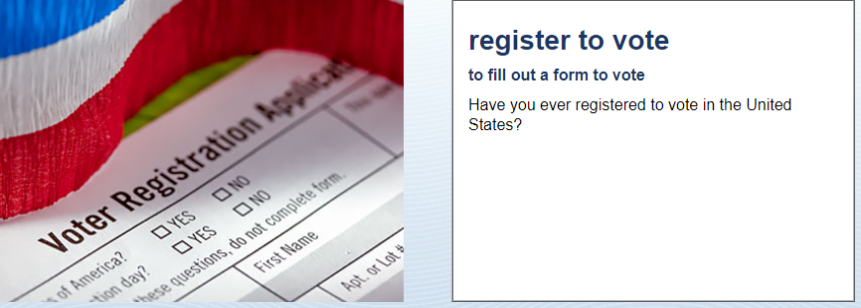
Civic Responsibility
No, never

Slide 5
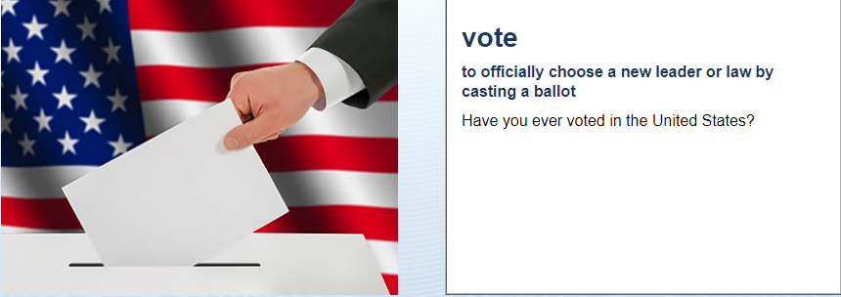
Civic Responsibility
No, never

Slide 6
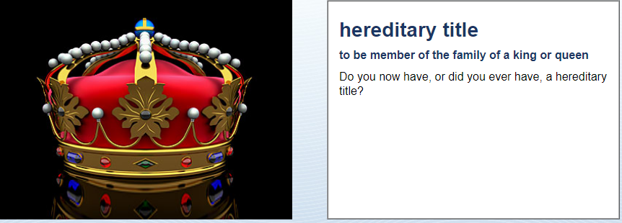
Civic Responsibility
No, never
What does “hereditary title” mean?
To be a king or queen in my old country.

Slide 7
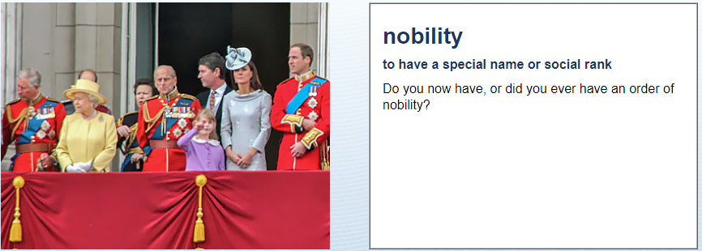
Civic Responsibility
No, never
What does “nobility” mean?
To be a prince or a duke in my old country.

Slide 8
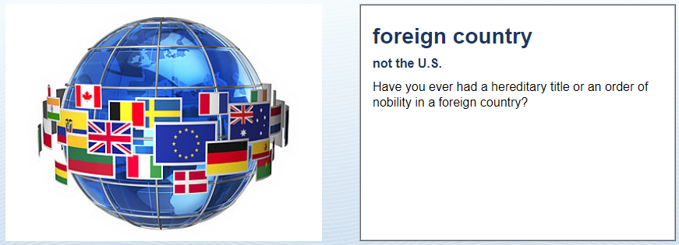
Civic Responsibility
No, never

Slide 9
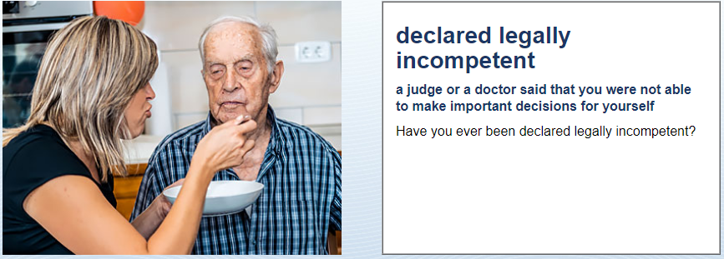
Civic Responsibility
No, never
What does “legally incompetent” mean?
To be mentally ill. You cannot make your own decisions.

Slide 10
Civic Responsibility
No, never
What does “mental institution” mean?
A hospital for mentally ill people.

Slide 11
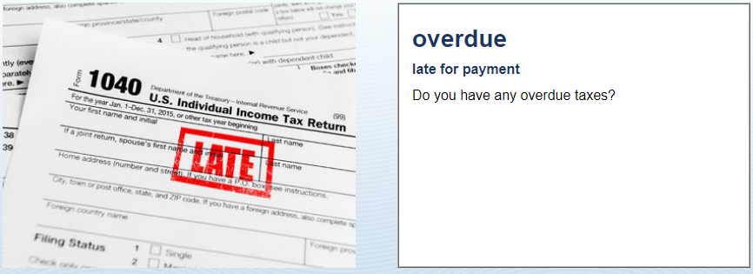
Civic Responsibility
No! No, no, no, no!!

Slide 12
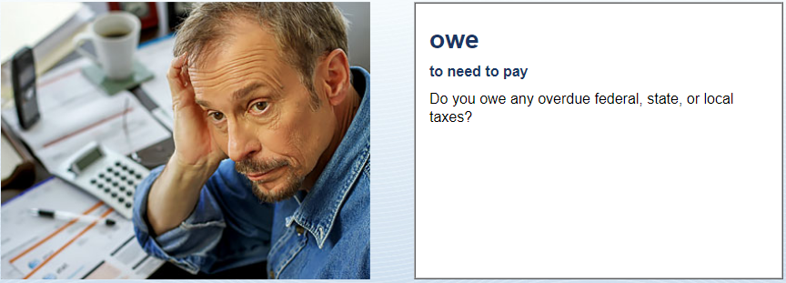
Civic Responsibility
No, I don’t

Slide 13
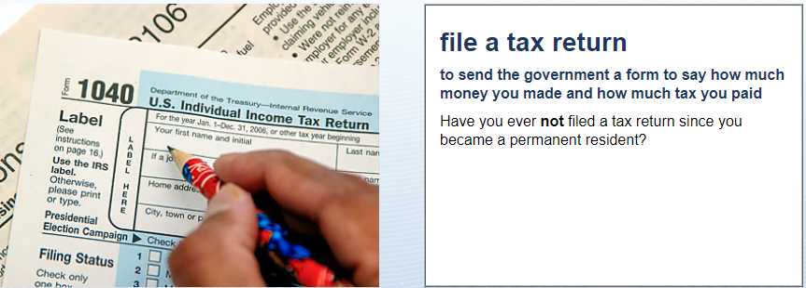
Civic Responsibility
No, never. I always pay my taxes.

Slide 14
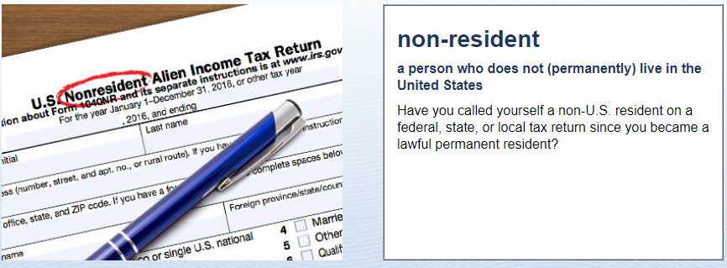
Civic Responsibility
No, never

