Slide 1
USA Learns Citizenship
2.8 Memberships and Associations

Slide 3
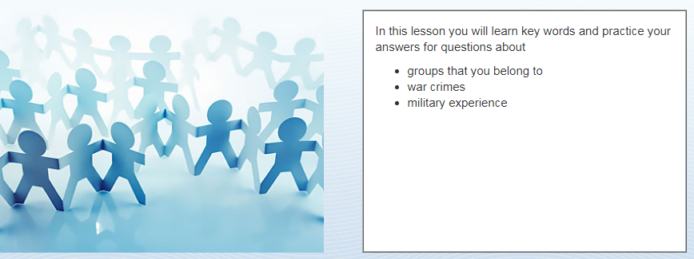
Objectives

Slide 5
Groups
Church
Union
Yoga group
Reading club
Golf club
No, never
OR: Yes, I belong to a church

Slide 6
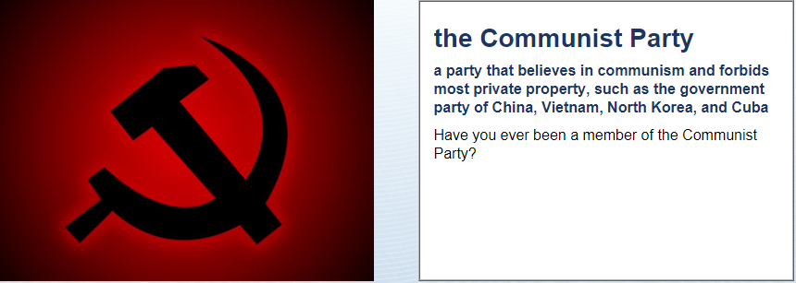
Groups
No, never
What is Communism?
No freedom – the ideas of Karl Marx, like Cuba or North Korea.

Slide 7
Have (were, did) you ever … ?
Usually, the answer is No
Have you ever …
Been a terrorist?
Been a habitual drunk?
Been a Communist?
Been a drug dealer?
Been a Nazi?

Slide 8
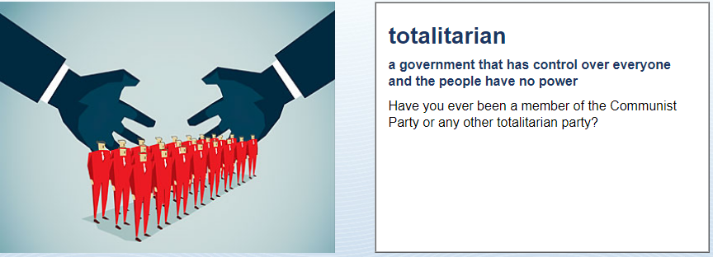
Groups
No, never
What is totalitarianism?
No freedom – like Nazi Germany

Slide 9
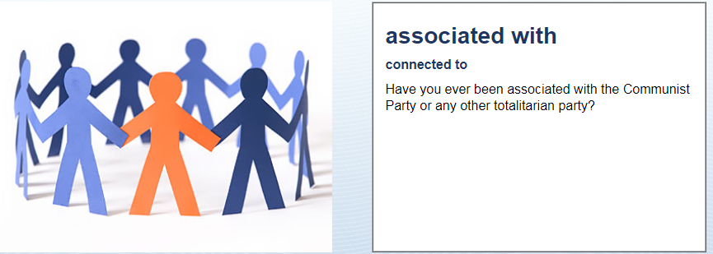
Groups
No, never

Slide 10
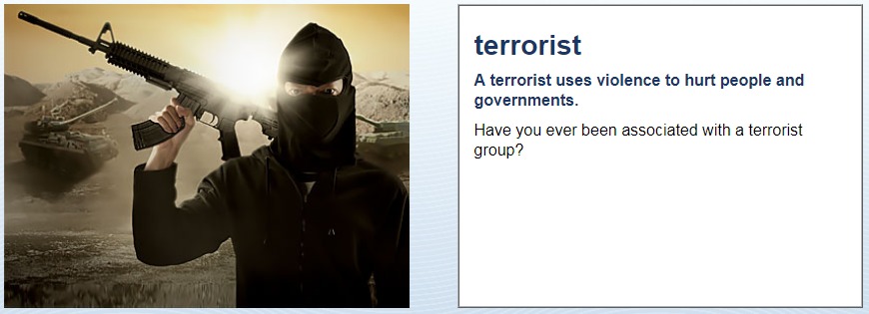
Groups
No, never
What is terrorism?
A terrorist group uses violence to hurt people - like ISIS

Slide 11
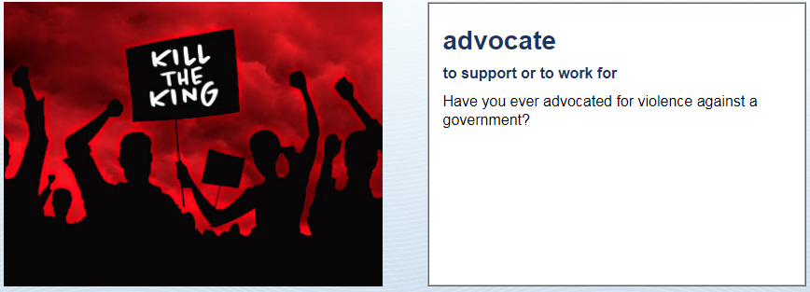
Groups
No, never

Slide 12
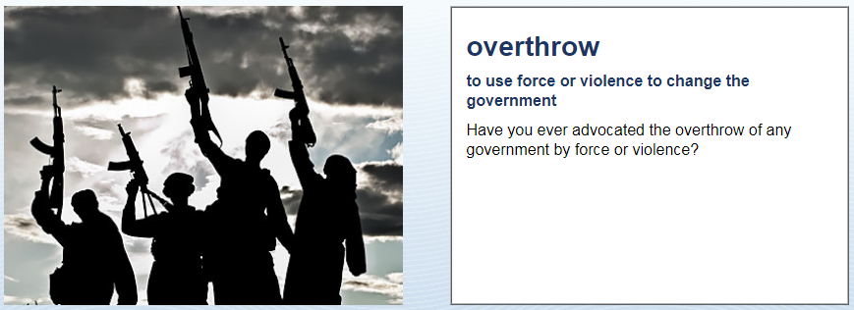
Groups
No, never

Slide 13
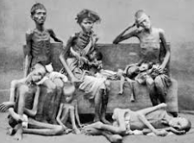
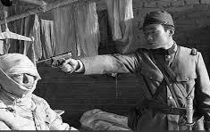
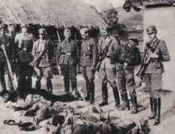
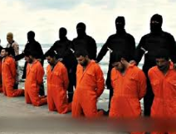

Slide 14
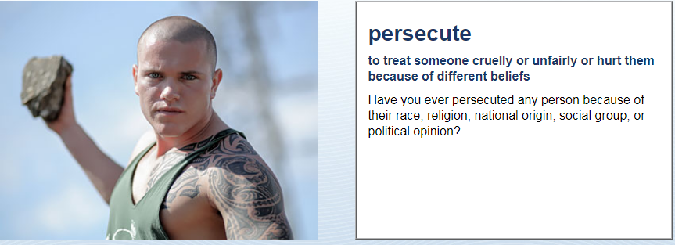
War Crimes
No, never

Slide 15
War Crimes
No, never

Slide 16
War Crimes
No, never
What is torture?
To hurt someone for information.

Slide 17
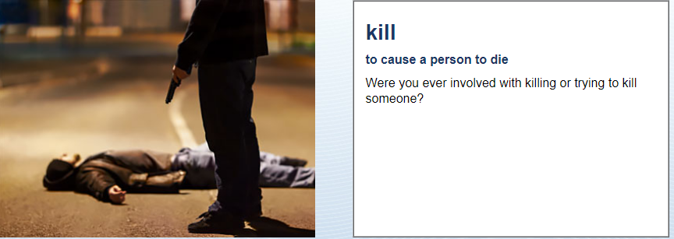
War Crimes
No, never

Slide 18
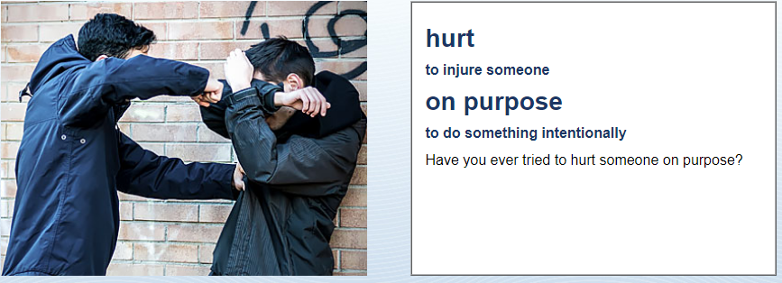
War Crimes
No, never

Slide 19
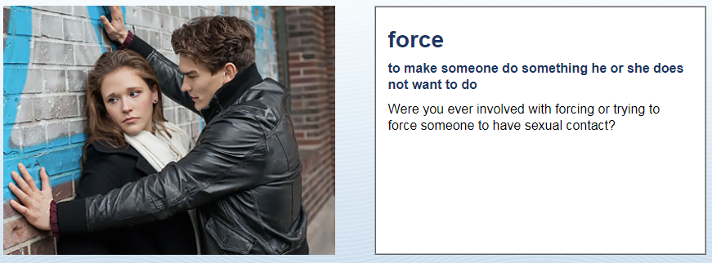
War Crimes
No, never

Slide 20
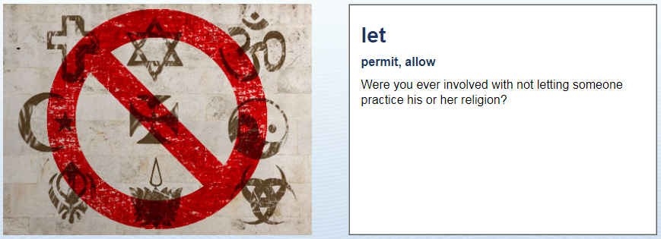
War Crimes
No, never

Slide 21
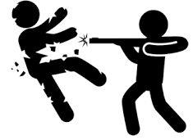
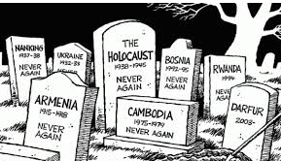
War Crimes
Persecute
- terrorize people because of their beliefs
Genocide
deliberate extermination of a people
Torture
hurt someone to get information or punish him
Kill/hurt
Rape/ sexual assault
No, never

Slide 23
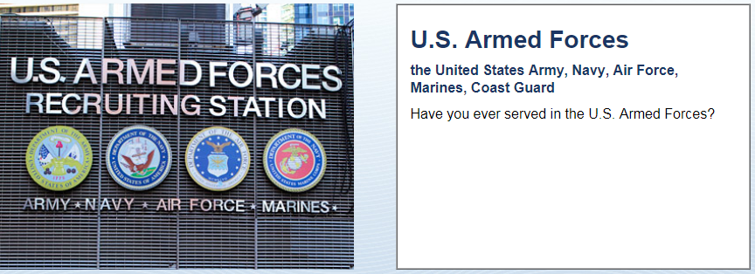
Military Groups
No, never

Slide 24
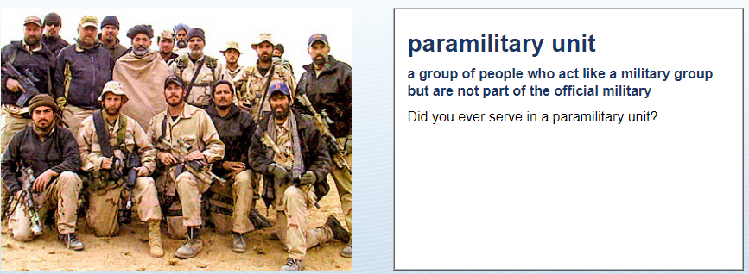
Military Groups
No, never

Slide 25
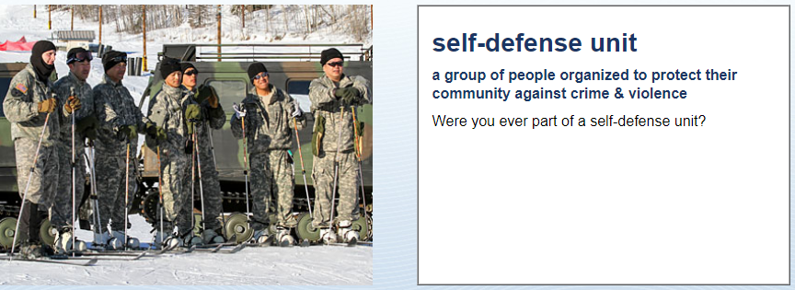
Military Groups
No, never

Slide 26
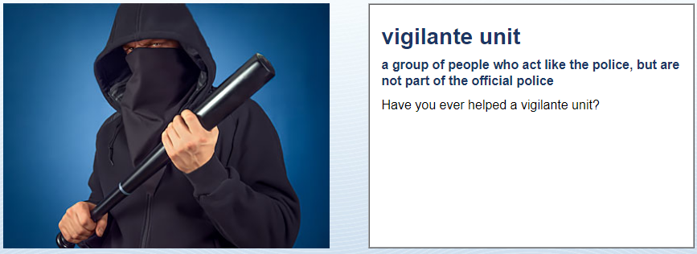
Military Groups
No, never

Slide 27
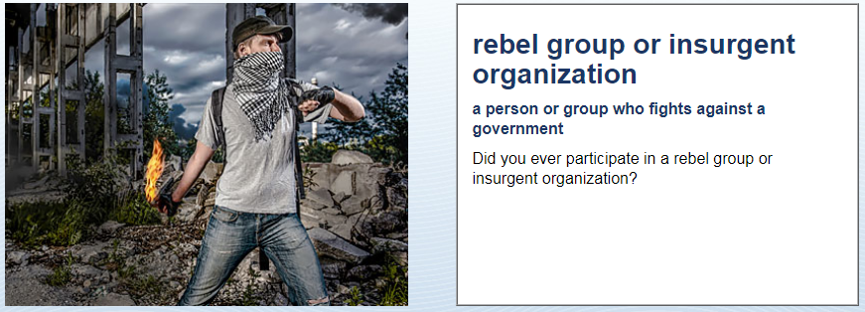
Military Groups
No, never

Slide 28
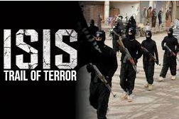
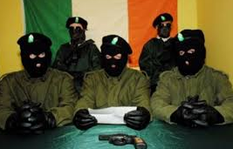
Military Groups
US Armed Forces (government military)
Rebel Groups (not government military):
Paramilitary Unit
Self-defense Unit
Vigilante Unit
Insurgent Organization
No, never
What is a rebel group?
They fight against the government.

