Slide 1
USA Learns Citizenship
2.9 Illegal Activities

Slide 3
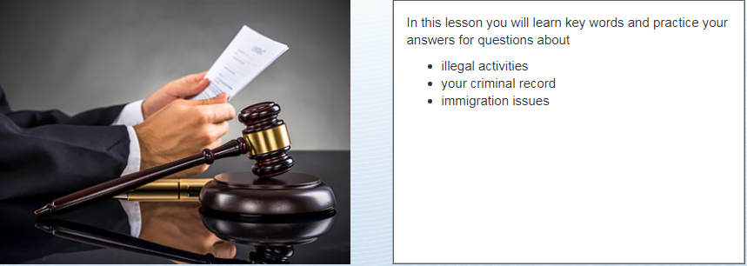
Objectives

Slide 5
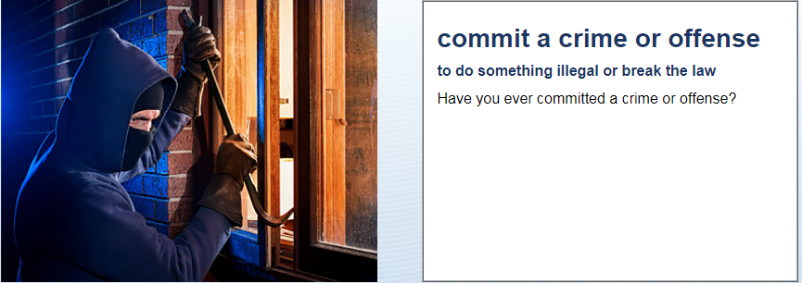
Criminal Record & Crimes
No, never

Slide 6
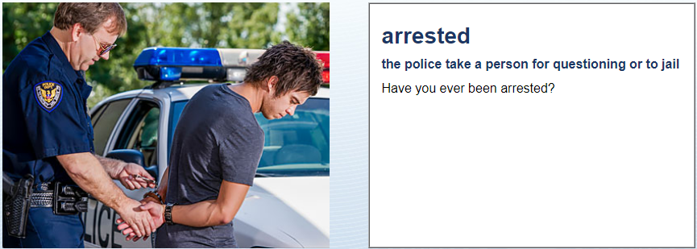
Criminal Record & Crimes
No, never
What does “arrested” mean?
The police take you to jail.

Slide 7
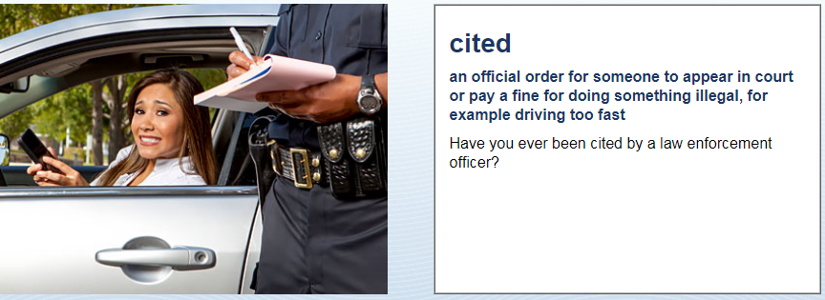
Criminal Record & Crimes
No, never

Slide 8
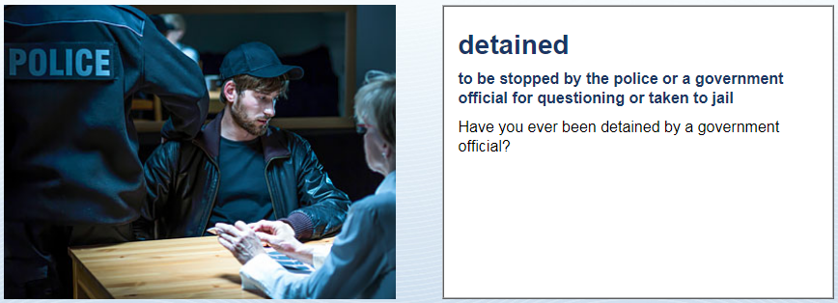
Criminal Record & Crimes
No, never

Slide 9
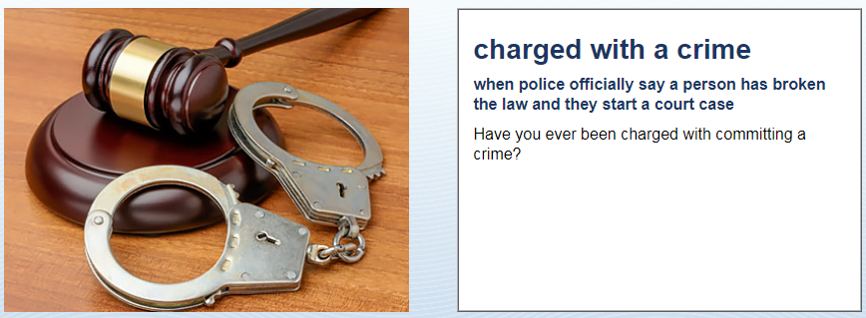
Criminal Record & Crimes
No, never

Slide 10
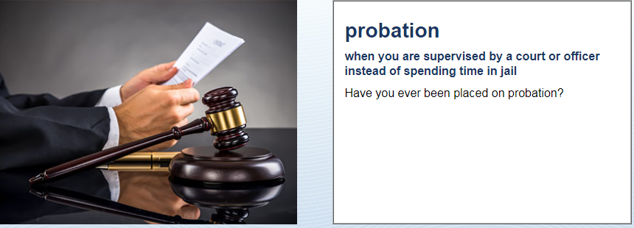
Criminal Record & Crimes
No, never

Slide 11
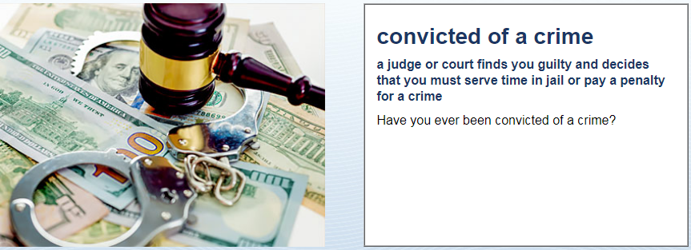
Criminal Record & Crimes
No, never
What does “convicted of a crime” mean?
The court sends you to jail.

Slide 12
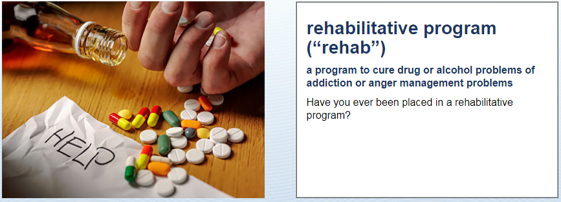
Criminal Record & Crimes
No, never
What does “rehablitation” mean?
Rehab is treatment for drugs or alcohol.

Slide 13
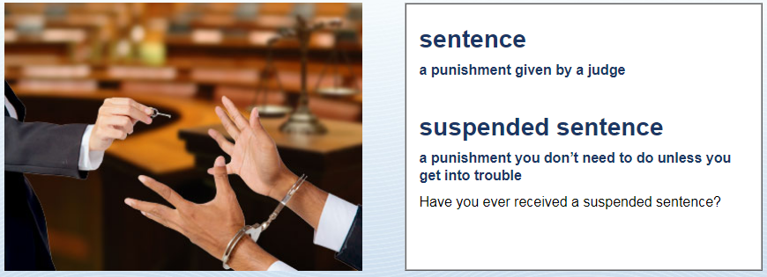
Criminal Record & Crimes
No, never

Slide 14
Criminal Record & Crimes
Have you ever committed a crime?
Offense
Arrested
Cited
Detained
Charged
Convicted
Rehab
Sentence
Suspended
Probation
Parole
No, never

Slide 16
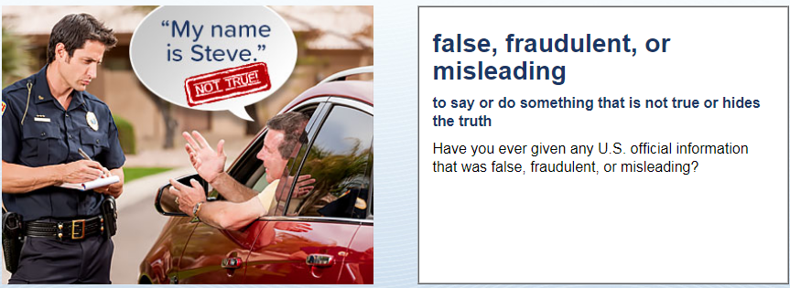
Immigration and Deportation
No, never

Slide 17
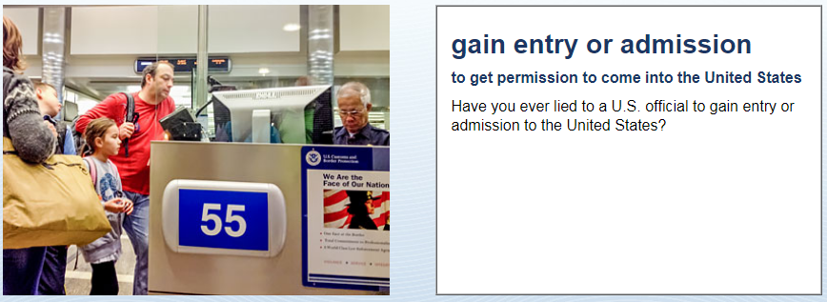
Immigration and Deportation
No, never

Slide 18
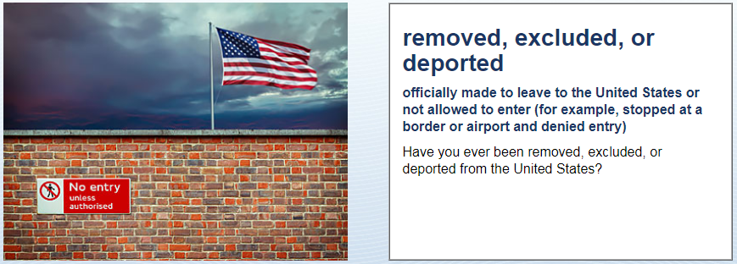
Immigration and Deportation
No, never
What does “deported” mean?
Sent back to my old country.

Slide 19
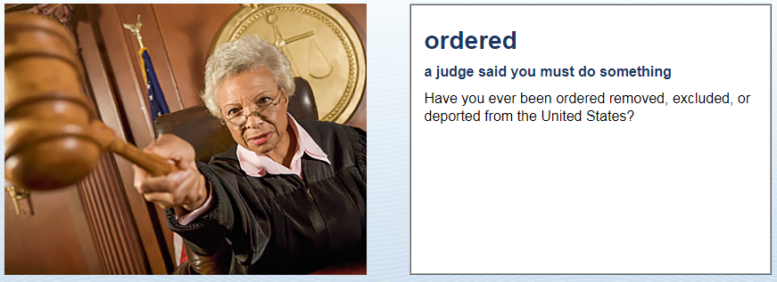
Immigration and Deportation
No, never

Slide 20
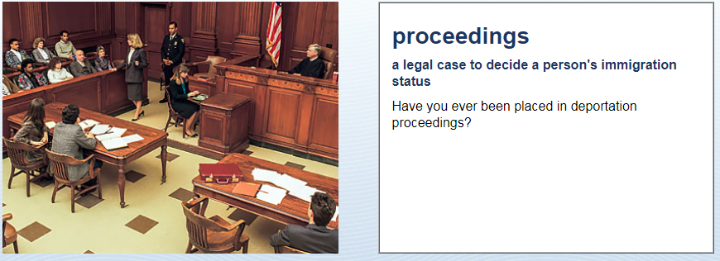
Immigration and Deportation
No, never

Slide 21
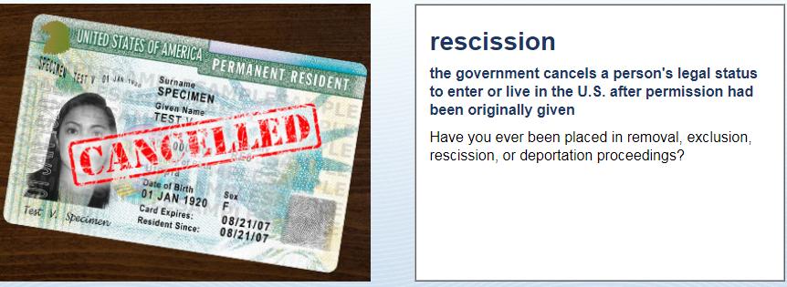
Immigration and Deportation
No, never

Slide 22
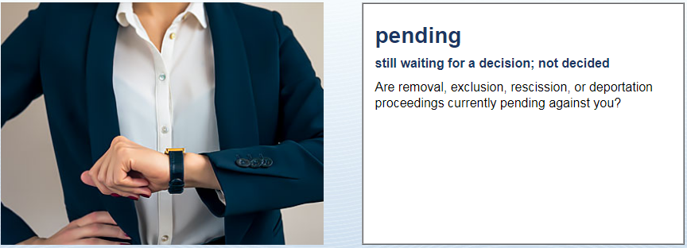
Immigration and Deportation
No, never

