Slide 1
USA Learns Citizenship
2.9 Illegal Activities

Slide 3
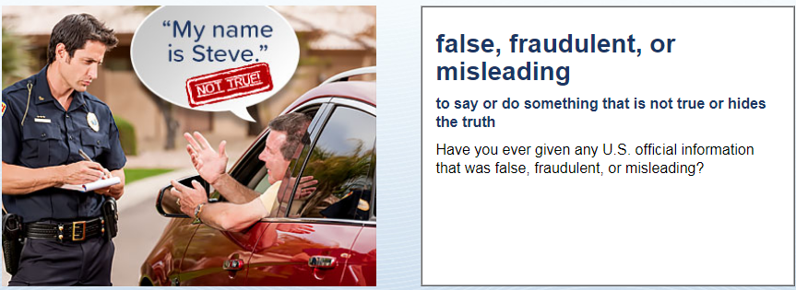
Immigration and Deportation
No, never

Slide 4
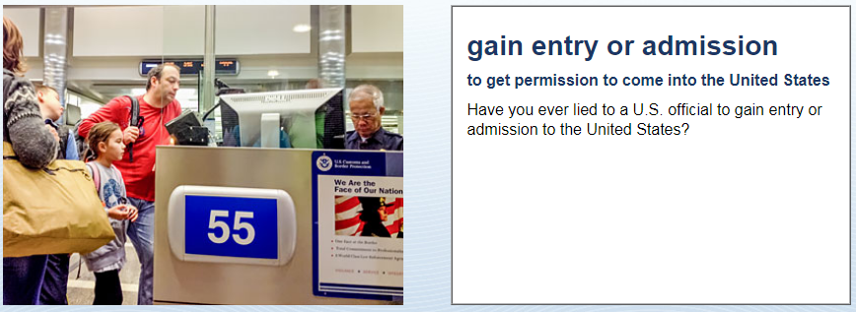
Immigration and Deportation
No, never

Slide 5
Immigration and Deportation
No, never
What does “deported” mean?
Sent back to my old country.

Slide 6
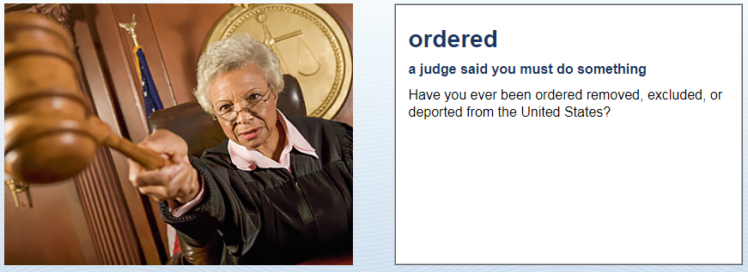
Immigration and Deportation
No, never

Slide 7
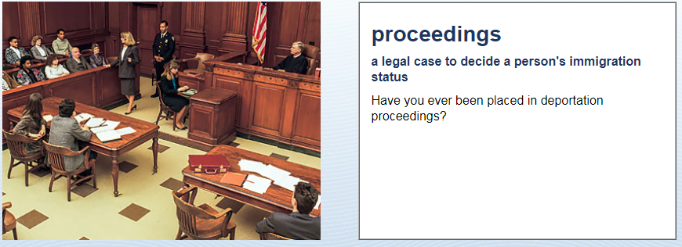
Immigration and Deportation
No, never

Slide 8
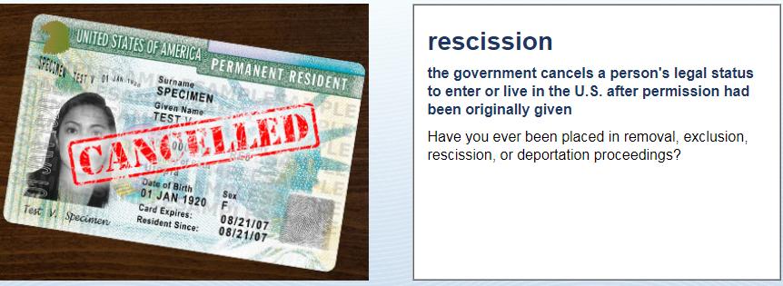
Immigration and Deportation
No, never

Slide 9
Immigration and Deportation
No, never

