Slide 1
Basic Citizenship Interview Quiz
Review

Slide 2
Green card

Slide 3
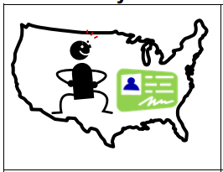
Legal permanent resident

Slide 4
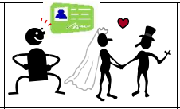
eligibility

Slide 5
Full name

Slide 6
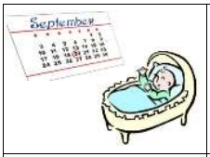
Date of birth

Slide 7
Date of residence

Slide 8
Country of birth

Slide 9
Country of nationality

Slide 10
disability

Slide 11
Phone number

Slide 12
Home address

Slide 13
Parent is a US citizen

Slide 14
work

Slide 15
school

Slide 16
travel outside the US

Slide 17
single

Slide 18
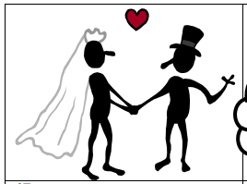
married

Slide 19
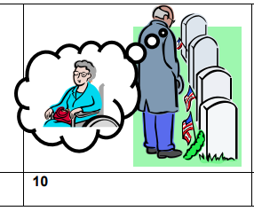
widowed

Slide 20
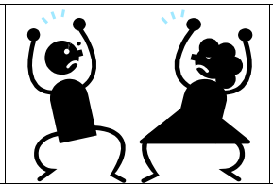
divorced

Slide 21
children

Slide 22
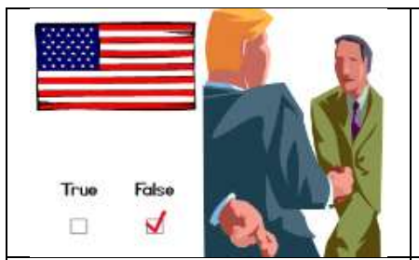
Claim to be a US citizen

Slide 23
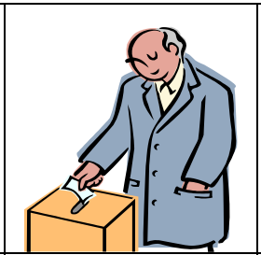
vote

Slide 24
nobility

Slide 25
Legally incompetent

Slide 26
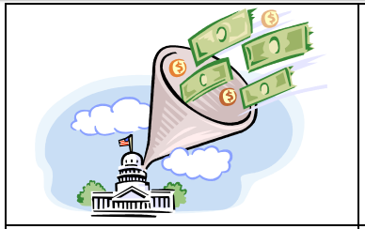
taxes

Slide 27
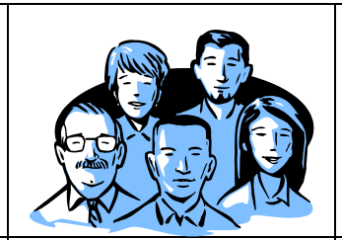
group

Slide 28
communist

Slide 29
terrorist

Slide 30
Hurt or kill

Slide 31
Military unit

Slide 32
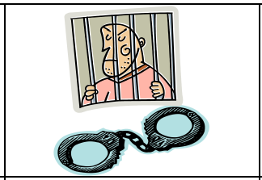
arrested

Slide 33
Habitual drunkard

Slide 34
illegal drugs

Slide 35
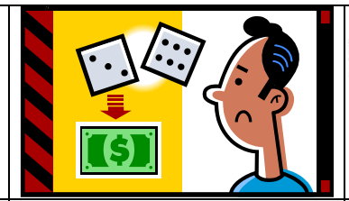
illegal gambling

Slide 36
Lie to get benefits

Slide 37
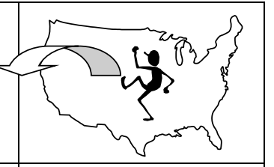
deported

Slide 38
Constitution

Slide 39
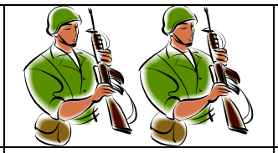
Bear arms

Slide 40
Non-combatant

