Slide 1
Naturalization Interview Beginning Quiz
Review

Slide 2
Name

Slide 3
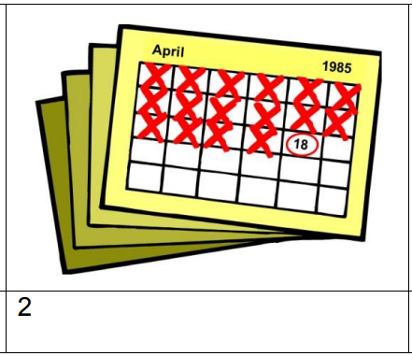
Date

Slide 4
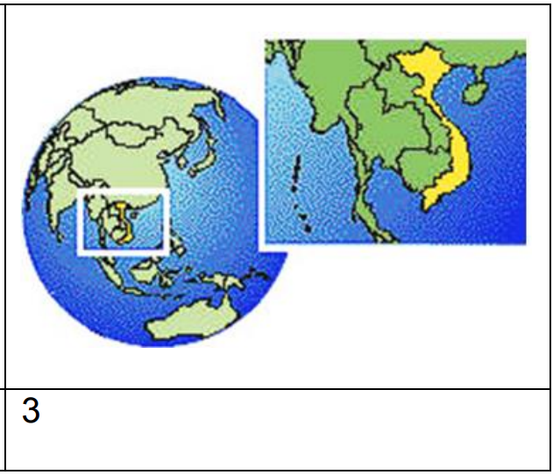
Country

Slide 5
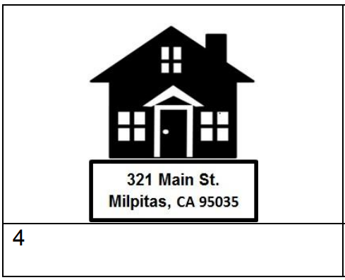
Address

Slide 6
Work

Slide 7
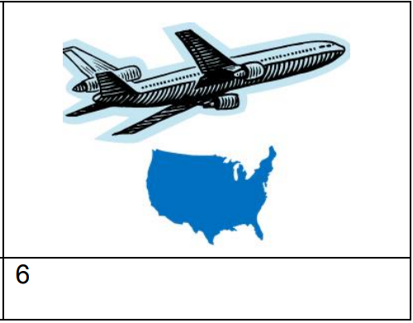
Travel

Slide 8
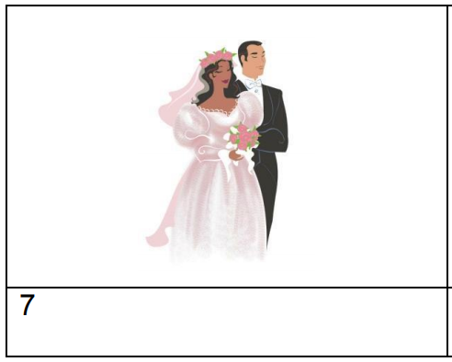
Married

Slide 9
Children

Slide 10
Crime

Slide 11
US Constitution

