Slide 1
Casual Citizenship Interview
Q & A

Slide 2
Explain how you are eligible to become a U.S. Citizen.
I have been a permanent resident for (>5) years

Slide 3
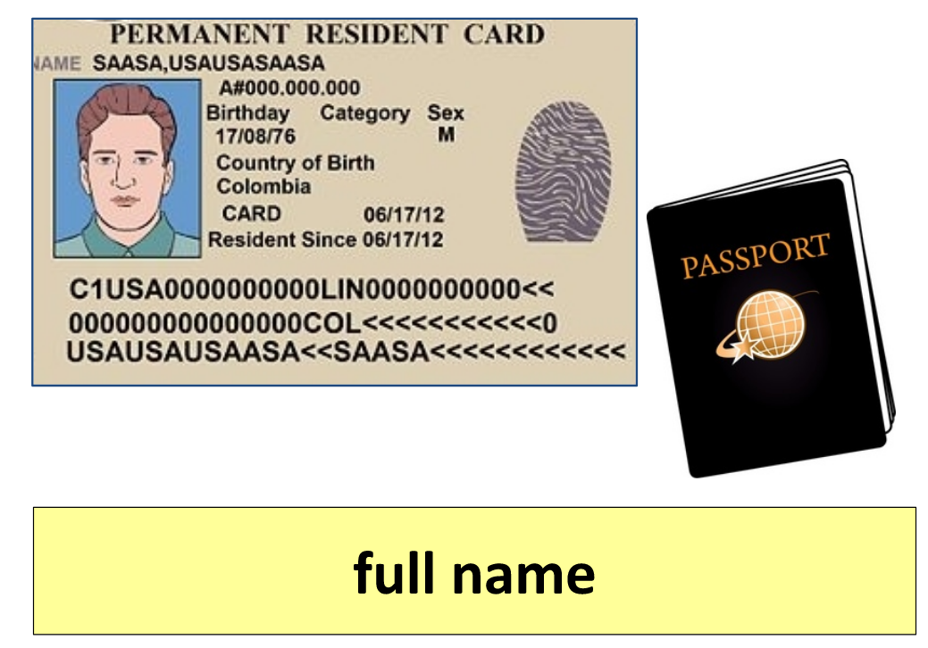
What is your full name?
My full name is (first, middle, last)

Slide 4
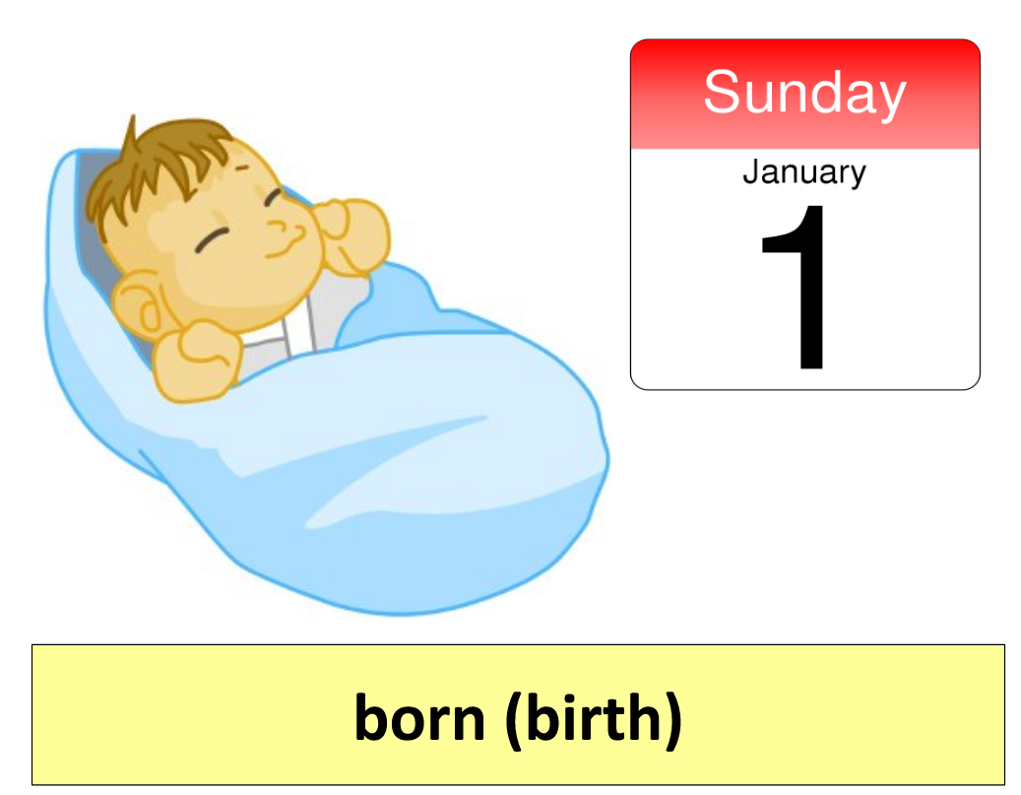
When were you born?
I was born on (month, day, year)

Slide 5
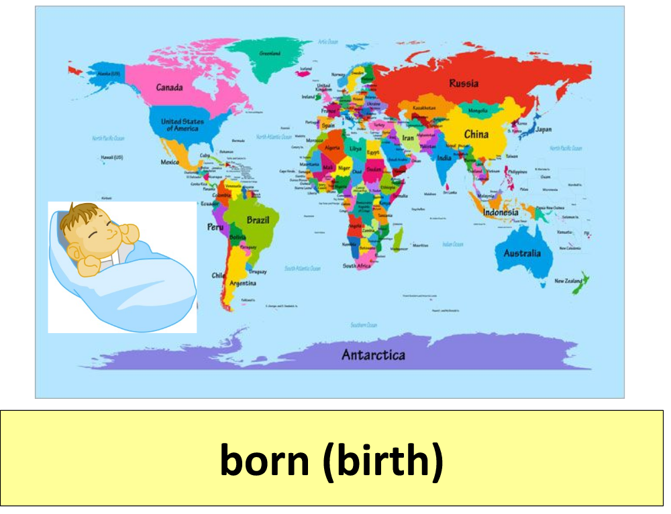
Where were you born?
I was born in (country)

Slide 6
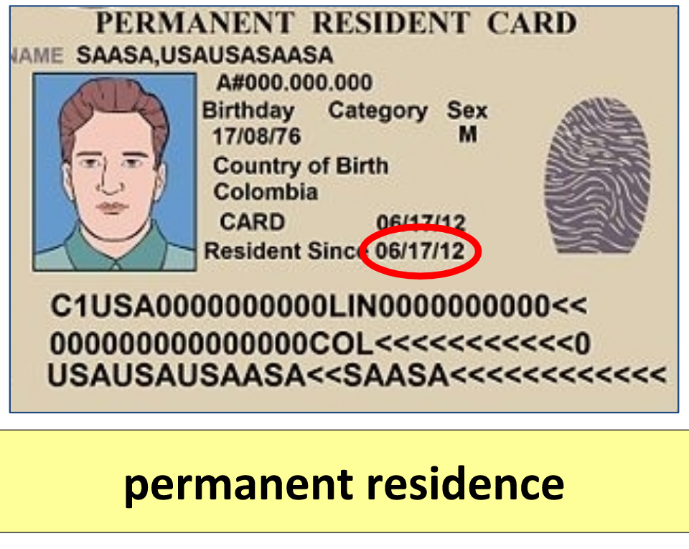
What is your date of permanent residence?
My date of permanent residence is (month, date, year)

Slide 7
What is your nationality?
My nationality is (country)

Slide 8
What is your home phone number?
My number is (408) XXX - XXXX

Slide 9
Where do you live?
I live in (city)

Slide 10
How do you make your living?
I work, I go to school, I look after my family, I am retired

Slide 11
Have you traveled outside the US in the last 5 years?
No / Yes, I left on (date) and returned on (date)

Slide 12
What is your marital status?
I am single / married / widowed / divorced

Slide 13
What is the name of your spouse? Is s/he a US citizen?
S/he is called (name). S/he is/not a US citizen.

Slide 14
When did you get married / divorced?.
I got married / divorced on (date)

Slide 15
Do you have any children? What are they called?.
I have no children / 2 children. They are called …

Slide 16
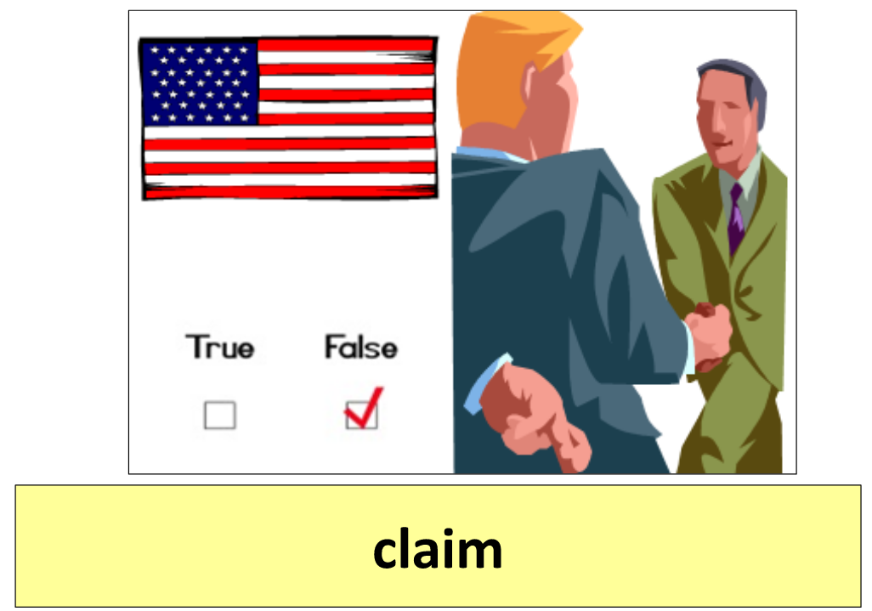
Have you ever claimed to be a US citizen?
No, never.

Slide 17
Have you ever failed to file your taxes?
No, I pay my taxes every year.

Slide 18
Have you ever been declared legally incompetent?
No, never

Slide 19
Do you belong to any groups or organizations?
No
Yes, I belong to a church

Slide 20
Have you ever been a member of the Communist party?
No, never

Slide 21
Have you ever been a terrorist?.
No, never

Slide 22
Have you ever sold or given weapons to another person?
No, never

Slide 23
Have you ever received any military training?
No, never

Slide 24
Have you ever been arrested or been in jail?
No, never

Slide 25
Have you ever committed a crime?
No, never

Slide 26
Have you ever sold or smuggled illegal drugs or narcotics?
No, never

Slide 27
Have you ever helped anyone enter the US illegally?
No, never

Slide 28
Have you ever been deported?
No, never

Slide 29
Did you register with the Selective Service?
Yes
No, I was older than 26 when I came to the US
No, I am female

Slide 30
Do you support the Constitution and form of government of the US?
Yes, I do!

Slide 31
Are you willing to take the full Oath of Allegiance to the US government?.
Yes I am – yes siree!!!!

Slide 32
If the law requires it, are you will to bear arms for the US armed forces?
Yes, I am

Slide 33
Are you will to perform non-combatant services for the US armed forces?
Yes, I am

Slide 34
Are you willing to help the government during a national emergency?
Yes, I am – too true!!!!

Slide 35
Do you promise that everything you have said is true?
Absolutely!!

Slide 36
Congratulations! You’re going to make a great US citizen!
Thank you very much!!!

