Slide 1
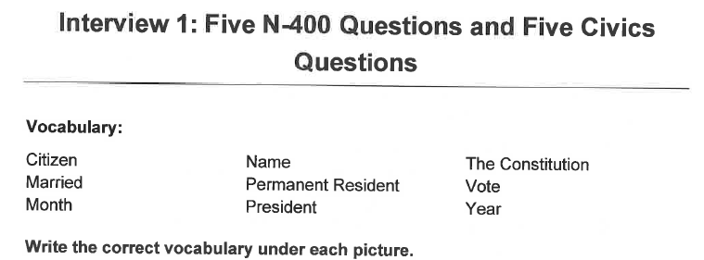
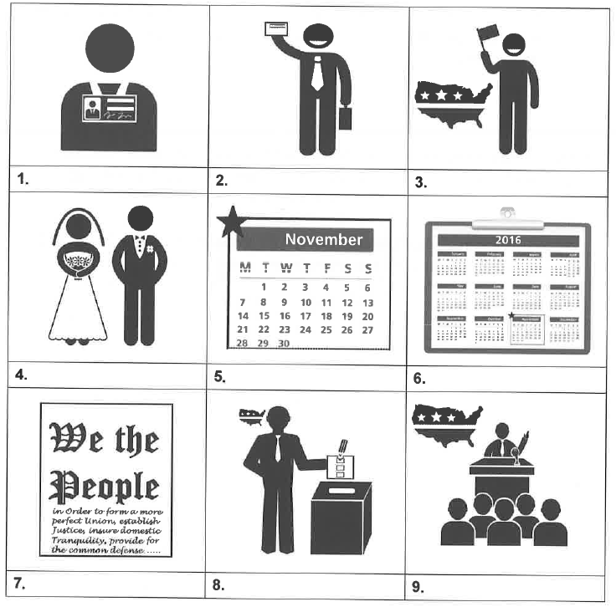
Permanent Resident
Name
Citizen
Married
Month
Year
The
Constitution
Vote
President

Slide 2
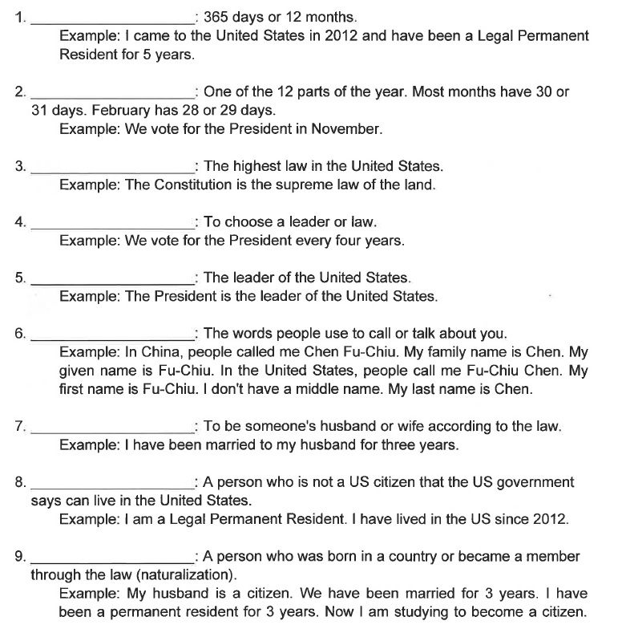
Year
Month
The Constitution
Vote
President
Name
Married
Permanent Resident
Citizen

