Slide 1
Citizenship Bootcamp Quiz 1
Vocabulary

Slide 2
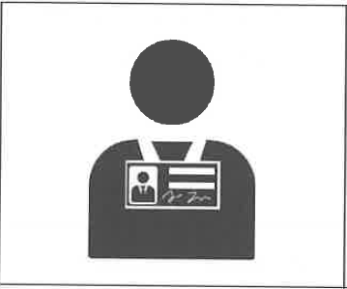
Permanent Resident
A person who is not a US citizen that the US government says can live in the United States.

Slide 3
Name
The words people use to call or talk about you.

Slide 4
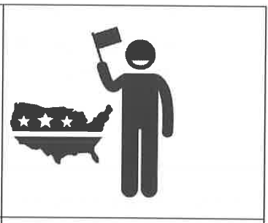
Citizen
A person who was born in a country or became a member through the law (naturalization).

Slide 5
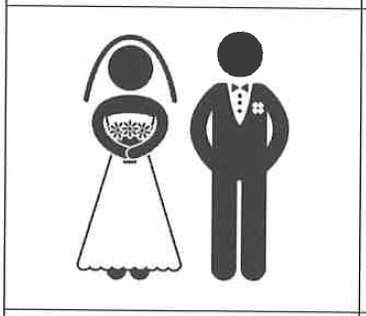
Married
To be someone's husband or wife according to the law.

Slide 6
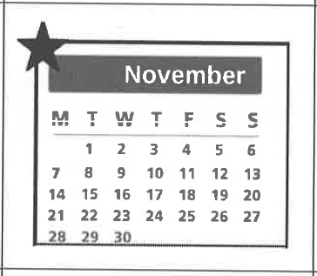
Month
One of the 12 parts of the year

Slide 7
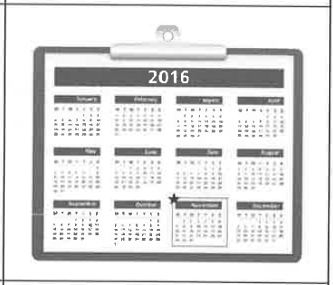
Year
365 days or 12 months.

Slide 8
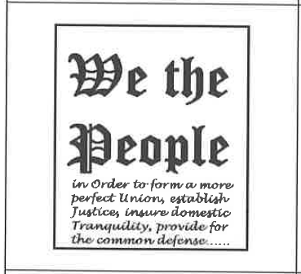
The Constitution
The highest law in the United States.

Slide 9
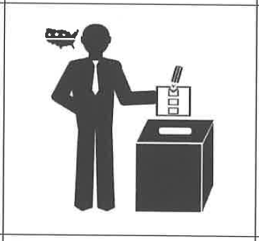
Vote
To choose a leader or law.

Slide 10
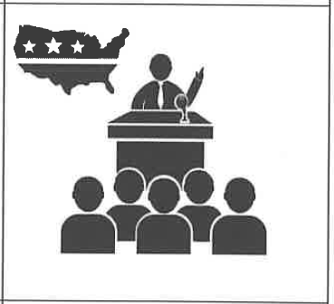
The President
The leader of the United States.

