Slide 1
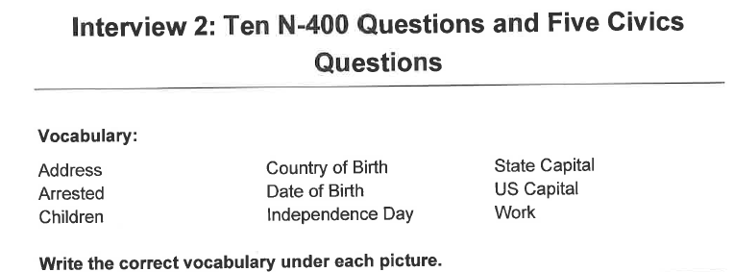
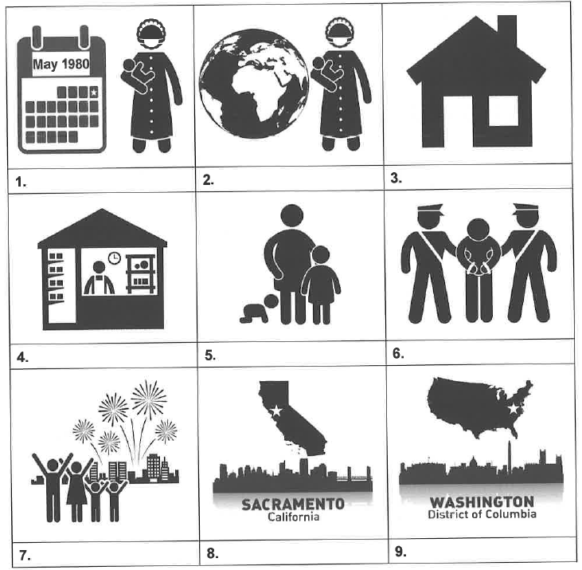
Country of
birth
Address
Date of birth
Work
Children
Arrested
Independence
Day
State Capital
US Capital

Slide 2
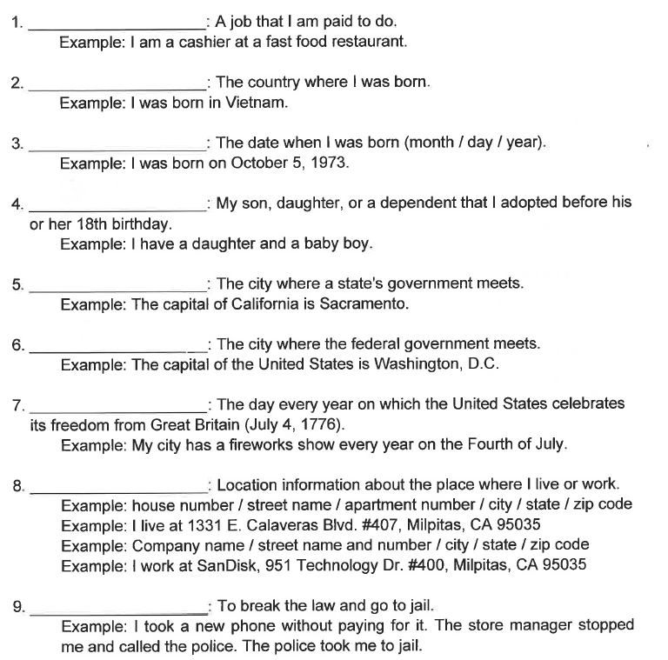
Work
Country of birth
Date of birth
Children
State Capital
US Capital
Independence Day
Address
Arrested

