Slide 1
Citizenship Bootcamp Quiz 2
Vocabulary

Slide 2
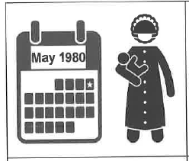
Date of birth
The date when I was born (month I day I year).

Slide 3
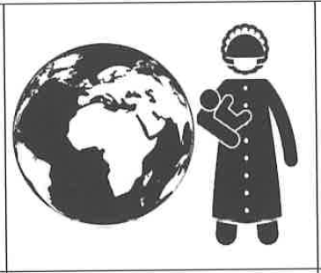
Country of birth
The country where I was born.

Slide 4
Address
Location information about the place where I live or work.

Slide 5
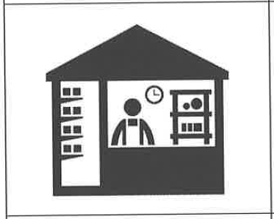
Work
A job that I am paid to do.

Slide 6
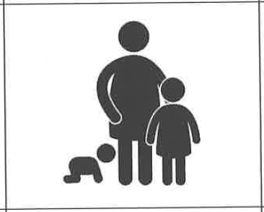
Children
My son, daughter, or a dependent that I adopted before his or her 18th birthday.

Slide 7
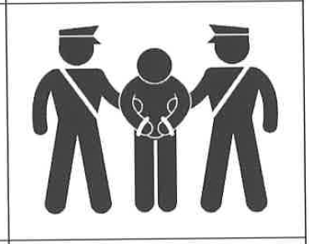
Arrested
To break the law and go to jail.

Slide 8
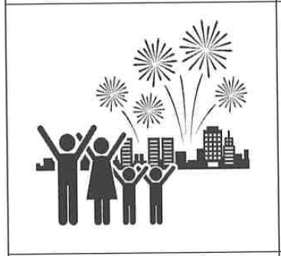
Independence Day
The day every year on which the United States celebrates its freedom from Great Britain (July 4, 1776).

Slide 9
State Capital
The city where a state's government meets.

Slide 10
US Capital
The city where the federal government meets.

