Slide 1
Citizenship Bootcamp Quiz 3
Vocabulary

Slide 2
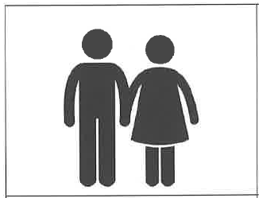
Marital status
Are you single, married, widowed, or divorced?

Slide 3
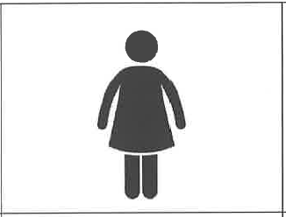
Single
A person who has never been married.

Slide 4
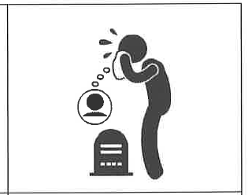
Widowed
The spouse who is still alive after the other spouse dies.

Slide 5
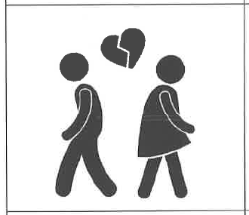
Divorced
To legally end a marriage.

Slide 6
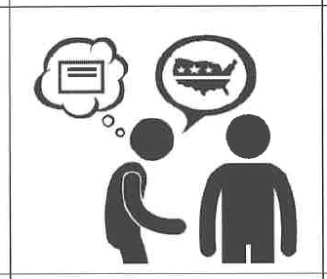
Claim
To lie or say something false that is not supported by facts.

Slide 7
Truth
To say something true that is supported by facts

Slide 8
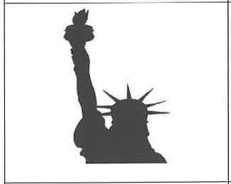
Statue of Liberty
An important symbol of freedom. It is on Liberty Island in New York Harbor.

Slide 9
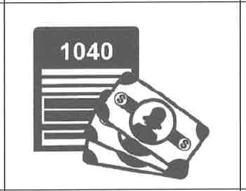
Taxes
Money to pay for the government, military, healthcare, schools, etc.

Slide 10
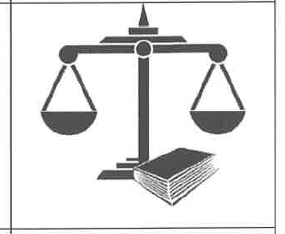
Law
The system of rules that the people must follow.

