Slide 1
Civics Corner
Part 02

Slide 2
Saturday Closures
October 12
November 30
December 21 & 28
January 4
February 22
April 11
May 23
Last class = May 30

Slide 3
First Interview Questions!
Why are you here today?
I’m here for my citizenship interview.
I want to become a US citizen
Why do you want to become a US citizen?
I want to be able to vote.
I want a US passport.
I want to live with my family.
There are good opportunities here.

Slide 4
First Interview Questions!
How are you eligible to become a US citizen?
I’m over 18 years old and I have been a permanent resident for (>5) years.
I’m over 18 years old and I have been a permanent resident for 3 years and I’m married to a US citizen.

Slide 5
First Interview Questions!
Please remain standing and raise your right hand. Repeat after me:
I promise to tell the truth, the whole truth and nothing but the truth, so help me God.
Do you understand what an oath is?
Yes, it is a promise to tell the truth
What did you just promise?
I promised to tell the truth.

Slide 6
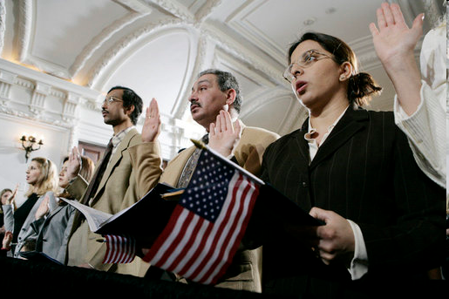
Review of Last Week’s Civics Qs
Q1 - 10

Slide 7
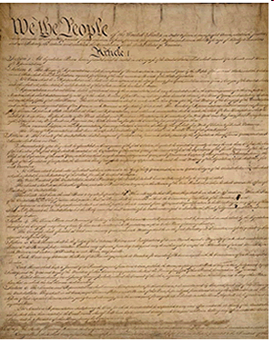
Question 1 What is the supreme law of the land?
the Constitution

Slide 8
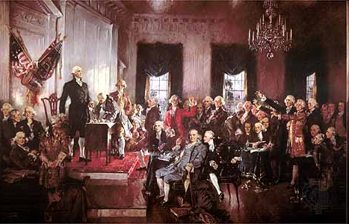
Question 2 What does the Constitution do?
sets up the government

Slide 9
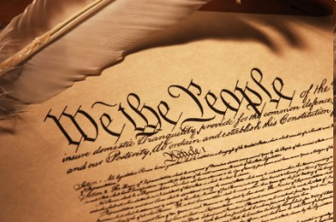
Question 3 The idea of self-government is in the first three words of the Constitution. What are these words?
We the People

Slide 10
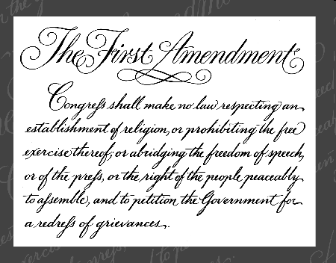
Question 4 What is an amendment?
a change to the Constitution
an addition to the Constitution

Slide 11
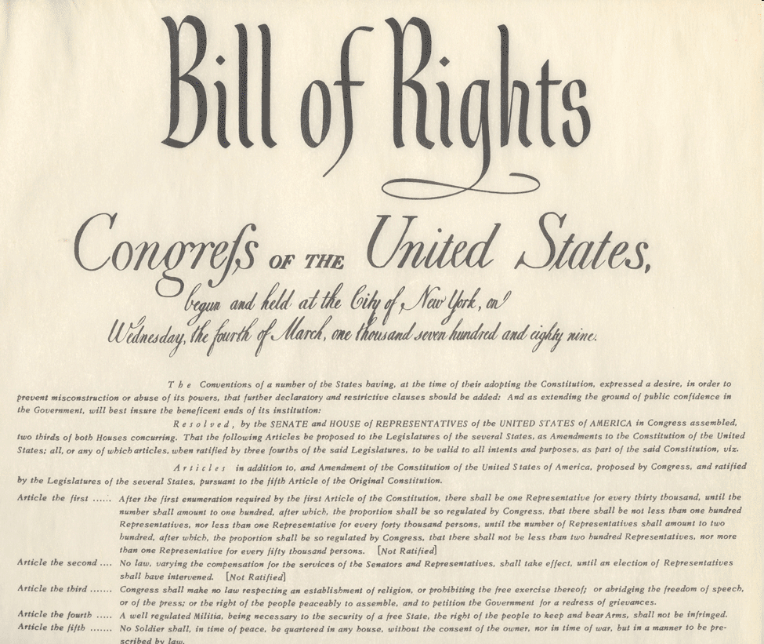
Question 5 What do we call the first ten amendments to the Constitution?
the Bill of Rights

Slide 12
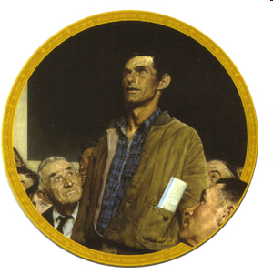
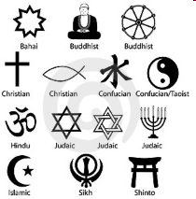
Question 6 What is one right or freedom from the First Amendment?
speech, religion, assembly, press, petition the government

Slide 13
Question 7 How many amendments does the Constitution have?
twenty-seven (27)

Slide 14
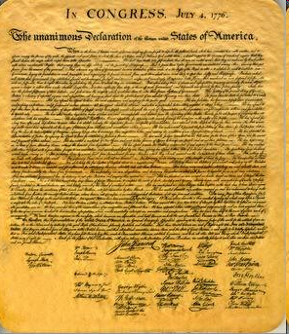
Question 8 What did the Declaration of Independence do?
announced our independence from Great Britain

Slide 15
Question 9 What are two rights in the Declaration of Independence?
life, liberty, pursuit of happiness

Slide 16
Question 10 What is freedom of religion?
You can practice any religion,
or not practice a religion.

Slide 17
Preparing for the Oath:
Government Basics

Slide 18
Reading and Writing Practice
Read the sentences out loud
Write down the sentences that I dictate.

Slide 19
Read the question.
1
When is Labor Day?
Listen and write the answer that your teacher dictates.
Labor Day is in September.

Slide 20
Read.
2
Who was the Father of Our Country?
Write.
Washington was the Father of Our Country.

Slide 21
Read.
3
Where does the President live?
Write.
The President lives in Washington, D.C.

Slide 22
Read.
4
What country is north of the U.S.?
Write.
Canada is north of the U.S.

Slide 23
Read.
5
What are the colors of the American flag?
Write.
The flag is red, white, and blue.

Slide 24
Dictation Review
Labor Day is in September.
Washington was the Father of Our Country.
The President lives in Washington, D.C.
Canada is north of the U.S.
The flag is red, white, and blue.
Notes:
Labor Day is in September.
Washington was the Father of Our Country.
The President lives in Washington, D.C.
Canada is north of the U.S.
The flag is red, white, and blue.

Slide 25
More Admin
On my desk:
Please fill in the Interview Date sheet.
Please email me your results after you’ve had your interview: amclin@cuhsd.org
Did everyone sign in???

Slide 26
Take a Break!! 10 minutes

