Slide 1
Civics Corner
Part 03

Slide 2
Saturday Closures
April 11
May 23
Last class = May 30

Slide 3
First Interview Questions!
Please remain standing and raise your right hand. Repeat after me:
I promise to tell the truth, the whole truth and nothing but the truth, so help me God.
Do you understand what an oath is?
Yes, it is a promise to tell the truth
What did you just promise?
I promised to tell the truth.

Slide 4
First Interview Questions!
Why are you here today?
I’m here for my citizenship interview.
I want to become a US citizen
Why do you want to become a US citizen?
I love America!
I want to vote.
I want a US passport.
I want to live with my family.

Slide 5
First Interview Questions!
How are you eligible to become a US citizen?
I have been a permanent resident for (>5) years.
OR
I have been a permanent resident for 3 years and I’m married to a US citizen.

Slide 6
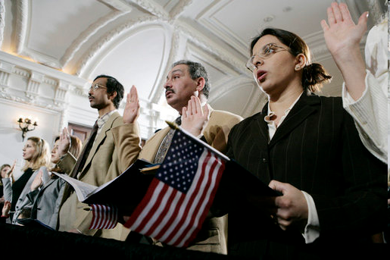
Review of Last Week’s Civics Qs
Q11 - 20

Slide 7
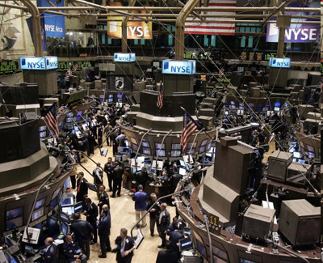
Question 11 What is the economic system in the United States?
capitalist economy
market economy

Slide 8
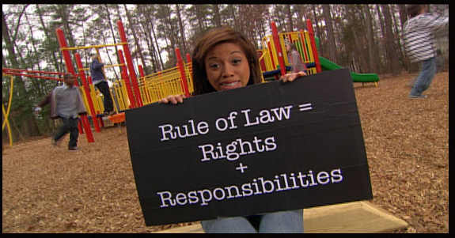
Question 12 What is the “rule of law”?
Everyone must follow the law. No one is above the law.

Slide 9
Question 14 What stops one branch of government from becoming too powerful?
checks and balances
separation of powers

Slide 10
Study the Chart
U.S. Capitol
White House
Supreme Court
Congress
President
Supreme Court
House of Representatives
Senate

Slide 11
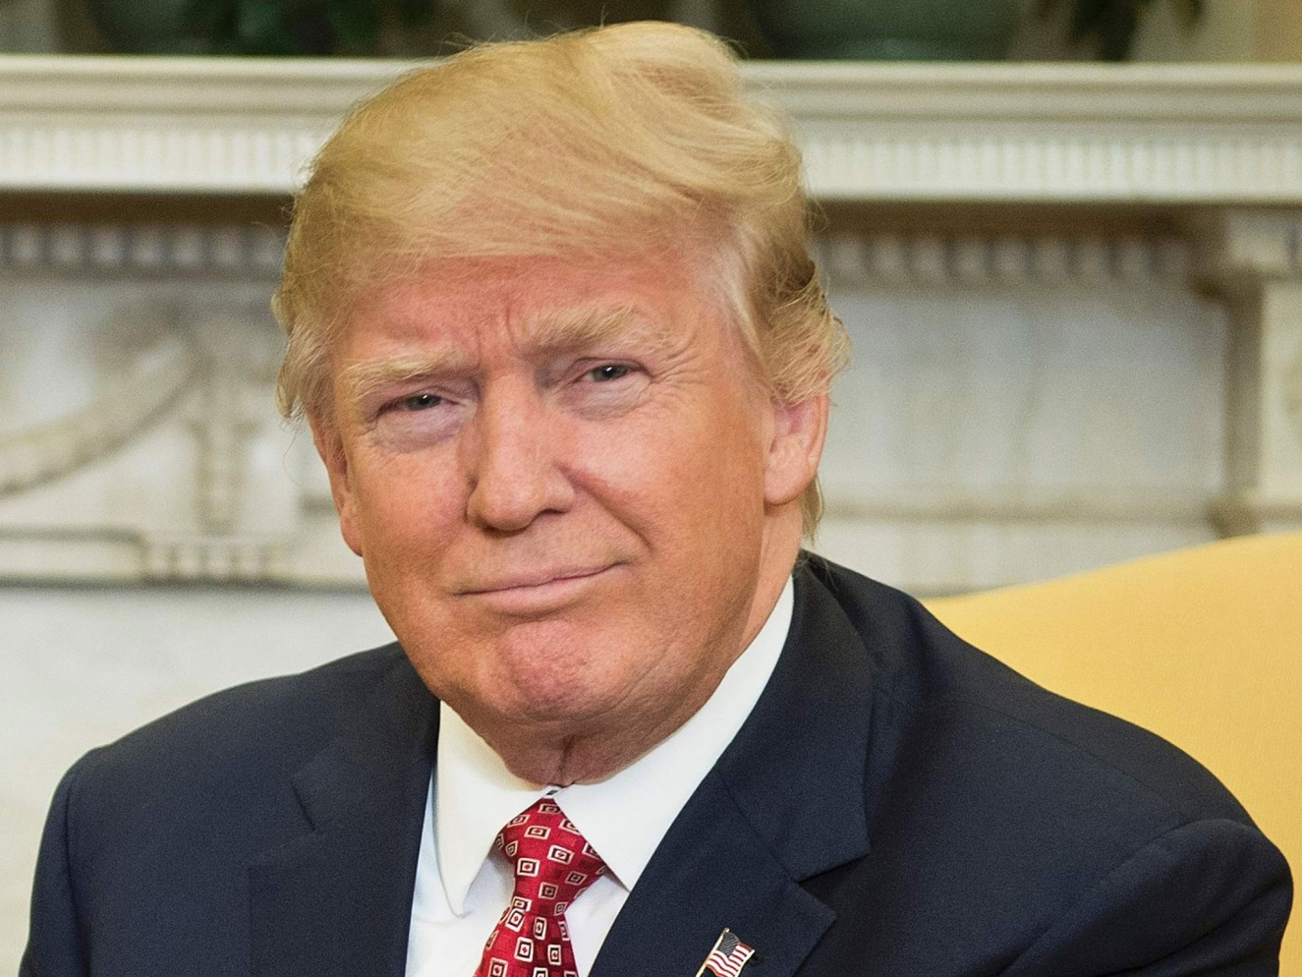
Question 15 Who is in charge of the executive branch?
the President

Slide 12
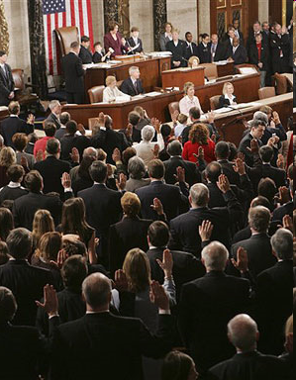
Question 16 Who makes federal laws?
Congress (Senate and House of Representatives)

Slide 13
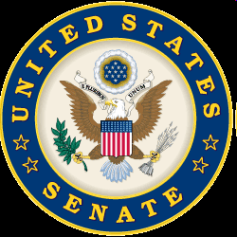
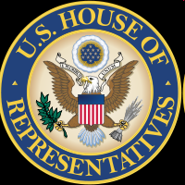
Question 17 What are two parts of the U.S. Congress?
the Senate
the House of Representatives

Slide 14
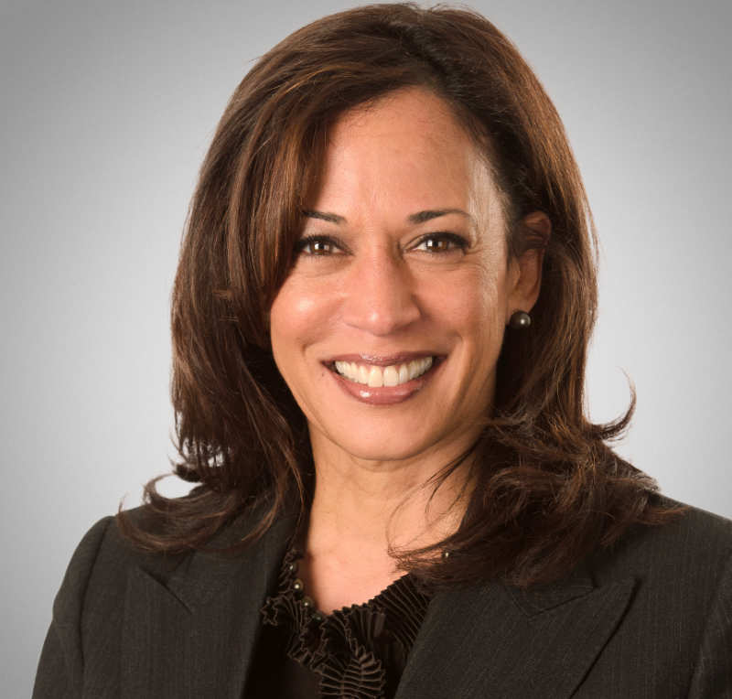
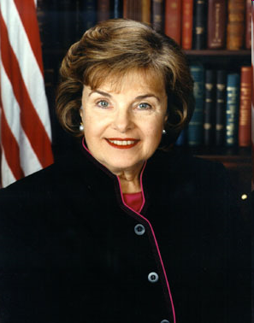
Question 18 How many U.S. Senators are there?
one hundred (100)

Slide 15
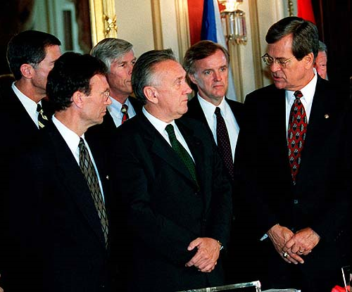
Question 19 We elect a U.S. Senator for how many years?
six (6)

Slide 16
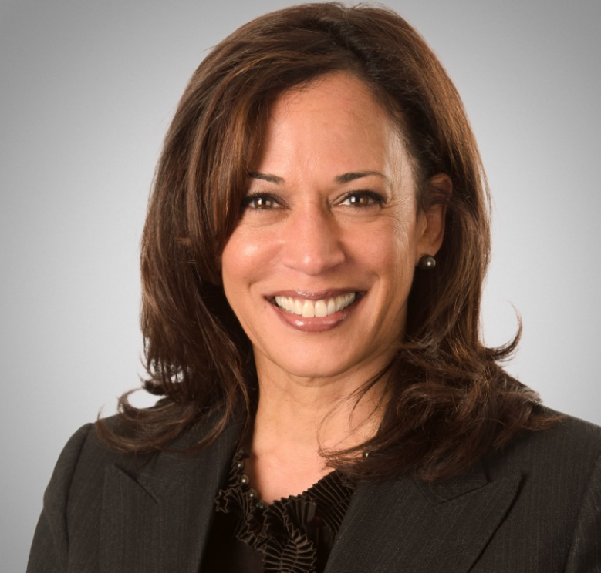
Question 20 Who is one of your state’s U.S. Senators?
Dianne Feinstein
Kamala Harris

Slide 17
Preparing for the Oath:
The Constitution

Slide 18
Dictation Practice
Read the sentences out loud.
Write down the sentences that I dictate.

Slide 19
Read.
6
When is Memorial Day?
Write.
Memorial Day is in May.

Slide 20
Read.
7
Who is on the dollar bill?
Write.
Washington is on the dollar bill.

Slide 21
Read.
8
What is the largest state?
Write.
Alaska is the largest state.

Slide 22
Read.
9
Who votes for Senators?
Write.
Citizens of the state vote for Senators.

Slide 23
Read.
10
What is one right in the Bill of Rights?
Write.
Freedom of speech is one right in the Bill of Rights.

Slide 24
Dictation Review
Memorial Day is in May.
Washington is on the dollar bill.
Alaska is the largest state.
Citizens of the state vote for Senators.
Freedom of speech is one right.
Notes:
Memorial Day is in May.
Washington is on the dollar bill.
Alaska is the largest state.
Citizens of the state vote for Senators.
Freedom of speech is one right.

Slide 25
More Admin
On my desk:
Let me know if you have your interview soon.
Please email me your results after you’ve had your interview: amclin@cuhsd.org
Did everyone sign in???

Slide 26
Take a Break!! 10 minutes

