Slide 1
Civics Corner
Part 04

Slide 2
Saturday Closures
April 11
May 23
Last class = May 30

Slide 3
First Interview Questions!
Please remain standing and raise your right hand. Repeat after me:
I promise to tell the truth, the whole truth and nothing but the truth, so help me God.
Do you understand what an oath is?
Yes, it is a promise to tell the truth
What did you just promise?
I promised to tell the truth.

Slide 4
First Interview Questions!
Why are you here today?
I’m here for my citizenship interview.
I want to become a US citizen
Why do you want to become a US citizen?
I love America!
I want to vote.
I want a US passport.
I want to live with my family.

Slide 5
First Interview Questions!
How are you eligible to become a US citizen?
I have been a permanent resident for (>5) years.
OR
I have been a permanent resident for 3 years and I’m married to a US citizen.

Slide 6
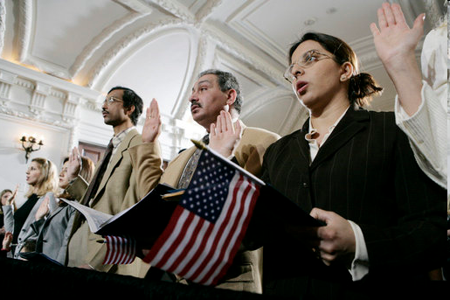
Review of Last Week’s Civics Qs
Q21 - 30

Slide 7
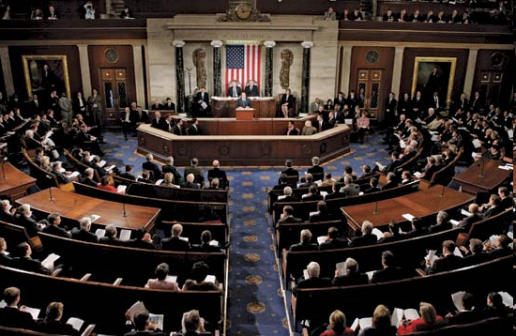
Question 21 The House of Representative has how many voting members?
four hundred thirty-five (435)

Slide 8
Question 22 We elect a U.S. Representative for how many years?
two (2)

Slide 9
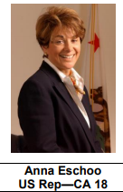
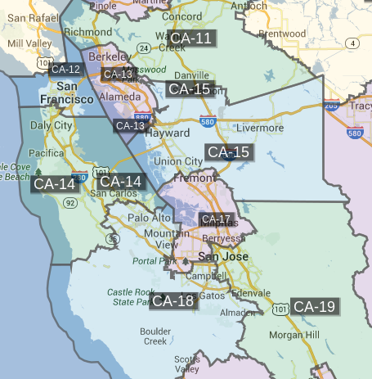
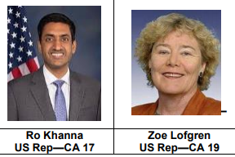
Question 23 Name your U.S. Representative

Slide 10
Question 23 Name your U.S. Representative
Anna Eschoo (18th District)

Slide 11
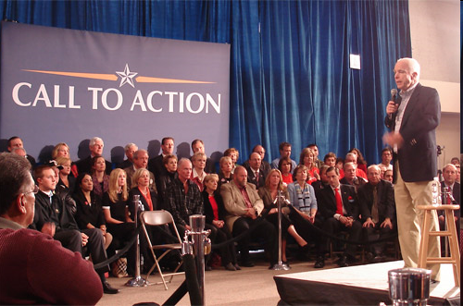
Question 24 Who does a senator represent?
all the people of the state

Slide 12
Question 25 Why do some states have more Representatives than other states?
because some states have more people

Slide 13
Question 26 We elect a President for how many years?
four (4)

Slide 14
Question 27 In what month do we vote for President?
November

Slide 15
Question 28 What is the name of the President of the United States now?
Donald Trump

Slide 16
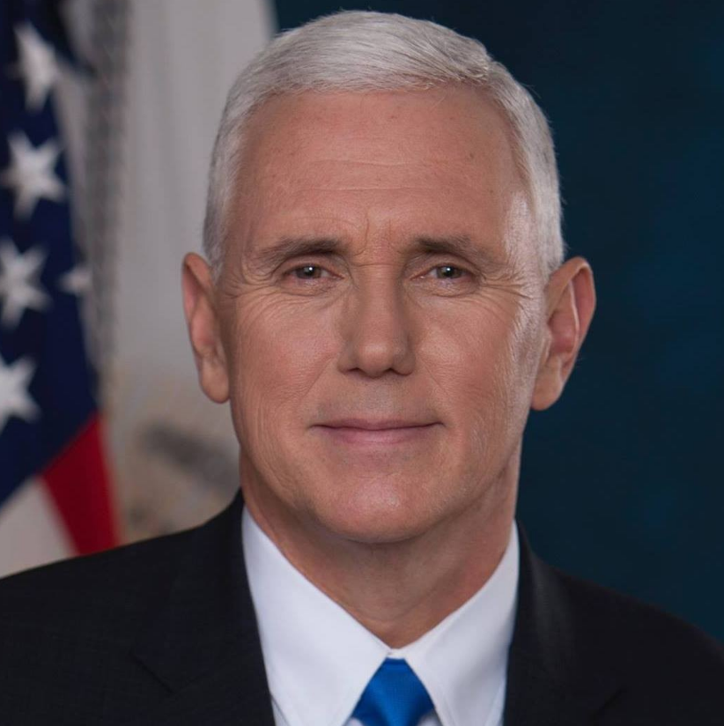
Question 29 What is the name of the Vice President now?
Mike Pence

Slide 17
Question 30 If the President can no longer serve, who becomes President?
the Vice President

Slide 18
Preparing for the Oath:
The Presidency

Slide 19
Dictation Practice
Write down the sentences that I dictate.

Slide 20
Reading & Writing Practice
by Don Fisher
Notes:
More powerpoints & printables at http://USCitizenshipTeachers.org Send correspondence to webmaster@USCitizenshipTeachers.org
Reading & Writing Practice Transcript
1. Read: When is Labor Day?
Write: Labor Day is in September.
2. R: Who was the Father of Our Country?
W: Washington was the Father of Our Country.
3. R: Where does the President live?
W: The President lives in Washington, D.C.
4. R: What country is north of the U.S.?
W: Canada is north of the U.S.
5. R: What are the colors of the American flag?
W: The flag is red, white, and blue.
6. R: When is Memorial Day?
W: Memorial Day is in May.
7. R: Who is on the dollar bill?
W: Washington is on the dollar bill.
8. R: What is the largest state?
W: Alaska is the largest state.
9. R: Who votes for Senators?
W: Citizens of the state vote for Senators.
10. R: What is one right in the Bill of Rights?
W: Freedom of speech is one right.
11. R: Who was the second President?
W: Adams was the second President.
12. R: What is the capital city of the U.S.?
W: Washington, D.C. is the capital.
13. R: What country is south of the U.S.?
W: Mexico is south of the United States.
14. R: When was Lincoln President?
W: Lincoln was President during the Civil War.
15. R: How many Senators are there?
W: There are 100 Senators.
16. R: Who lived in America first?
W: The American Indians lived here first.
17. R: When is Independence Day?
W: Independence Day is in July.
18. R: Who was the first President?
W: Washington was the first President.
19. R: Where does Congress meet?
W: Congress meets in Washington.
20. R: When is Columbus Day?
W: Columbus Day is in October.
21. R: How many states are there?
W: There are fifty states.
22. R: Who pays taxes?
W: Citizens pay taxes.
23. R: What city has many people?
W: New York City has many people.
24. R: Who elects Congress?
W: Citizens elect Congress.
25. R: When is Thanksgiving?
W: Thanksgiving is in November.
26. R: What state has the most people in Congress?
W: California has the most people in Congress.
27. R: Where is the White House?
W: The White House is in Washington, D.C.
28. R: Why do people come to the U.S.?
W: They want to be free.
29. R: When is Presidents’ Day?
W: Presidents’ Day is in February.
30: R: What was one of the first states?
W: Delaware was one of the first states.
31. R: Who lives in the White House?
W: The President lives in the White House.
Note: Minor spelling errors are allowed. Students may leave out some small words and still pass. Check the scoring explanation on the USCIS website http://www.uscis.gov/portal/site/uscis/citizenship.

Slide 21
Read.
11
Who was the second President?
Write.
Adams was the second President.

Slide 22
Read.
12
What is the capital city of the U.S.?
Write.
Washington, D.C. is the capital.

Slide 23
Read.
13
What country is south of the United States?
Write.
Mexico is south of the United States.

Slide 24
Read.
14
When was Lincoln President?
Write.
Lincoln was President during the Civil War.

Slide 25
Read.
15
How many Senators are there?
Write.
There are 100 Senators.

Slide 26
Dictation Review
Adams was the second President.
Washington, D.C. is the capital.
Mexico is south of the United States.
Lincoln was President during the Civil War.
There are 100 Senators.
Notes:
11. R: Who was the second President?
W: Adams was the second President.
12. R: What is the capital city of the U.S.?
W: Washington, D.C. is the capital.
13. R: What country is south of the U.S.?
W: Mexico is south of the United States.
14. R: When was Lincoln President?
W: Lincoln was President during the Civil War.
15. R: How many Senators are there?
W: There are 100 Senators.

Slide 27
More Admin
On my desk:
Please fill in the Interview Date sheet.
Please email me your results after you’ve had your interview: amclin@cuhsd.org
Did everyone sign in???

Slide 28
Take a Break!! 10 minutes

