Slide 1
Civics Corner
Part 06

Slide 2
Saturday Closures
November 30
December 21 & 28
January 4
February 22
April 11
May 23
Last class = May 30

Slide 3
First Interview Questions!
Why are you here today?
I want to become a US citizen
I’m here for my citizenship interview.
Why do you want to become a US citizen?
I love America!
I want to vote.
I want a US passport.
I want to live with my family.

Slide 4
First Interview Questions!
How are you eligible to become a US citizen?
I have been a permanent resident for (>5) years.
OR
I have been a permanent resident for 3 years and I’m married to a US citizen.

Slide 5
First Interview Questions!
Please remain standing and raise your right hand. Repeat after me:
I promise to tell the truth, the whole truth and nothing but the truth, so help me God.
Do you understand what an oath is?
Yes, it is a promise to tell the truth
What did you just promise?
I promised to tell the truth.

Slide 6
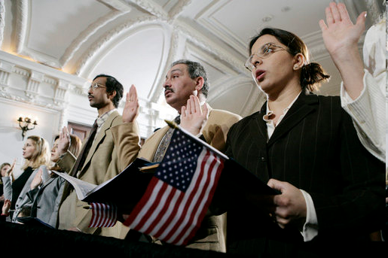
Review of Last Week’s Civics Qs
Q41 - 50

Slide 7
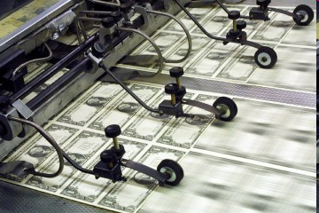
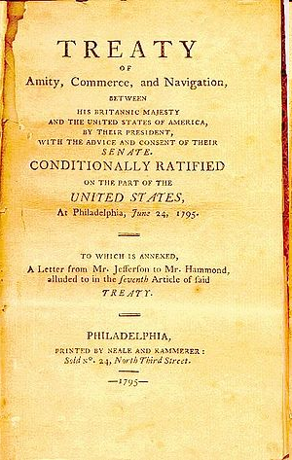
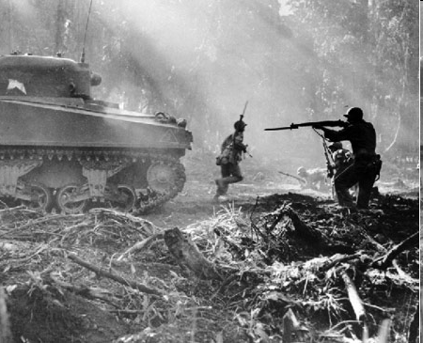
Question 41 Under our Constitution, some powers belong to the federal government. What is one power of the federal government?
to print money,
to declare war,
to create an army,
to make treaties

Slide 8
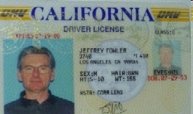
Question 42 Under our Constitution, some powers belong to the states. What is one power of the state?
provide schooling and education
provide protection (police)
provide safety (fire department)
give a driver's license
approve zoning and land use

Slide 9
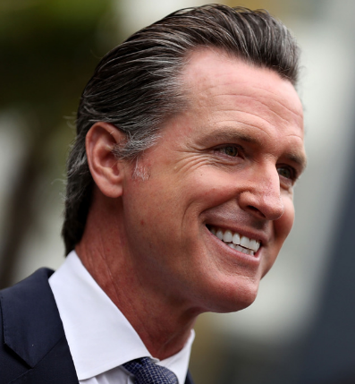
Question 43 Who is the Governor of your state?
Gavin Newsom

Slide 10
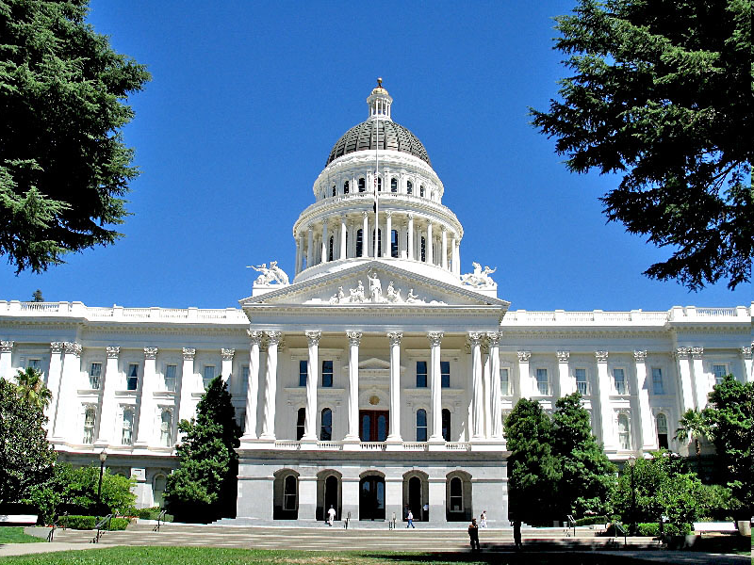
Question 44 What is the capital of your state?
Sacramento

Slide 11
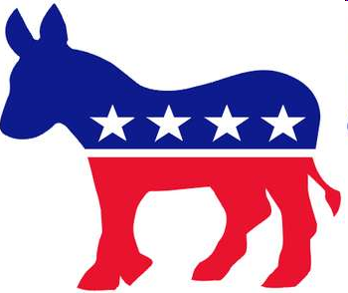
Question 45 What are the two major political parties in the United States?
Democratic and Republican

Slide 12
Question 46 What is the political party of the President now?
Republican Party

Slide 13
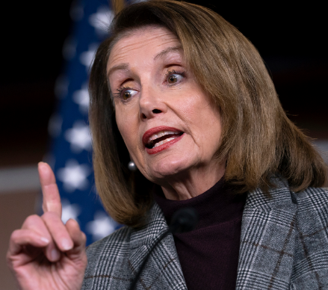
Question 47 What is the name of the Speaker of the House of Representatives now?
Nancy Pelosi

Slide 14
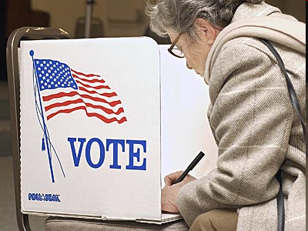
Question 48 There are four amendments to the Constitution about who can vote. Describe one of them.
Citizens 18 and older can vote.
You don’t have to pay to vote.
Any citizen can vote. (men and women)
A male citizen of any race can vote.

Slide 15
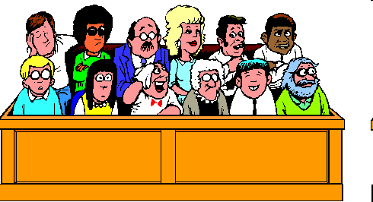
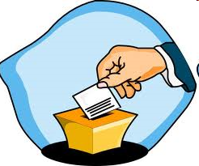
Question 49 What is one responsibility that is only for United States citizens?
serve on a jury
vote

Slide 16
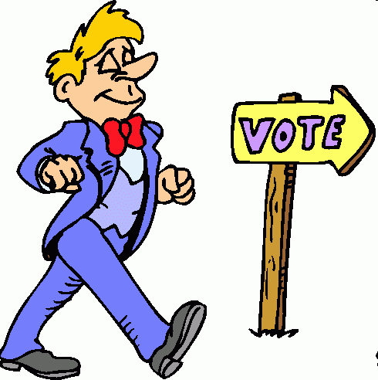
Question 50 Name one right only for United States citizens?
Vote in a federal election,
Run for office,

Slide 17
Preparing for the Oath:
Courts

Slide 18
Dictation Practice
Write down the sentences that I dictate.

Slide 19
Read.
21
How many states are there?
Write.
There are 50 states.

Slide 20
Read.
22
Who pays taxes?
Write.
Citizens pay taxes.

Slide 21
Read.
23
What city has many people?
Write.
New York City has many people.

Slide 22
Read.
24
Who elects Congress?
Write.
Citizens elect Congress.

Slide 23
Read.
25
When is Thanksgiving?
Write.
Thanksgiving is in November.

Slide 24
Dictation Review
There are fifty states.
Citizens pay taxes.
New York City has many people.
Citizens elect Congress.
Thanksgiving is in November.
Notes:
21. R: How many states are there?
W: There are fifty states.
22. R: Who pays taxes?
W: Citizens pay taxes.
23. R: What city has many people?
W: New York City has many people.
24. R: Who elects Congress?
W: Citizens elect Congress.
25. R: When is Thanksgiving?
W: Thanksgiving is in November.

Slide 25
Take a Break!! 10 minutes

Slide 26
More Admin
On my desk:
Please fill in the Interview Date sheet.
Please email me your results after you’ve had your interview: amclin@cuhsd.org
Did everyone sign in???
Does anyone have an interview date soon?

