Slide 1
Civics Corner
Part 08

Slide 2
Saturday Closures
April 11
May 23
Last class = May 30

Slide 3
Interview Small Talk
How are you?
I’m good, thank you. And you?
How’s the weather outside?
Oh, very nice. I love California weather.
How did you come here today?
I drove my car; my daughter drove me.
What’s the traffic like?
Not too bad – only 20 minutes to get here.

Slide 4
Interview Small Talk
Why did you come here today?
I want to become an American citizen
Why do you want to be a U. S. citizen?
I want to vote, have a US passport, live with my family
Have you studied for the citizenship test?
Yes, I take a citizenship course in Campbell
Do you have your permanent resident card?
Yes, here is my green card, my driver’s license and my passport.
How are you eligible to become a US citizen?
I have been a permanent resident for 5 years.

Slide 5
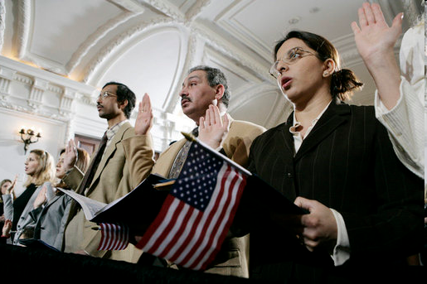
Review of Last Week’s Civics Qs
Q61 - 70

Slide 6
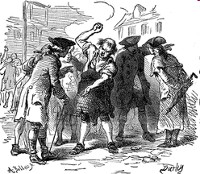
Question 61 Why did the colonists fight the British?
because of high taxes
because the British army stayed in their homes
because they didn’t have self-government

Slide 7
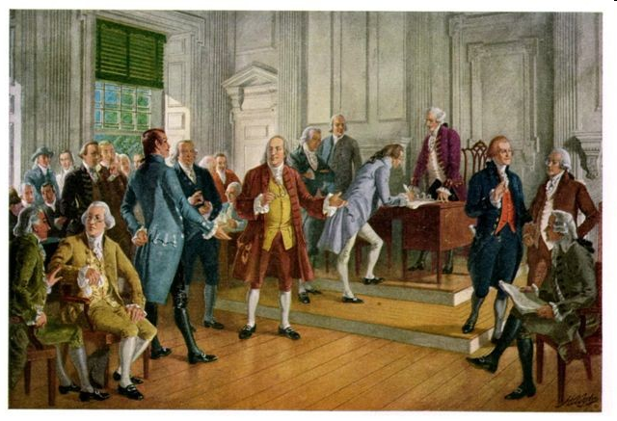
Question 62 Who wrote the Declaration of Independence?
Thomas Jefferson

Slide 8
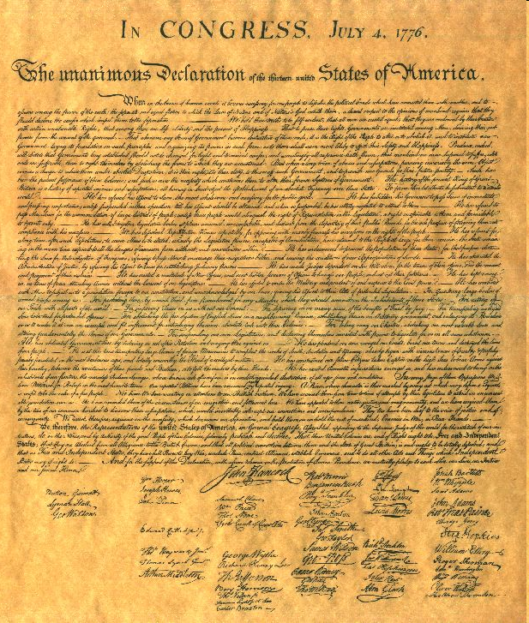
Question 63 When was the Declaration of Independence adopted?
July 4, 1776

Slide 9
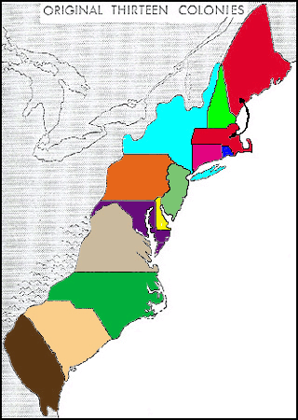
Question 64 There were 13 original states. Name three.
New Hampshire
New York
Massachusetts
Pennsylvania
Rhode Island
Connecticut
Maryland
New Jersey
Virginia
Delaware
North Carolina
Georgia
South Carolina

Slide 10
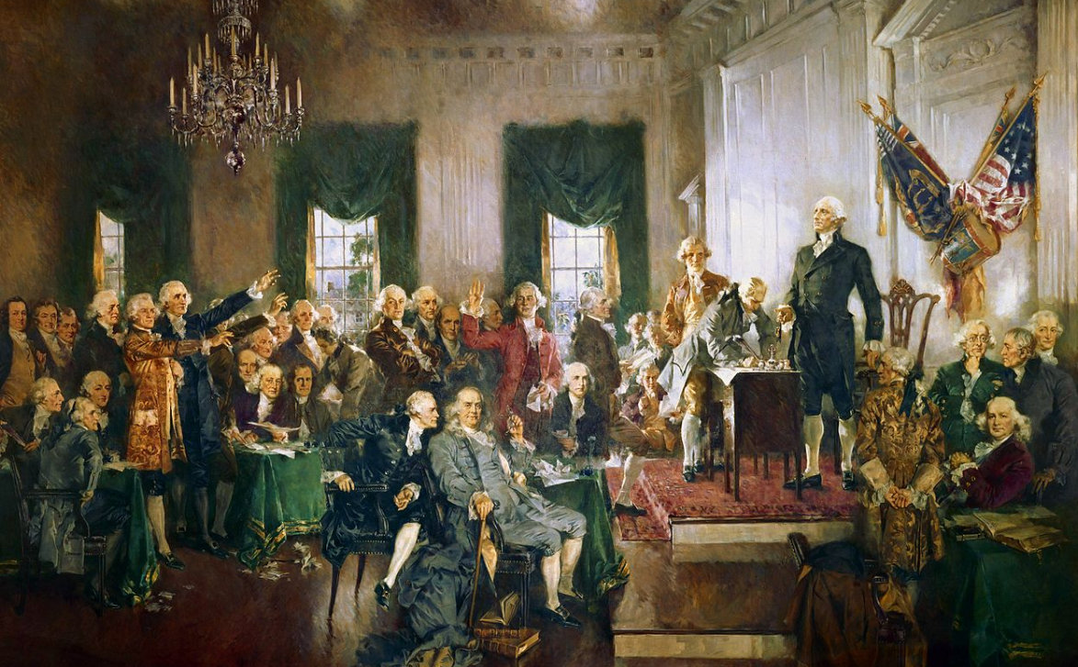
Question 65 What happened at the Constitutional Convention?
The Founding Fathers wrote the Constitution.

Slide 11
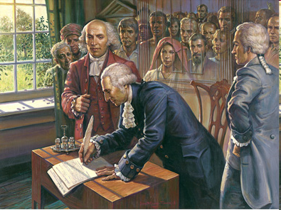
Question 66 When was the Constitution written?
1787

Slide 12
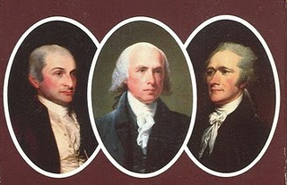
Question 67 The Federalist Papers supported the passage of the U.S. Constitution. Name one of the writers.
James Madison
Alexander Hamilton
John Jay
Publius

Slide 13
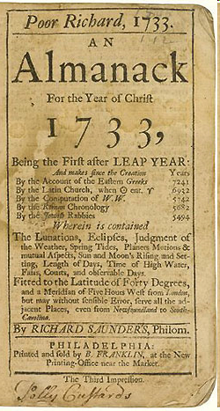
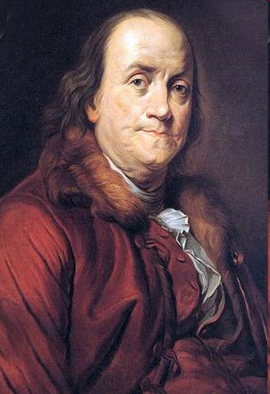
Question 68 What is one thing Benjamin Franklin is famous for?
U.S. diplomat
writer of “Poor Richard’s Almanac”
oldest member of the Constitutional Convention
started the first free libraries
first Postmaster General of the United States

Slide 14
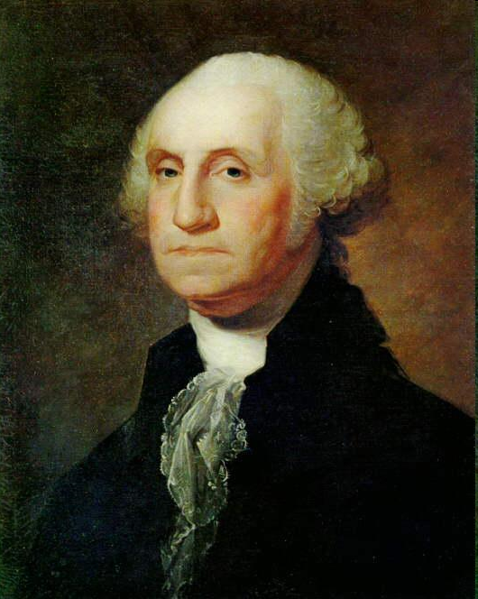
Question 69 Who is the “Father of Our Country?”
George Washington

Slide 15
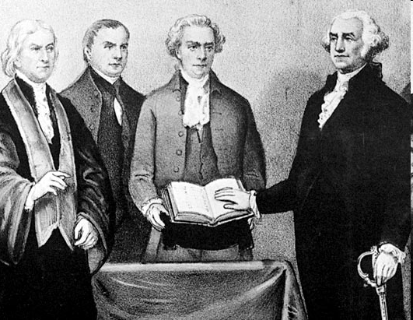
Question 70 Who was the first President?
George Washington

Slide 16
Dictation Practice – Unit 8
Write down the sentences that I dictate.

Slide 17
Read.
31
Who lives in the White House?
Write.
The President lives in the White House.

Slide 18
Read the question.
32
What country is north of Mexico?
Listen and write the answer that your teacher dictates.
The U.S. is north of Mexico.

Slide 19
Read.
33
What is the name of the war between the north and the south?
Write.
The war between the north and the south was the Civil War.

Slide 20
Read.
34
Why is Washington called the Father of Our Country?
Write.
Washington was the first President.

Slide 21
Read.
35
Who elects the Senate?
Write.
The citizens elect the Senate.

Slide 22
Dictation Review
The President lives in the White House.
The US is north of Mexico.
The war between the north and the South was the Civil War.
Washington was the first President.
The citizens elect the Senate.
Notes:
Who lives in the White House?
The President lives in the White House.
What country is north of Mexico?
The US is north of Mexico.
What is the name of the war between the North and the South?
The war between the north and the South was the Civil War.
Why is Washington called the Father of Our Country?
Washington was the first President.
Who elects the Senate?
The citizens elect the Senate.

