Slide 1
Civics Corner
Part 09

Slide 2
Saturday Closures
November 30
December 21 & 28
January 4
February 22
April 11
May 23
Last class = May 30

Slide 3
Interview Waivers
50s
Waiver 1 (50/20):
+ 50 years old
+ 20 years Green Card
Waiver 2 (55/15):
+ 55 years old
+ 15 years Green Card
No English test; Civics test in your own language.
60s
Waiver 3 (65/20):
+ 65 years old
+ 20 years Green Card
No English test; mini civics test in your own language.

Slide 4
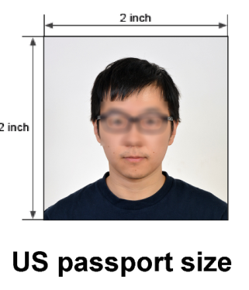
Take with you to your interview
Appointment notice
Permanent Resident card
Passports (even if expired)
Driver’s License
2 passport photos
Selective Service registration
Marriage, divorce & death certificates
Certificate for name change
Divorce certificate for spouse’s previous marriage
Paperwork from criminal cases

Slide 5
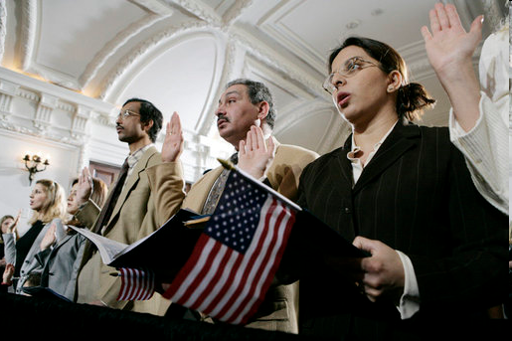
Review of Last Week’s Civics Qs
Q71 - 80

Slide 6
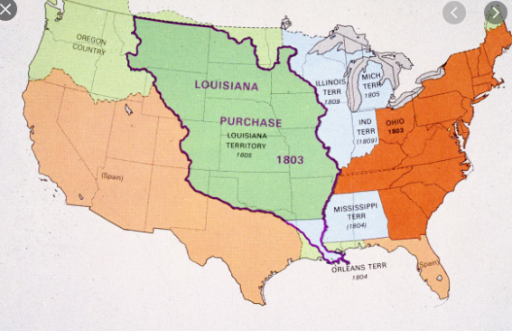
Question 71 What territory did the United States buy from France in 1803?
the Louisiana Territory

Slide 7
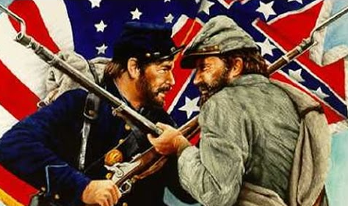
Question 72 Name one war fought by the United States in the 1800’s.
War of 1812
Mexican-American War
Civil War
Spanish-American War

Slide 8
Question 73 Name the U.S. war between the North and the South.
the Civil War

Slide 9
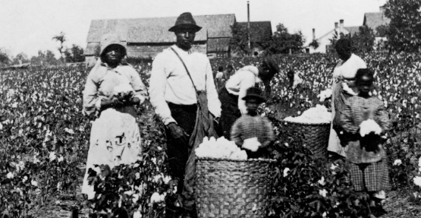
Question 74 Name one problem that led to the Civil War.
slavery
economic reasons
states’ rights

Slide 10
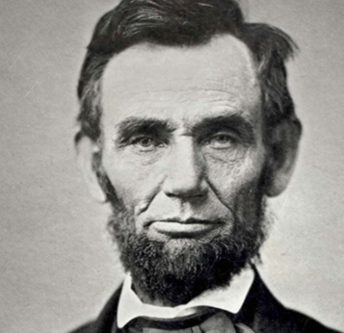
Question 75 What was one important thing that Abraham Lincoln did?
freed the slaves
saved the Union
led the United States during the Civil War

Slide 11
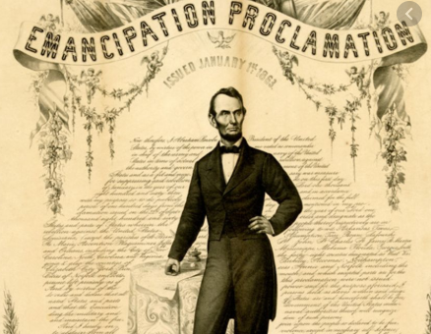
Question 76 What did the Emancipation Proclamation do?
freed the
slaves

Slide 12
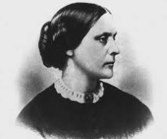
Question 77 What did Susan B. Anthony do?
fought for women’s rights
fought for civil rights

Slide 13
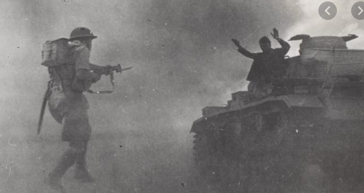
Question 78 Name one war fought by the United States during the 1900’s.
World War 1
World War 2
Korean War
Vietnam War
(Persian) Gulf War

Slide 14
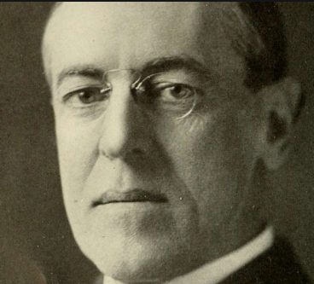
Question 79 Who was President during World War I?
Woodrow
Wilson

Slide 15
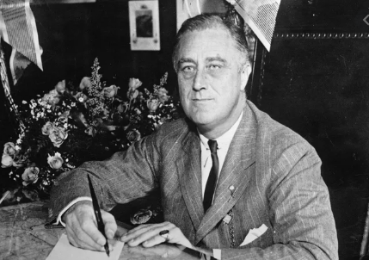
Question 80 Who was President during the Great Depression and World War II?
Franklin Roosevelt

Slide 16
Preparing for the Oath:
Symbols & Holidays

Slide 17
Dictation Practice Q36-40
Write down the sentences that I dictate.

Slide 18
Read.
36
Who has the right to vote?
Write.
Citizens who are 18 and older have the right to vote.

Slide 19
Read.
37
What does Congress do?
Write.
Congress makes laws.

Slide 20
Read.
38
Where does Congress meet?
Write.
Congress meets in the US Capitol Building.

Slide 21
Read.
39
What was the first state?
Write.
Delaware was the first state.

Slide 22
Read.
40
Name one right of everyone living in the United States.
Write.
Everyone living in the United States has freedom of speech.

Slide 23
Dictation Review
Citizens who are 18 and older have the right to vote.
Congress makes laws.
Congress meets in the US Capitol Building.
Delaware was the first state.
Everyone living in the United States has freedom of speech.
Notes:
Citizens who are 18 and older have the right to vote.
Congress makes laws.
Congress meets in the US Capitol Building.
Delaware was the first state.
Everyone living in the United States has freedom of speech.

Slide 24
More Admin
On my desk:
Did everyone sign in???
Does anyone have an interview date soon?
Please fill in the Interview Date sheet.
Please email me your results after you’ve had your interview: amclin@cuhsd.org

Slide 25
Take a Break!! 10 minutes

