Slide 1
Civics Corner
Part 10

Slide 2
Saturday Closures
December 21 & 28
January 4
February 8 & 22
April 4 & 11
May 23
Last class = May 30

Slide 3
New Class Semester 2
January 25: Final class of semester 1.
February 1: Start of semester 2 (for new students only)
February 8: No class
Feb 15: Semester 2 for returning students.

Slide 4
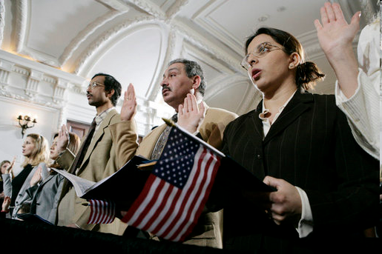
Review of Last Week’s Civics Qs
Q81 – 90

Slide 5
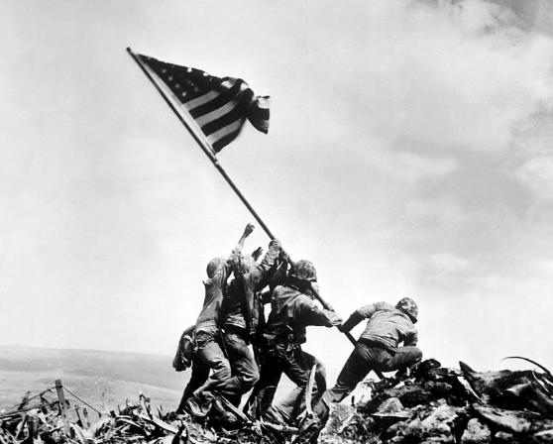
Question 81 Who did the United States fight in World War 2?
Japan, Germany & Italy

Slide 6
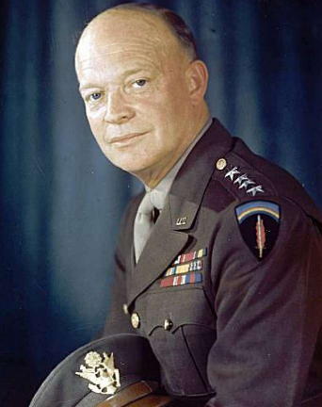
Question 82 Before he was President, Eisenhower was a general. What war was he in?
World War 2

Slide 7
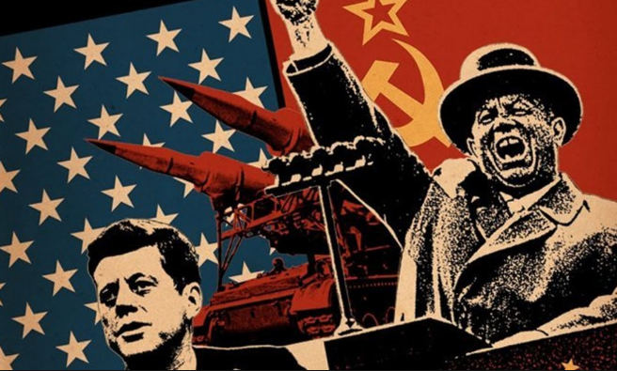
Question 83 During the Cold War, what was the main concern of the US?
Communism

Slide 8
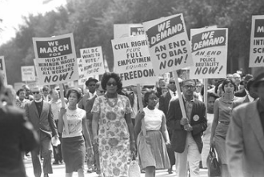
Question 84 What movement tried to end racial discrimination?
The Civil Rights Movement

Slide 9
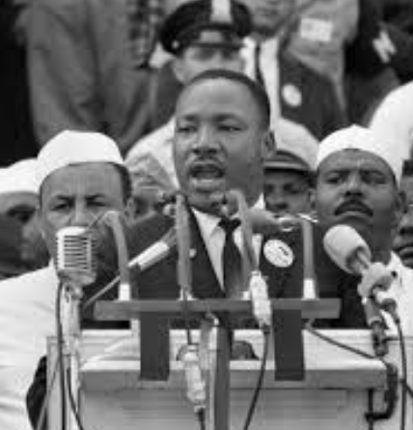
Question 85 What did Martin Luther King Jr do?
Fought for Civil Rights.

Slide 10
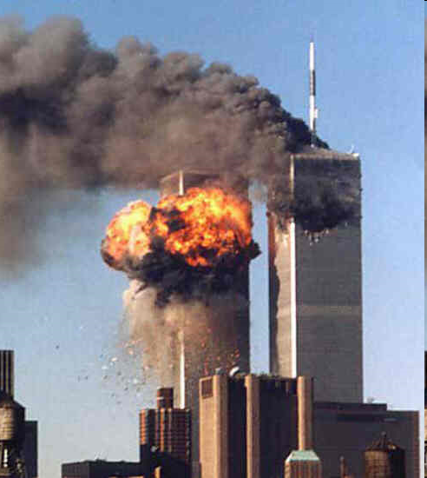
Question 86 What major event happened on September 11, 2001 in the United States?
Terrorists attacked the United States.

Slide 11
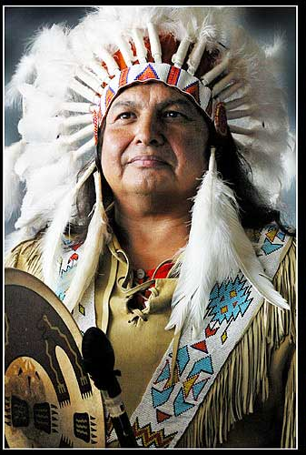
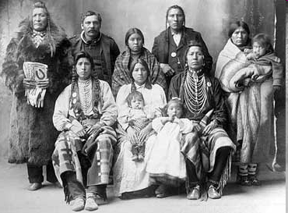
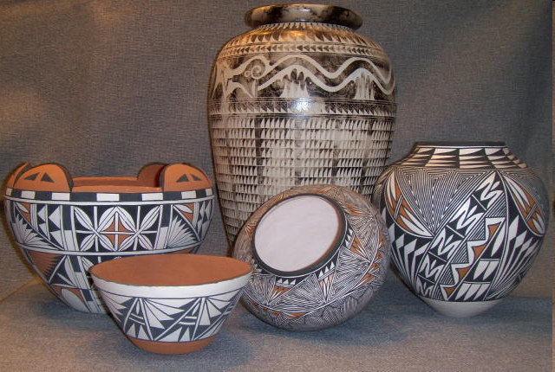
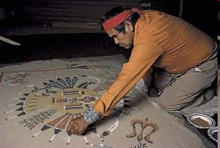
Question 87 Name one American Indian tribe in the United States.
Blackfeet
Creek
Cherokee
Pueblo
Apache
Navajo
more

Slide 12
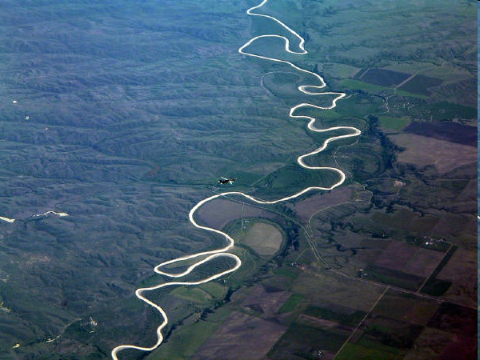
Question 88 Name one of the two longest rivers in the United States.
Mississippi River
Missouri River

Slide 13
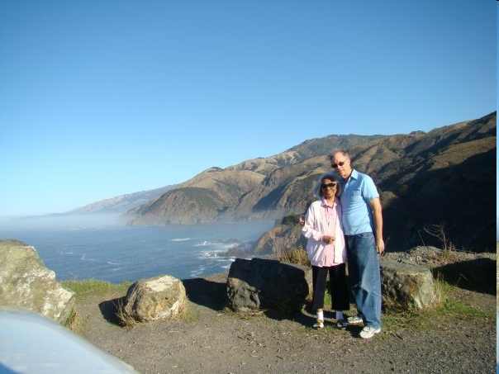
Question 89 What ocean is on the West Coast of the United States?
Pacific Ocean

Slide 14
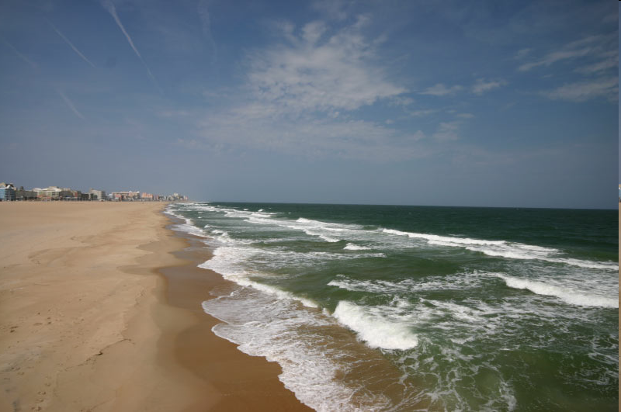
Question 90 What ocean is on the East coast of the United States?
Atlantic Ocean

Slide 15
Preparing for the Oath:
Voting

Slide 16
Reading & Writing Practice
Write down the sentences that I dictate.

Slide 17
Read.
41
What is one right that is only for US citizens?
Write.
One right that is only for US citizens is to vote in a federal election.

Slide 18
Read.
42
What is one right in the Bill of Rights?
Write.
Freedom of speech is one right in the Bill of Rights.

Slide 19
Read.
43
What President is on the five-dollar bill?
Write.
President Lincoln is on the five-dollar bill.

Slide 20
Read.
44
What was the first US capital?
Write.
New York City was the first capital.

Slide 21
Read.
45
What President is on the one-dollar bill?
Write.
President Washington is on the one-dollar bill.

Slide 22
Dictation Review
One right that is only for US citizens is to vote in a federal election.
Freedom of speech is one right in the Bill of Rights.
President Lincoln is on the five-dollar bill.
New York City was the first capital.
President Washington is on the one-dollar bill.

Slide 23
More Admin
On my desk:
Did everyone sign in???
Does anyone have an interview date soon?
Please fill in the Interview Date sheet.
Please email me your results after you’ve had your interview: amclin@cuhsd.org

Slide 24
Take a Break!! 10 minutes

