Slide 1
Civics Corner
Part 14

Slide 2
Saturday Closures
February 8 & 22
April 4 & 11
May 23
Last class = May 30

Slide 3
New Class Semester 2
January 25: Final class of semester 1.
February 1: Start of semester 2 (for new students only)
February 8: No class
Feb 15: Semester 2 for returning students.

Slide 4
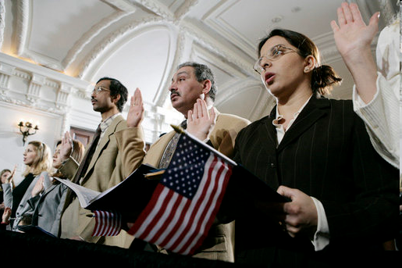
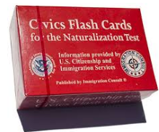
Civics Qs
Flashcards!!

Slide 5
Preparing for the Oath:
Growing Nation

Slide 6
Civics Qs
Flashcards!!

Slide 7
No Dictation Practice
Reading and Writing Sentences Info Sheet

Slide 8
Read the question.
61
What country is south of the United States?
Listen and write the answer that your teacher dictates.
Mexico is south of the United States.

Slide 9
Read.
62
Who is on the dollar bill?
Write.
Washington is on the dollar bill.

Slide 10
Read.
63
Who was President during the Civil War?
Write.
Lincoln was President during the Civil War.

Slide 11
Read.
64
Where does Congress meet?
Write.
Congress meets in the United States Capitol.

Slide 12
Read.
65
How many Senators are there in Congress?
Write.
There are 100 Senators in Congress.

Slide 13
Review
Mexico is south of the United States.
Washington is on the dollar bill.
Lincoln was President during the Civil War.
Congress meets in the United States Capitol.
There are 100 Senators in Congress.
Notes:
What country is south of the United States?
Mexico is south of the United States.
Who is on the dollar bill?
Washington is on the dollar bill.
Who was President during the Civil War?
Lincoln was President during the Civil War.
Where does Congress meet?
Congress meets in the United States Capitol.
How many Senators are there in Congress?
There are 100 Senators in Congress.

Slide 14
More Admin
On my desk:
Did everyone sign in???
Does anyone have an interview date soon?
Please fill in the Interview Date sheet.
Please email me your results after you’ve had your interview: amclin@cuhsd.org

Slide 15
Take a Break!! 10 minutes

