Slide 1
Interview
Commands
During the interview, you might hear commands. Here are some sample commands for you.

Slide 2
Commands
Please be seated.

Slide 3
Commands
Please hand me your passport.

Slide 4
Commands
Read this sentence.

Slide 5
Commands
Please follow me.

Slide 6
Commands
Please print your name.

Slide 7
Commands
Write this sentence here.

Slide 8
Commands
Raise your right hand.

Slide 9
Commands
Please remain standing.

Slide 10
Commands
Sign your name here.

Slide 11
Commands
Please wait here.

Slide 12
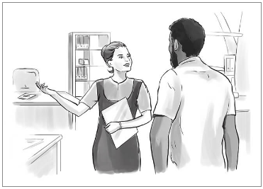
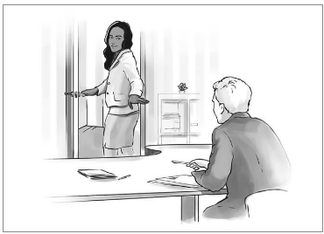
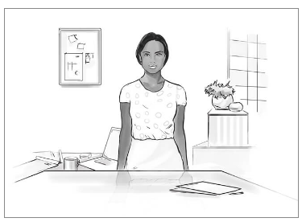
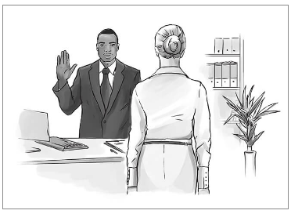
Please remain standing
a
b
c
d

Slide 13
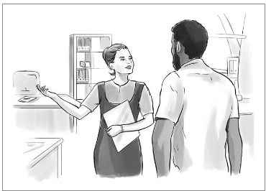
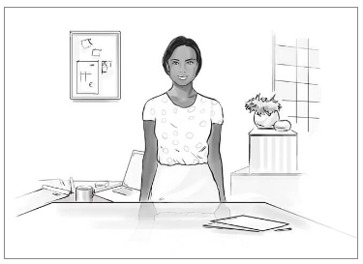
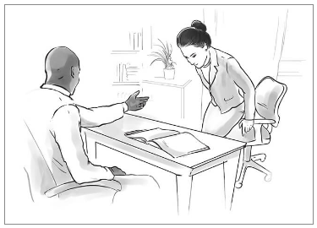
Please wait here
a
b
c
d

Slide 14
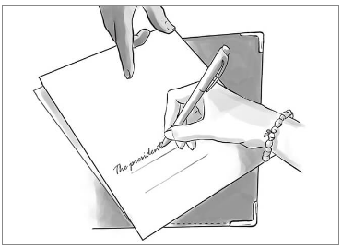
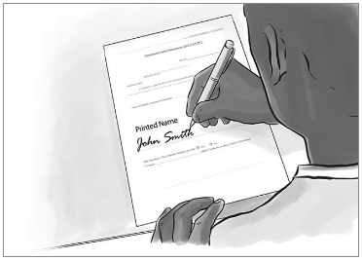
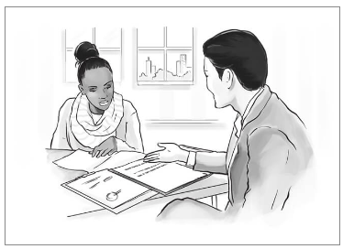
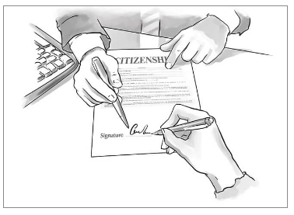
Read this sentence
a
b
c
d

Slide 15
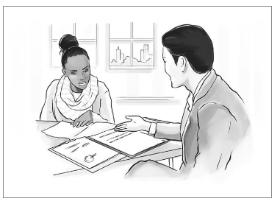
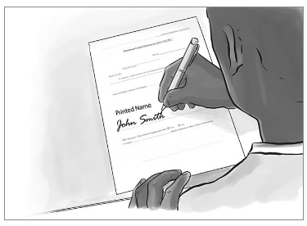
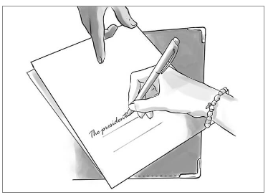
Write this sentence here
a
b
c
d

Slide 16
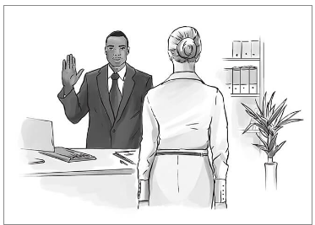
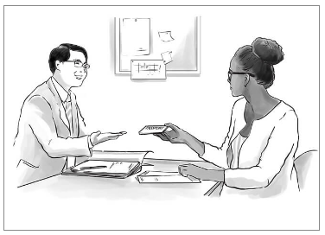
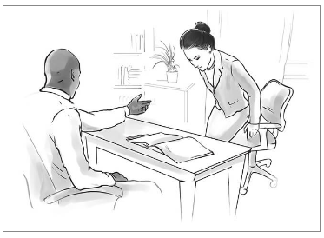
Please hand me your passport
a
b
c
d

Slide 17
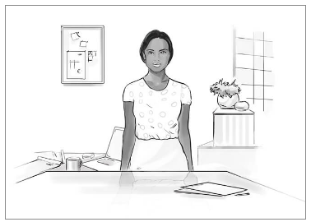
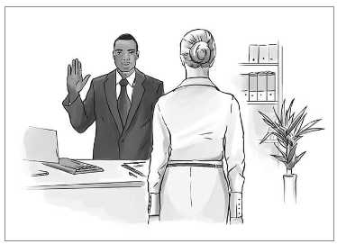
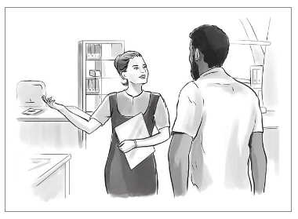
Please be seated
a
b
c
d

Slide 18
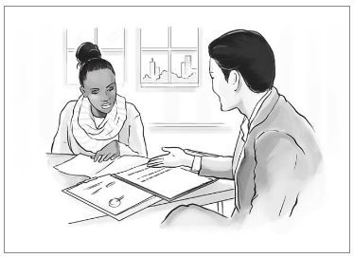
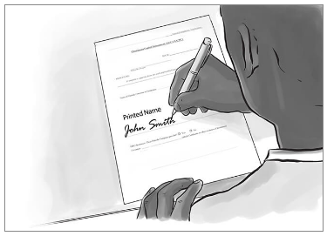
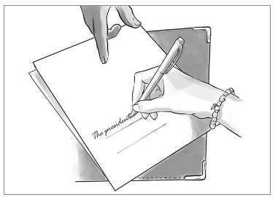
Please print your name
a
b
c
d

Slide 19
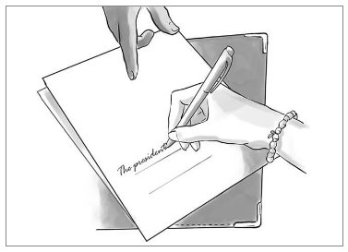
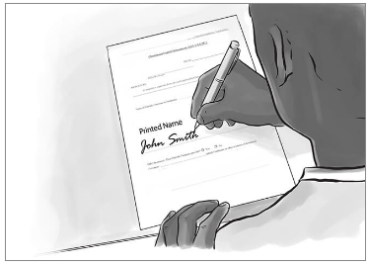
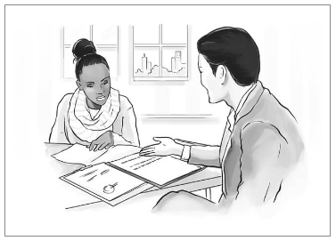
Sign your name here
a
b
c
d

Slide 20
Please follow me
a
b
c
d

Slide 21
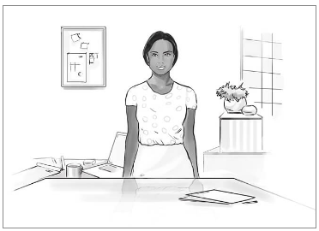
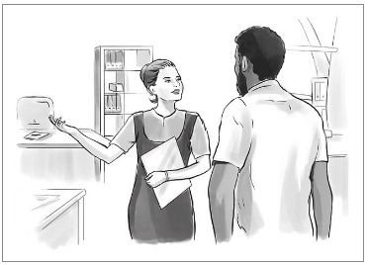
Raise your right hand
a
b
c
d

Slide 22
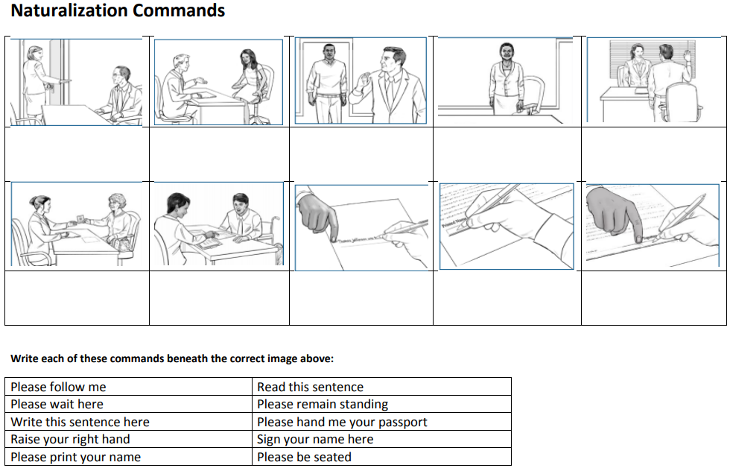
Now You Try!
Please wait
here
Please be seated
Please follow me
Please remain standing
Raise your right hand
Please hand me your passport
Read this sentence
Write this sentence here
Please print your name
Sign your name here

