Slide 1
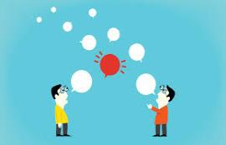
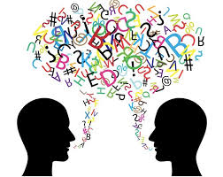
Common Conversations
How to express reactions

Slide 2
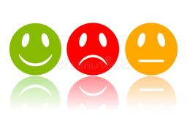
Expressions for Good and Bad News
Happy Sad OK
Happy
Awesome!
That’s amazing!
That’s great!
OK
Really!
Cool!
Interesting!
Sad
That’s too bad.
Oh no!
I’m sorry to hear that

Slide 3
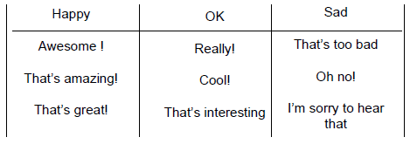
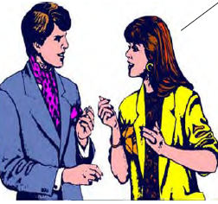
What Should the Reaction Be?
I live in Campbell. How about you?
I live in Campbell too!
That’s great!

Slide 4
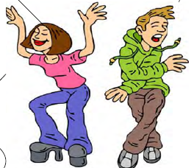
What Should the Reaction Be?
I love dancing! Do you?
Yes, I do!
Awesome!

Slide 5
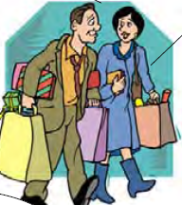
What Should the Reaction Be?
How often do you go shopping at this mall?
Every Saturday morning.
That’s interesting.

Slide 6
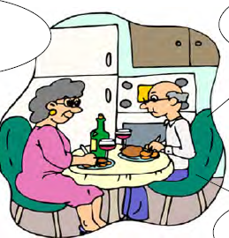
What Should the Reaction Be?
Do you like the wine?
Not really – I don’t like red wine.
Oh no!

Slide 7
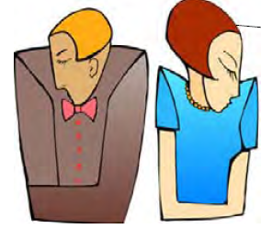
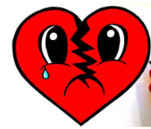
What Should the Reaction Be?
I just broke up with my girlfriend.
I’m sorry to hear that.

Slide 8
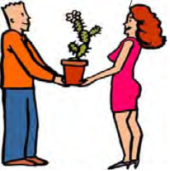
What Should the Reaction Be?
Happy birthday!
Thank you! The cactus is my favorite plant!
That’s amazing!

Slide 9
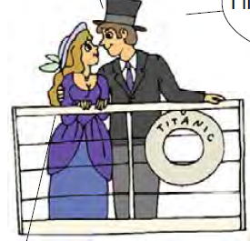
What Should the Reaction Be?
I really like romantic movies
Me too!
Awesome!

