Slide 1
Elementary Citizenship Interview
Q & A

Slide 2
How are you eligible to become a US citizen?
I am over 18 years old and have been a:
Permanent resident for 5 years OR
Permanent resident for 3 years and married to a US citizen for 3 years

Slide 3
What is your current legal name?
My current legal name is ……

Slide 4
What is your date of birth?
My date of birth is (month, day, year)

Slide 5
What is your date of permanent residence?
My date of permanent residence is (month, day, year)

Slide 6
What is your country of birth?
My country of birth is (country)

Slide 7
What is your current home address?
My current home address is …..

Slide 8
Was your mother or father a US citizen before you were 18 years old?
No, they were not OR
Yes, my mother / father was a US citizen.

Slide 9
Do you work or go to school?
Yes, I work at …
Yes, I go to school at …
I am retired
I stay home and take care of the family.

Slide 10
Have you taken any trips outside the US?
No, I have not left the US.
Yes, I left on (date) and returned on (date)

Slide 11
Are you married?
No, I’m single
Yes, I’m married
No, I’m divorced
Yes, I’m widowed

Slide 12
Do you have any children?
No, I have no children.
Yes, I have one child.
Yes, I have 2 children.

Slide 13
Have you ever claimed to be a US citizen?
No

Slide 14
Have you ever voted in any US elections?
No

Slide 15
Do you pay your taxes every year?
Yes, I do

Slide 16
Have you ever been a terrorist or committed acts of violence?
No, never

Slide 17
Have you ever been arrested or committed a crime?
No, never

Slide 18
Have you ever been deported?
No, never

Slide 19
Do you support the Constitution and the form of government of the US?
Yes, I do

Slide 20
If the law requires it, are you willing to bear arms in the US Army?
Yes, I am.

Slide 21
Are you willing to perform non-combatant services for the US Army?
Yes, I am.

Slide 22
Are you willing to help the government during a national emergency?
Yes, I am.

Slide 23
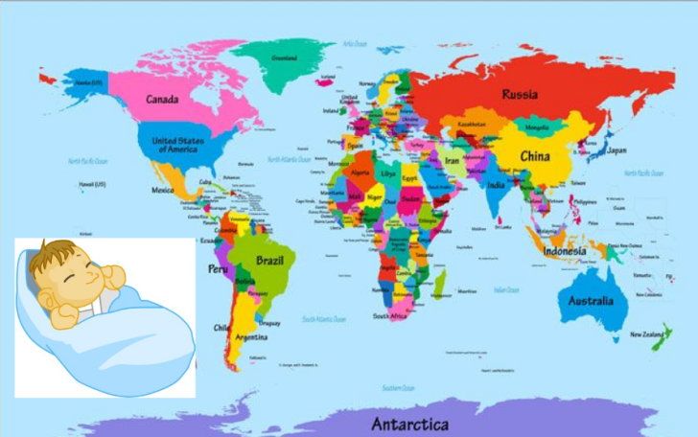
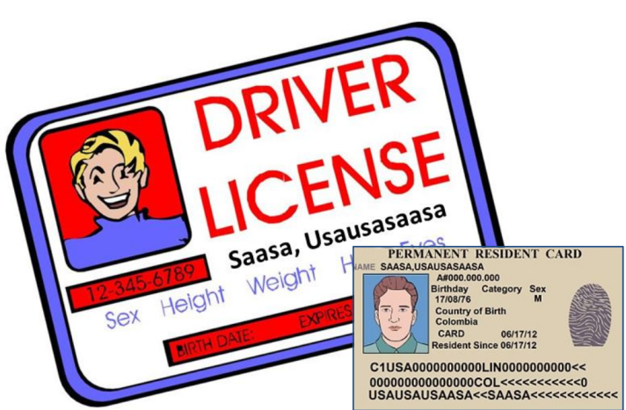
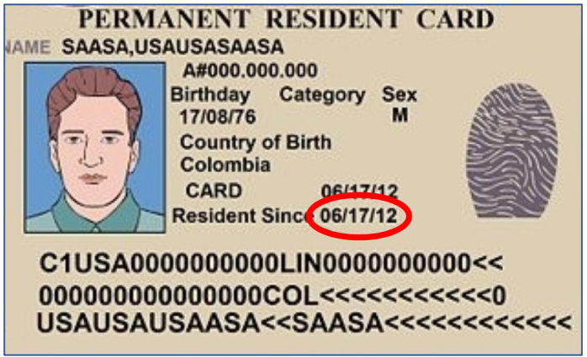
Quiz Time!!!!
Country of birth
Marital status
Legal name
Work, school,
Retired, family
Home
address
Eligible
Parent a US citizen
Date of permanent residence
Date of birth
Trips

Slide 24
Claimed to be
a US citizen
National
emergency
Taxes
Arrested
Deported
Non-combatant
Bear arms
Terrorist
Vote
Children

