Slide 1
Essa Lesson 10
Rights and Responsibilities Part 1

Slide 2
Responsibilities of US Citizens

Slide 3
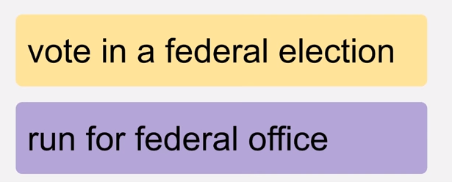
Rights Only for US Citizens

Slide 4
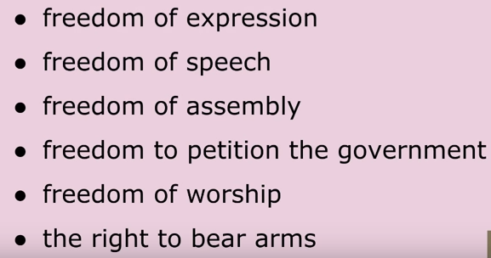
Rights of Everyone Living in the US

Slide 5
The Oath of Allegiance

Slide 6
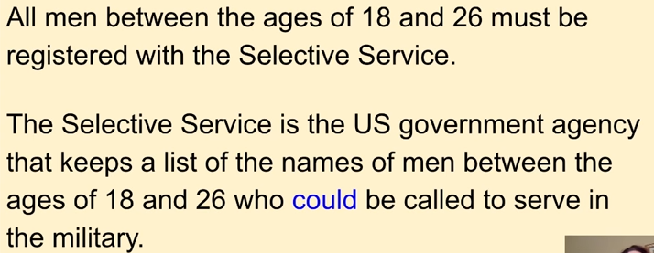
The Selective Service

Slide 7
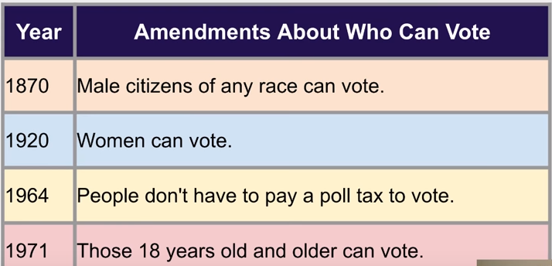
Amendments About Who Can Vote

Slide 8
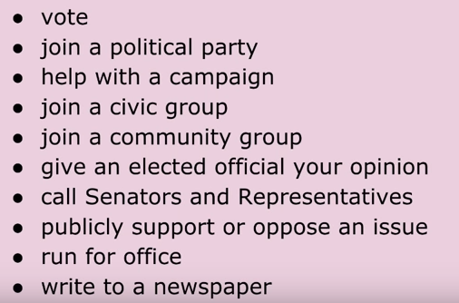
Ways to Participate in Democracy

Slide 9
Federal Tax

Slide 10
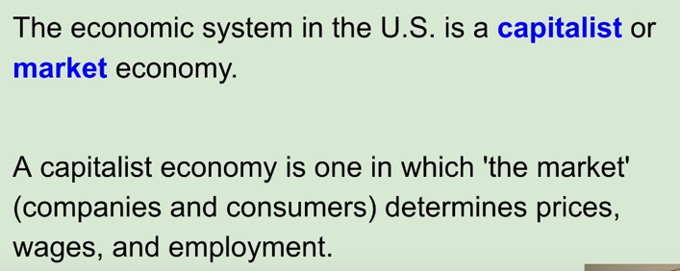
Economic System in the US

Slide 11
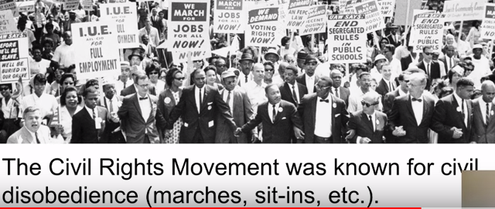
The Civil Rights Movement (1955-1968)

Slide 12
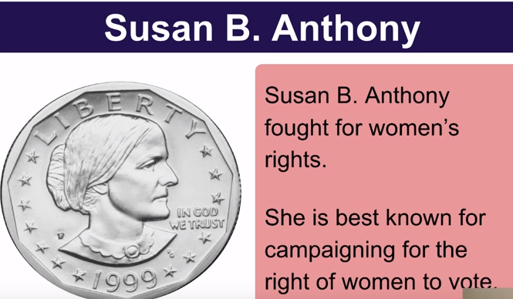
The Civil Rights Movement (1955-1968)

Slide 13
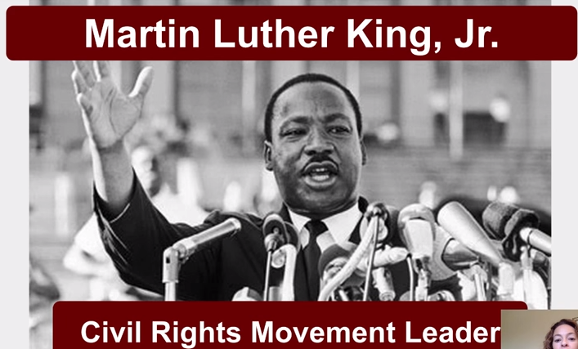
The Civil Rights Movement (1955-1968)

Slide 14
The Civil Rights Act

