Slide 1
Essa Lesson 8
Branches of Government Part 2

Slide 2
The 3 Branches of Government
President
Congress
The Courts
The US Congress makes federal laws

Slide 3
US Senators

Slide 4
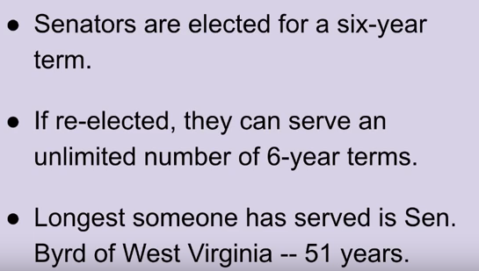
US Senators

Slide 5
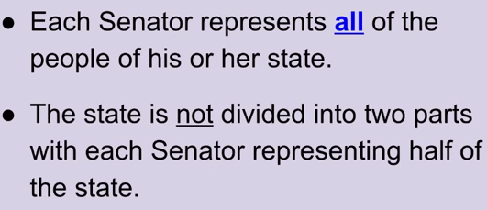
The US Senate

Slide 6
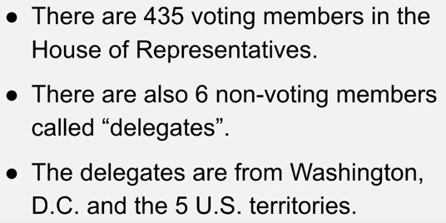
Congressional Representatives

Slide 7
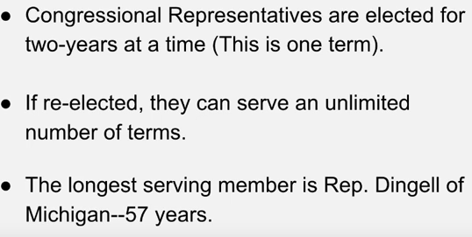
Congressional Representatives

Slide 8
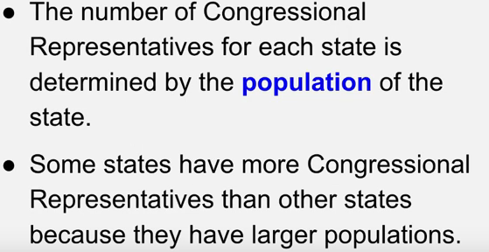
Congressional Representatives

Slide 9
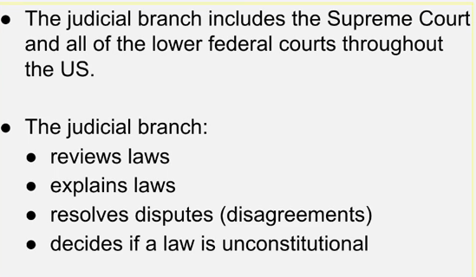
The Judicial Branch

Slide 10
The Supreme Court

Slide 11
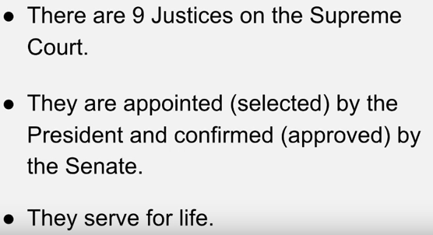
The Supreme Court

Slide 12
State Governments

Slide 13
Finally …
John Roberts
Paul Ryan
Mike Pence

Slide 14
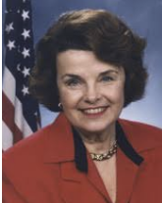
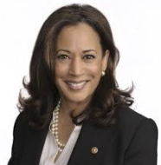
CA Senators
Diane Feinstein
Kamala Harris

Slide 15
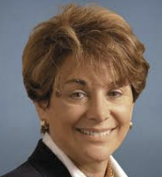
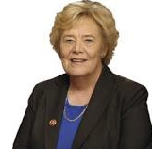
Local Congressional Representatives
Anna Eschoo
D-CA 18th District
Zoe Lofgren
D-CA 19th District

