Slide 1
Click to
start
In love
furious
cold
disgusted
sleepy
hot
happy
hungry
shy
scared
exhausted
sad
surprised
angry
bored

Slide 2
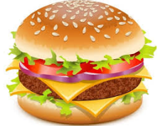
He’s thirsty.
He’s hungry.
He’s cold.
great
next

Slide 3
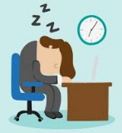
He’s sleepy.
He’s happy.
He’s angry.
great
next

Slide 4
He’s hot.
He’s shy.
He’s angry.
great
next

Slide 5
He’s surprised.
He’s tired.
He’s bored.
great
next

Slide 6
He’s scared.
He’s disgusted.
He’s shy.
great
next

Slide 7
He’s in love.
He’s frustrated.
He’s bored.
great
next

Slide 8
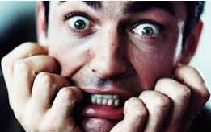
He’s angry.
He’s scared.
He’s sad.
great
next

Slide 9
He’s furious.
He’s cold.
He’s hot.
great
next

Slide 10
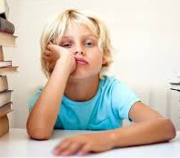
He’s hot.
He’s happy.
He’s bored.
great
next

Slide 11
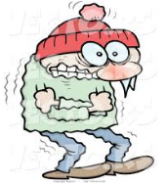
He’s cold.
He’s sleepy.
He’s in love.
great
next

Slide 12
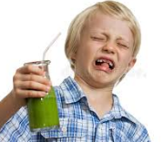
He’s happy.
He’s scared.
He’s disgusted.
great
next

Slide 13
He’s happy.
He’s sad.
He’s shy.
great
next

Slide 14
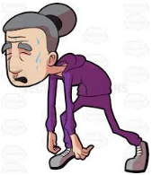
He’s surprised.
He’s exhausted.
He’s angry.
great
next

Slide 15
He’s cold.
He’s sad.
He’s sleepy.
great
next

Slide 16
He’s hot.
He’s furious.
He’s hungry.
great
The end

Slide 17
Quiz
Time!
In love
furious
cold
disgusted
sleepy
hot
happy
hungry
shy
scared
exhausted
sad
surprised
angry
bored

