Slide 1
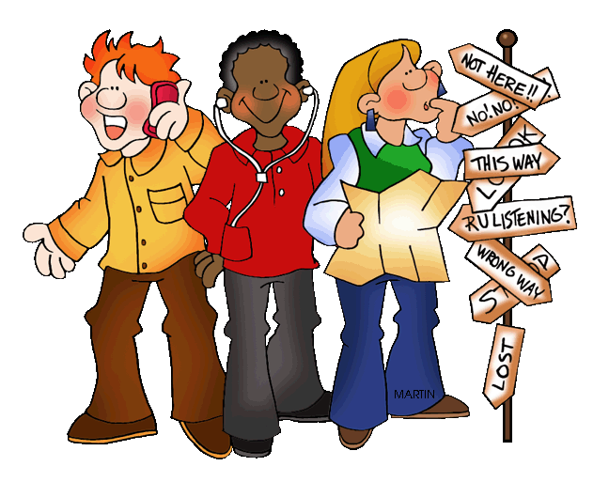
GIVING DIRECTIONS

Slide 2
TURN LEFT
GO STRAIGHT AHEAD/ON
TURN RIGHT

Slide 3
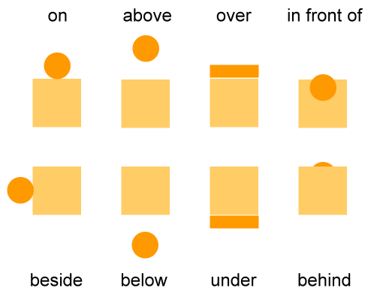
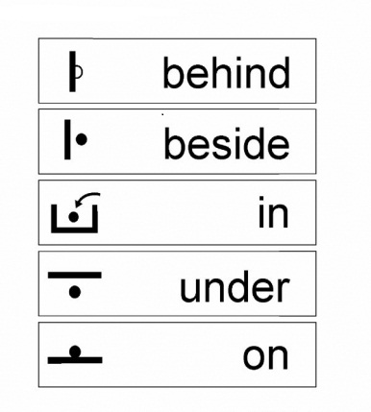
PREPOSITIONS OF PLACE
Next to

Slide 4
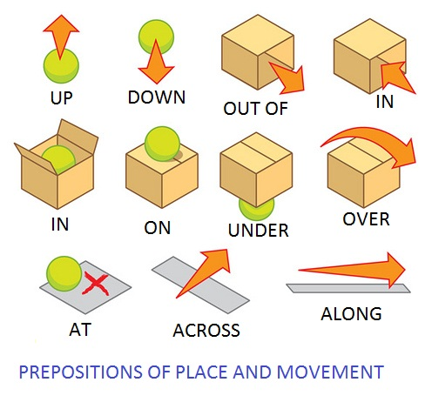
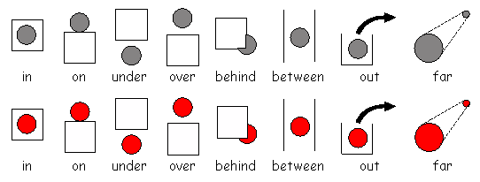

Slide 5
PRACTICE!!!
NOW GO AHEAD AND TRY!!!

Slide 6
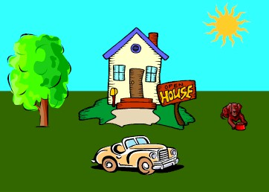
1. The house is_________ the car.
2. The dog is _________ the sun.
3. The tree is to the ______of the house.
4. The car is ___________ the house.
5. The sun is _________ the dog.
6. The house is _________ the dog and the tree.
7. The dog is to the _____ of the house.
BEHIND
BELOW
LEFT
IN FRONT OF
ABOVE
BETWEEN
RIGHT

Slide 7
1. The cat is_________ the table.
2. The vase is _________ the table.
3. The flowers are _________ the vase.
UNDER
ON
IN

Slide 8
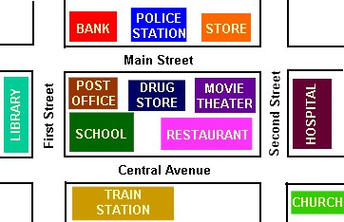
BETWEEN
1. The police station is ___________ the bank and the store.
2. The drug store is _____________ the police station. 3. The school is ___________ the restaurant.
4. The train station is ______________ the school. 5. The drug store is ___________ the movie theater and the post office.
ACROSS FROM
NEXT TO
ACROSS FROM
BETWEEN

Slide 9
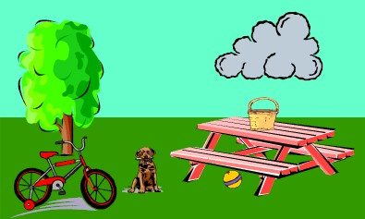
CLOUD
TREE
BASKET
TABLE
DOG
BICYCLE
BALL
Example: ball/table - The ball is under the table
1. basket/table: 2. tree/bicycle 3. cloud/table 4. bicycle/tree 5. dog/the bicycle & the table
The basket is on the table
The tree is behind the bicycle
The cloud is above the table
The bicycle is in front of the tree
The dog & bicycle are on the left of the table

Slide 10
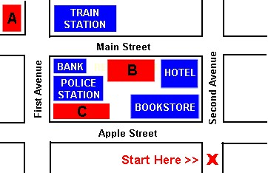
DIALOGUES
Dialog 1
A – Excuse me? B – Yes? A – How do I get to the post office? B – Go past the hotel and turn left onto Main Street. Go one block and turn right. It’s across from the train station. A – Thank you.

Slide 11
Dialog 2
A – How do I get to the supermarket? B – It’s easy. Turn left at the corner onto Apple Street. Go one block. The supermarket is on the corner of First Avenue and Apple Street, next to the police station. A – Thanks.

Slide 12
Dialog 3
A - Excuse me. How do I get to the restaurant? B – Go straight past the bookstore and the hotel. Turn left onto Main Street. It’s the second building on the left, between the hotel and the bank. A – Thank you.

Slide 13
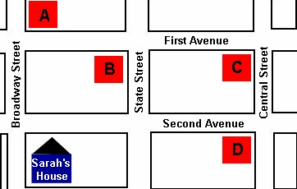
Hi Sarah. I'm glad you can come to my party on Friday night. My house is easy to find. From your house go straight up Broadway to the corner of Broadway and Second Avenue. Turn right. Go straight two blocks and then turn left. It's on the left on the corner of First Avenue and Central Street. See you on Friday!
Which is Amanda's house?
( ) A ( ) B ( ) C ( ) D
X

