Slide 1
CitizenVIP ESL
Information About You

Slide 2
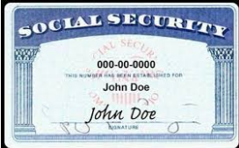
Social Security Number
What is your Social Security Number?
Do you know your Social Security Number?
Tell me your Social Security Number.
My Social Security Number is XXX-XX-XXXX

Slide 3
Date of Birth (month, day, year)
What is your date of birth?
What is your birthday?
When were you born?
On what day were you born?
What is the date of your birth?
Your date of birth is when?
My date of birth is (month, day, year)

Slide 4
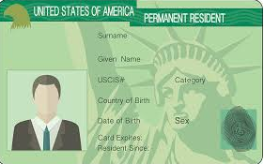
Permanent Resident/”A” Number
What is the date you became a permanent resident?
When did you become a permanent resident?
On what date did you become a permanent resident?
What is your USCIS “A” number?
How long have you been a permanent resident?
I became a permanent resident on (month, day, year).
My “A” number is …
I have been a permanent resident for X years

Slide 5
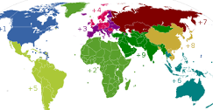
Country of Birth
What country were you born in?
What is your country of birth?
Where were you born?
In what country were you born?
I was born in (country)

Slide 6
Country of Nationality
What is your nationality?
What country are you currently a citizen of?
What is your country of nationality?
My country of nationality is (country)

Slide 7
Parents US Citizens?
Is either of your parents a US citizen?
Are your parents US citizens?
Is your mother or father a US citizen?
No.

Slide 8
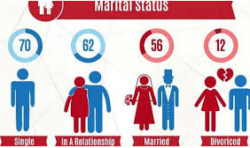
Marital Status
What is your current marital status?
What is your marital status?
Are you currently married?
Are you single?
Are you divorced?
Are you widowed?
I’m single / married / divorced/ widowed.

Slide 9
Questions
What is your
date of birth?
What is your Social
Security Number?
What country were
you born in?
What is your
country of nationality?
Is either of your parents
a US citizen?
What is your current
marital status?

Slide 10
Practice in Pairs:
What is your Social Security Number?
My Social Security Number is …
What is your date of birth?
My date of birth is (month, day, year)
When did you become a permanent resident?
I became a permanent resident on (month, day, year)
What is your USCIS “A” number?
My “A” number is …..
How long have you been a permanent resident?
I have been a permanent resident for (number) years.
What country were you born in?
I was born in (country)
What is your nationality?
My nationality is (country)
Is either of your parents a US citizen?
No
What is your current marital status?
I am single / married / divorced / widowed

