Slide 1
CitizenVIP ESL
Intros & Greetings

Slide 2
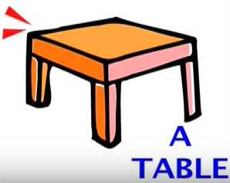
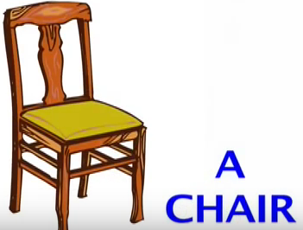
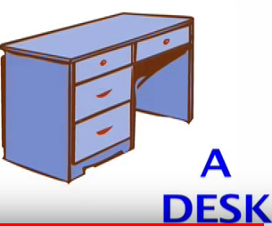
Office Objects

Slide 3
Office Objects

Slide 4
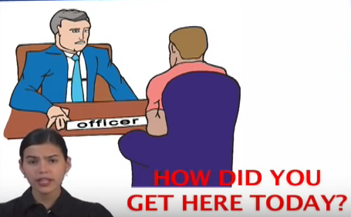

Slide 5
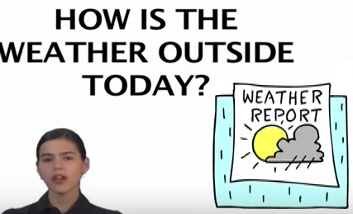
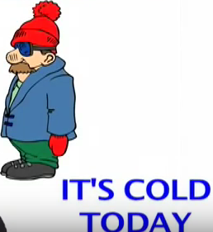

Slide 6
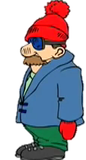
Practice in Pairs
What is your name? How do you spell it?
My name is … .
I spell my name … .
How did you get here today?
I took (a car, a bus, a taxi)
How is the weather outside today?
It’s sunny / hot / cold / raining / cloudy today

