Slide 1
Occupations Matching Exercise

Slide 2
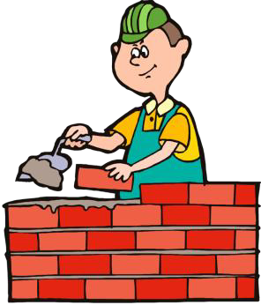
Builder

Slide 3
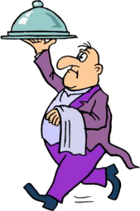
Waiter

Slide 4
Dentist

Slide 5
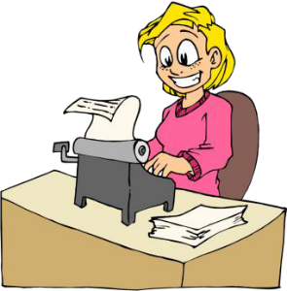
Secretary

Slide 6
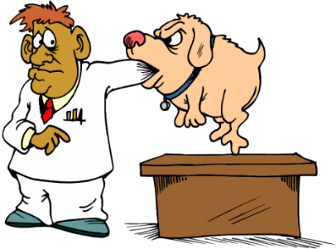
Vet

Slide 7
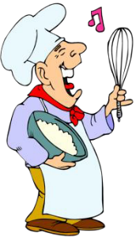
Cook

Slide 8
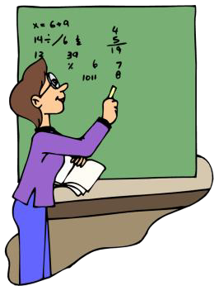
Teacher

Slide 9
Doctor

Slide 10
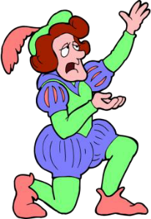
Actor

Slide 11
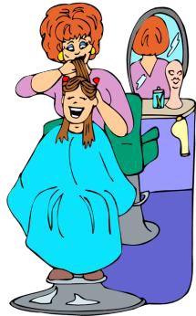
Hairdresser

Slide 12
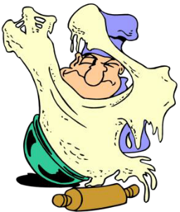
Baker

Slide 13
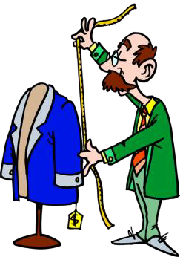
Tailor

Slide 14
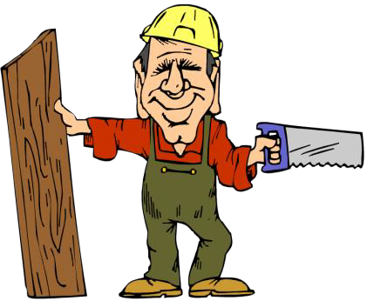
Carpenter

Slide 15
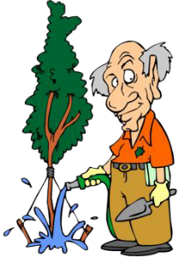
Gardener

Slide 16
Singer

Slide 17
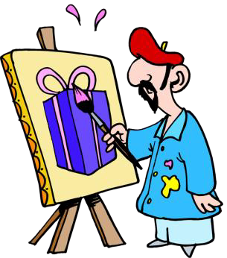
Artist

Slide 18
Nurse

Slide 19
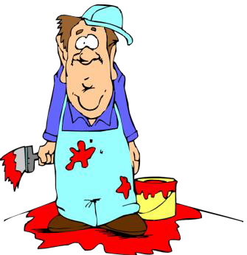
Painter

Slide 20
Businessman

Slide 21
Reporter

Slide 22
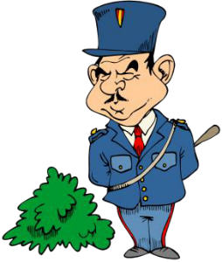
Policeman

Slide 23
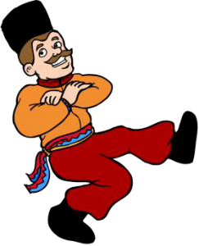
Dancer

Slide 24
Cashier

Slide 25
Farmer

Slide 26
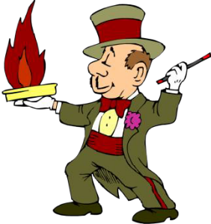
Magician

