Slide 1
N-400 Practice Interview
Part 11: Children

Slide 2
How many children do you have?
I don’t have any children. (Skip to Section 12)
I have __ living, __ missing, __ dead children.

Slide 3
If you have children, where were they born?
____ children were born in the United States.
____ children were born in (country)

Slide 4
If you have children, how old are they?
____ children are under 18 years of age.
____ children are over 18 years of age.

Slide 5
If you have children, what is their marital status?
___ children are unmarried.
____ children are married

Slide 6
If you have children, where do they live?
) ____ children live with me.
____ children live in (city)

Slide 7
How many stepchildren do you have?
I don’t have any stepchildren.
I have ___ stepchildren.

Slide 8
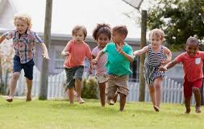
How many legally adopted children do you have?
don’t have any legally adopted children.
I have ___ legally adopted children

Slide 9
How many children were born when you were not married?
My children were born when I was married.
___ children were born when I was not married

Slide 10
What is your child’s name?
My child’s name is ___

Slide 11
Is he / she a U.S. citizen?
Yes, he / she is a US citizen.
No, he/she is not a US citizen. He / she is a citizen of (country)

Slide 12
What is your child’s date of birth?
His / her date of birth is __ __ / __ __ / __ __ __ __.

Slide 13
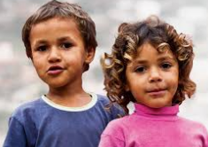
What is your child’s country of home address?
He/she lives with me.
His/her address is ___

Slide 14
What is your child’s relationship to you?
Biological child
Stepchild
Legally Adopted Child

