Slide 1
N-400 Practice Interview
Part 12: Info About You
Q 1 - 8

Slide 2
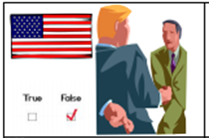
Have you ever claimed to be a US citizen?
No, never

Slide 3
Have you ever registered to vote?
No, never

Slide 4
Have you ever voted in any U.S. elections?
No, never

Slide 5
Do you have any title of nobility in a foreign country?
No, I don’t

Slide 6
Have you been declared legally incompetent?
No, never

Slide 7
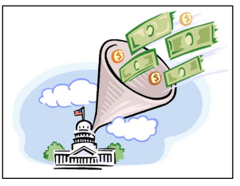
Do you owe any taxes?
No, I don’t

Slide 8
Do you pay your taxes every year?
Yes, I do

Slide 9
Have you ever called yourself a non-resident on a federal, state, or local tax return?
No

