Slide 1
N-400 Practice Interview
Part 12: Info About You
Q22 - 36

Slide 2
Have you ever committed a crime?
No, never

Slide 3
Have you ever been arrested?
No, never

Slide 4
Have you ever been charged with commiting a crime?
No, never

Slide 5
Have you ever been convicted of committing a crime?
No, never

Slide 6
Have you ever been placed in a rehabilitative program?
No, never

Slide 7
Have you ever been placed on probation or been paroled?
No, never

Slide 8
Have you ever been in jail or prison?
No, never

Slide 9
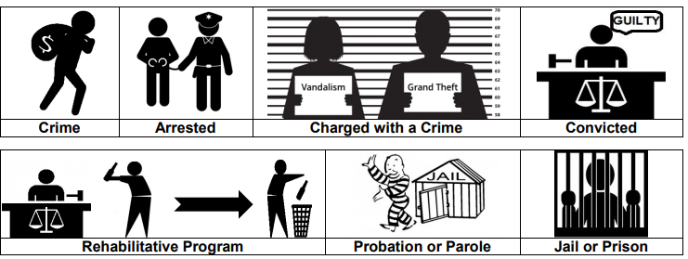
The Criminal Process

Slide 10
Have you ever been a habitual drunkard?
No, never

Slide 11
Have you ever been a prostitute?
No, never

Slide 12
Have you ever sold or smuggled illegal drugs or narcotics?
No, never

Slide 13
Have you ever committed bigamy? What is bigamy?
No, never
You are married to more than one person at the same time.

Slide 14
Have you ever married someone to get an immigration benefit (Green Card)?
No, never

Slide 15
Have you ever helped anyone enter the U.S. illegally?
No, never

Slide 16
Have you ever gambled illegally? What is illegal gambling?
No, never.
You play cards and don’t pay taxes.

Slide 17
Have you ever failed to support your children or pay alimony? What is alimony?
No, never.
Alimony is the money that a court makes you pay monthly to your ex-spouse.

Slide 18
Have you ever lied to the US government to get public benefits (ex: welfare)?
No, never

Slide 19
Have you ever given any U.S. Government officials any information that was false, fraudulent, or misleading?
No, never

Slide 20
Have you ever lied to U.S. Government officials to gain entry or admission into the U.S. or to gain immigration benefits while in the United States?
No, never

Slide 21
Have you ever been removed, excluded, or deported from the U.S.?
No, never

Slide 22
Have you ever been placed in removal, exclusion, rescission, or deportation proceedings from the U.S.?
No, never

Slide 23
Have you ever been placed in removal, exclusion, rescission, or deportation proceedings from the U.S.?
No, never

Slide 24
Are removal, exclusion, rescission, or deportation proceedings from the U.S. (including administratively closed proceedings) currently pending against you?
No

