Slide 1
N-400 Practice Interview
Part 2: Information About You

Slide 2
What is your current legal name?
My current legal name is (first, middle, last)

Slide 3
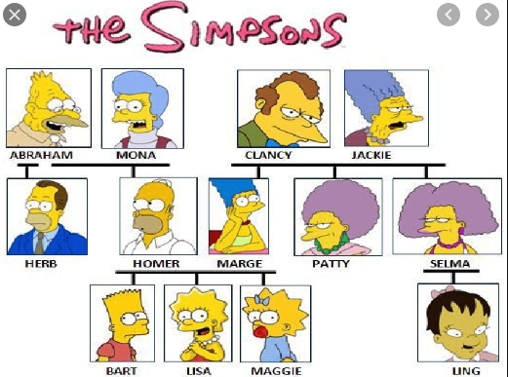
What is your family name?
My last name is …

Slide 4
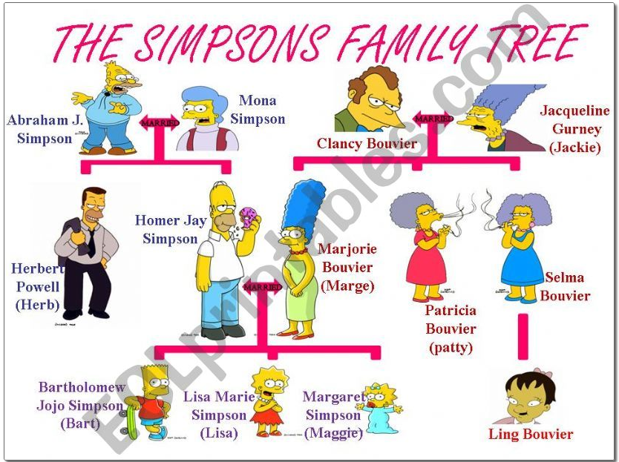
What is your given name?
My first name is …

Slide 5
Do you have a middle name?
No.
Yes. My middle name is …

Slide 6
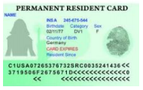
What is your name exactly as it appears on your Permanent Resident Card?
My name on my Green Card is …

Slide 7
Is the name on your Green Card the same as your current legal name?
Yes.
No. The name on my Green Card is not the same as my current legal name because:
1. The name on my Green Card is my maiden name. I got married.
2. I went to court and legally changed my name.

Slide 8
Do you have a nickname or maiden name?
No
Yes – my nickname/maiden name is …

Slide 9
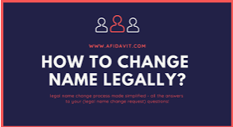
Do you want to legally change your name?
No
Yes – I would like to change it to …

