Slide 1
N-400 Practice Interview
Part 4: Information to Contact You

Slide 2
What is your daytime ‘phone number?
My ‘phone number is (XXX) XXX-XXXX

Slide 3
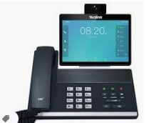
What is your work ‘phone number?
My work ‘phone number is (XXX) XXX-XXXX

Slide 4
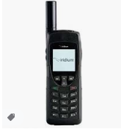
What is your evening‘ phone number?
My evening ‘phone number is (XXX) XXX-XXXX
My evening ‘phone number is the same as my day ‘phone number

Slide 5
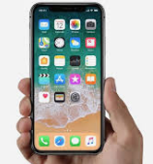
What is your cell ‘phone number?
My cell ‘phone number is (XXX) XXX-XXXX

Slide 6
What is your email address?
My email address is xxxxx at yahoo.com
I don’t have an email address

Slide 7
How long have you lived at your Current Home Address?
I have lived at my current home address since (date)

Slide 8
What is your Mailing Address?
My Mailing Address is the same as my Current Home Address.

Slide 9
What is your Previous Home Address?
My previous home address is …
I have lived at my current home address for 5 years.

