Slide 1
N-400 Practice Interview
Part 7: Biographic Info

Slide 2
Are you Hispanic or Latino?
Yes, I am Hispanic or Latino.
No, I am not Hispanic or Latino.

Slide 3
What is your race?
I am:
White
Asian
Black/African American
Native American
Native Hawaiian/Pacific Islander

Slide 4
How tall are you?
I am ___ feet and ___ inches

Slide 5
How much do you weigh?
I weigh ___ pounds

Slide 6
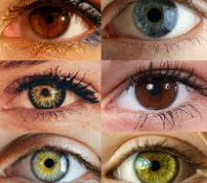
What is your eye color? What color are your eyes?
I have ___ eyes:
Brown
Blue
Green
Hazel
Gray
Black
Purple

Slide 7
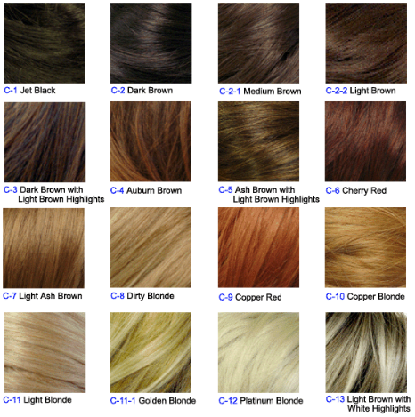
What is your hair color? What color is your hair?
I have ___ hair:
Black
Brown
Blonde
Red
Gray
White
I am bald

