Slide 1
N-400 Part 12 Vocabulary Review
Qs 1 - 8

Slide 2
Claim
To say that something is true even though it is false.

Slide 3
Claim
To put my name and personal information on an official list of people who can vote.

Slide 4
Vote
To choose a new leader or law.

Slide 5
Election
To choose a new leader for a government office.

Slide 6
Nobility
To be a member of the king’s (royal) family.

Slide 7
Title of Nobility
A special name or rank

Slide 8
Legally Incompetent
A judge says that I cannot make decisions. A lawyer or my family make decisions for me.

Slide 9
Owe
I must pay the government money.

Slide 10
Taxes
Money for the government to pay for military, schools, etc.

Slide 11
Non-resident (alien)
This person does not live in the United States.

Slide 12
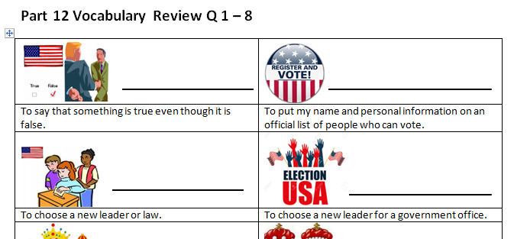
Please take out this sheet:
Match the vocabulary in the Word Bank with the correct definition

Slide 13
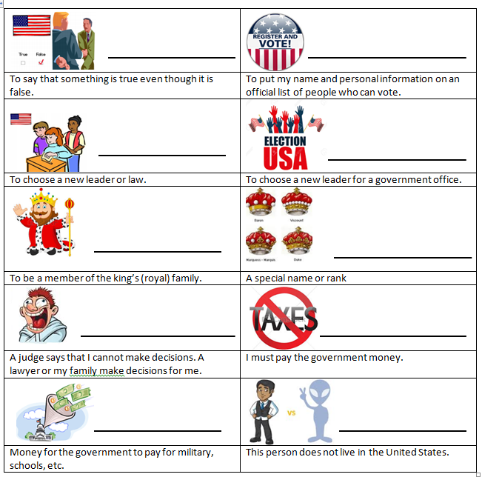
Review:
claim
register
vote
election
Title of nobility
nobility
Legally incompetent
owe
Non-resident
taxes

