Slide 1
N-400 Part 12 Vocabulary Review
Q30: Criminal Acts

Slide 2
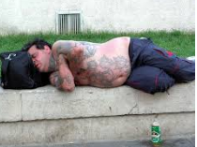
Habitual Drunkard
Someone who drinks too much alcohol every day and gets sick

Slide 3
Prostitute
A woman who sells sex for money.

Slide 4
Illegal Drugs
Drugs that are against the law, such as cocaine, heroin and opium

Slide 5
Bigamy
To be married to more than one person at the same time

Slide 6
Immigration Benefit
To become eligible for a Green Card by marrying a US citizen

Slide 7
Illegal Entry
To be in the US without a proper visa

Slide 8
Illegal Gambling
To play cards or games for money and not pay taxes

Slide 9
Alimony
Money that a court orders someone to pay monthly to their ex-spouse after a divorce

Slide 10
Child Support
Money that a court orders someone to pay monthly to their ex-spouse for their children after a divorce.

Slide 11
Public Benefits
Social services or financial support from the government.

Slide 12
Please take out this sheet:
Match the vocabulary in the Word Bank with the correct definition

Slide 13
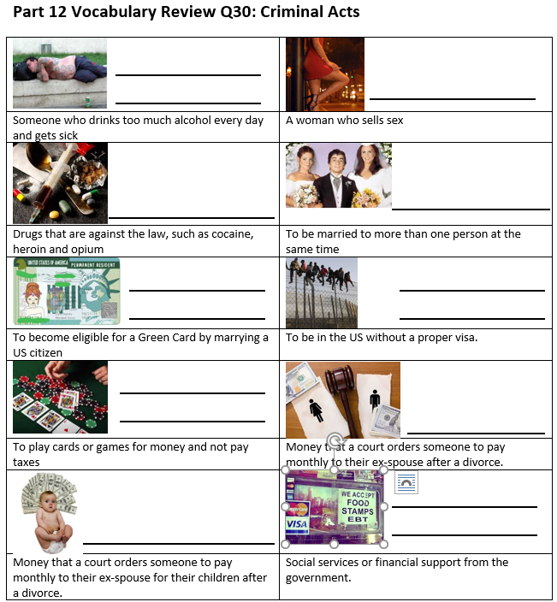
Review:
Habitual Drunkard
Prostitute
Illegal Drugs
Bigamy
Immigration Benefit
Illegal Entry
Illegal Gambling
Alimony
Public Benefits (Welfare)
Child Support

