Slide 1
N-400 Part 12 Vocabulary Review
Q37-44: US Military Service

Slide 2
US Armed Forces
To be a member of the US Army, Navy, Air Force, Marines, or Coast Guard.

Slide 3
Deployed
To serve in the US military service outside the US (in another country)

Slide 4
Court-martialed
To be arrested and put on trial in a military court

Slide 5
Discharge
To leave the armed forces.

Slide 6
The Draft
Compulsory military service

Slide 7
Deserted
To run away from the armed forces

Slide 8
Selective Service
All males 18 – 26 must register to join the armed forces if there is a national emergency.

Slide 9
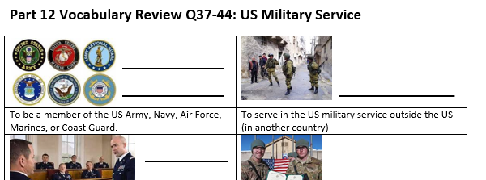
Please take out this sheet:
Match the vocabulary in the Word Bank with the correct definition

Slide 10
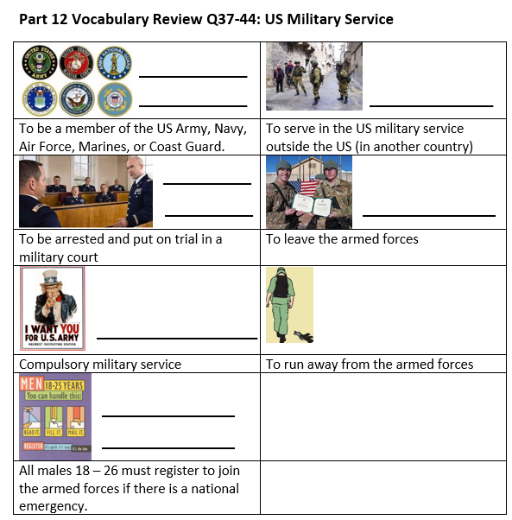
Review:
US Armed Forces
Deployed
Court Martialed
Discharged
The Draft
Deserted
Selective Service

