Slide 1
N-400 Part 12 Vocabulary Review
Q45-50: Attachment to the Consitution

Slide 2
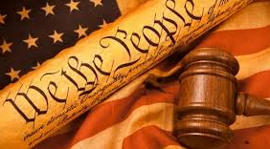
US Constitution
The supreme law of the United States

Slide 3
US Form of Government
The US is a federal republic (democracy)

Slide 4
Oath
A serious promise

Slide 5
Allegiance
To be loyal.

Slide 6
The Oath of Allegiance
The promise to be loyal to the US

Slide 7
Bear Arms
To use a weapon to protect the US

Slide 8
Non-combatant
To work in the Army without using a weapon

Slide 9
Work of National Importance
To help the country during a national emergency (flood, hurricane, fire, earthquake)

Slide 10
Under Civilian Direction
To follow the orders of non-military safety officers or disaster relief workers from the Red Cross

Slide 11
Please take out this sheet:
Match the vocabulary in the Word Bank with the correct definition

Slide 12
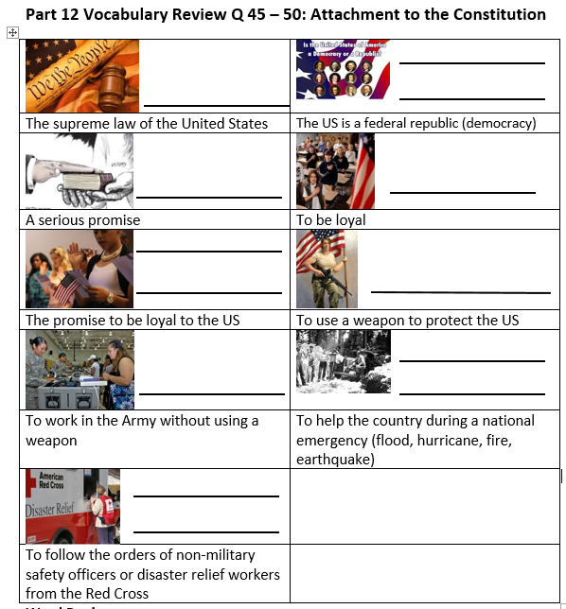
Review:
The Constitution
US form of government
Oath
Allegiance
Oath of Allegiance
Bear Arms
Non Combatant
Work of national importance
Under Civilian Direction

