Slide 1
Ready for the Interview
N-400 Part 2: Information About You:
Name Country of Birth
Social Security Number Country of Nationality
Gender Exemptions
Dates

Slide 2
Listen to Maria (1-12)
Key Vocab:
Current legal name
Last name
Family name
Key Vocab:
First name
Given name
Middle name

Slide 3
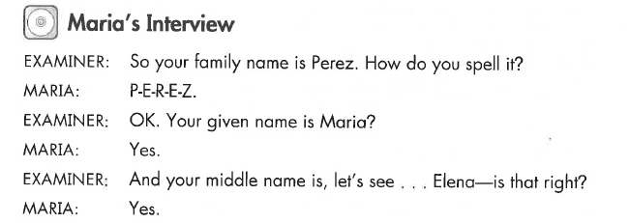
Maria’s Interview
Q & A:
How do you spell your family name?
P-E-R-E-Z

Slide 4
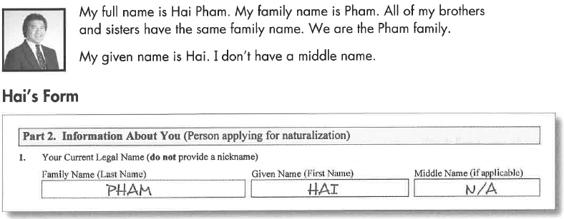
Listen to Hai
Key Vocab:
Family name (last name)
Given name (first name)
Middle name

Slide 5
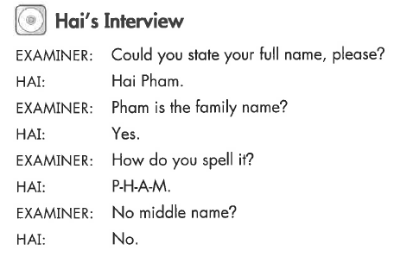
Hai’s Interview (11)
Q & A:
Please state your full name.
How do you spell that?

Slide 6
What Will YOU Say?
State your full name.
What is your full name?
What is your family name?
What is your last name?
What is your first name?
What is your given name?
Do you have a middle name?
How do you spell that?
My full name is …
My last name is …
My first name is …
My middle name is ..
Full name

Slide 7
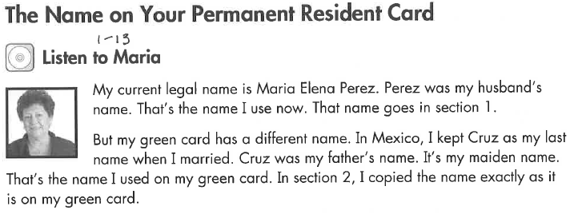
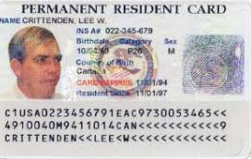
Listen to Maria
Key Vocab:
Name on your Permanent Resident Card

Slide 8
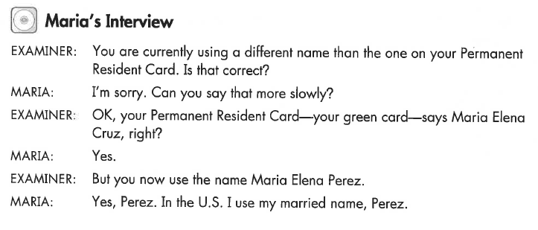
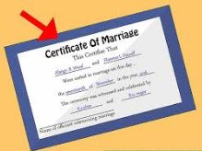
Maria’s Interview
Q & A:
Have you used any other name?
I use my married name.

Slide 9
Listen to Hai (12)
Key Vocab:
Never used any other name

Slide 10
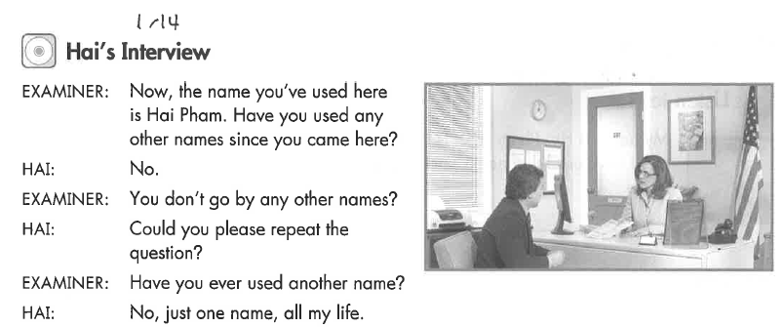
Hai’s Interview
Q & A:
Have you used any other name?

Slide 11
Listen to Nick
Key Vocab:
Adopted

Slide 12
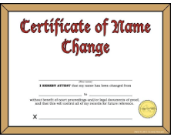
Nick’s Interview
Q & A:
Have you used any other name?
I changed my name …

Slide 13
Listen to Lisa
Key Vocab:
Current legal name
Nickname

Slide 14
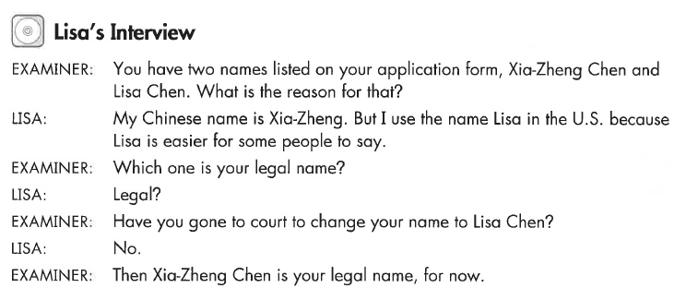
Lisa’s Interview
Key Vocab:
Legal name
Change your name

Slide 15
What Will YOU Say?
Please state your full legal name.
What is your current legal name?
Have you used any other names since you came here?
Have you used any other names since you became a permanent resident?
Do you go by any other names?
What other names have you used?
Have you ever changed your name?
My legal name is …
No
Yes – I got married

Slide 16
Listen to Lisa
Key Vocab:
Do you want to change your name?
I want to change my name.
I want my citizenship papers to say my new name, … .

Slide 17
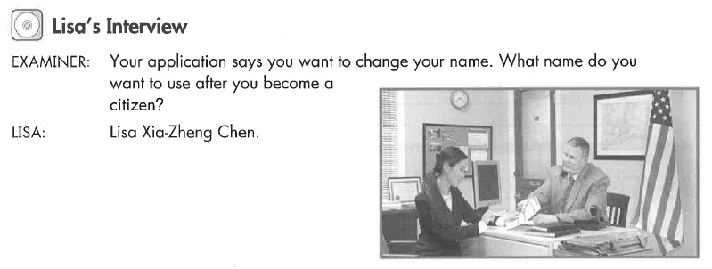
Lisa’s Interview
Q & A:
What name do you want to use after you become a citizen?

Slide 18
Listen to Hai
Key Vocab:
Do you want to change your name?
No, I don’t

Slide 19
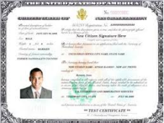
What Will YOU Say?
Do you want to change your name?
Would you like to change your name?
What name do you want to use when you become a US citizen?
What name do you want on your naturalization certificate?
No, I don’t want to change my name.
Yes, I would like to change my name to …

Slide 20
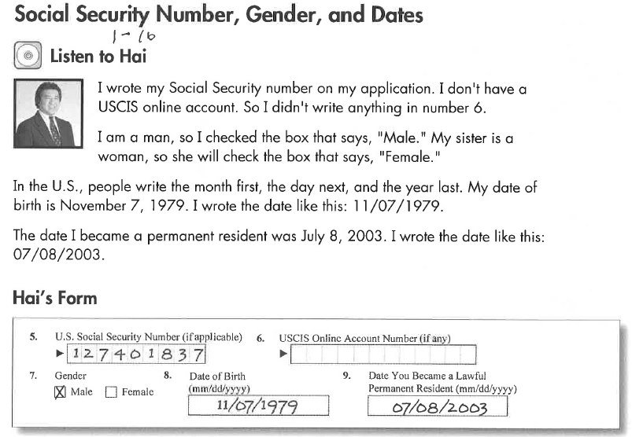
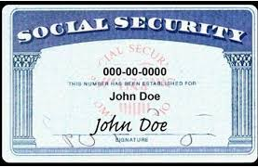
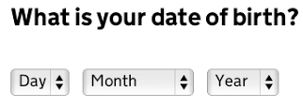
Listen to Hai (1-16)
Q & A:
What is your Social Security Number?
It is XXX-XX-XXXX
What is your date of birth?
Month, day, year

Slide 21
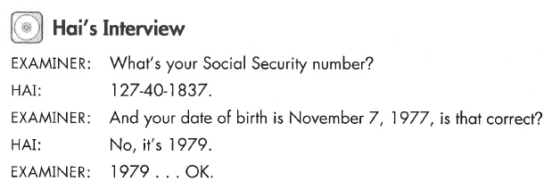
Hai’s Interview
Key Vocab:
Social Security Number
Date of birth
Gender – male (man), female (woman)

Slide 22
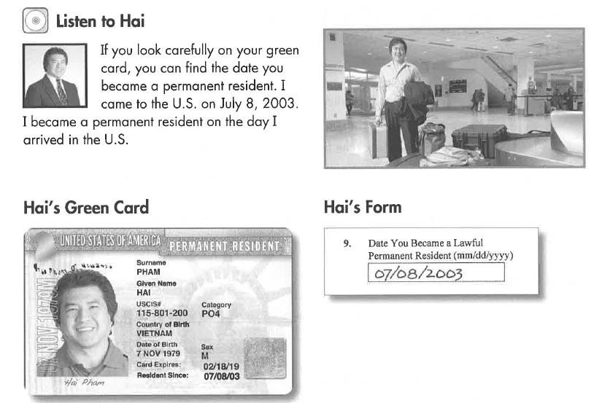
Listen to Hai (1-16)

Slide 23
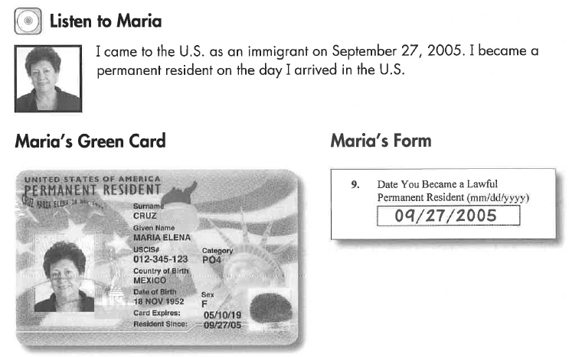
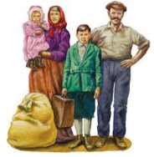
Listen to Maria
Key Vocab:
Immigrant

Slide 24
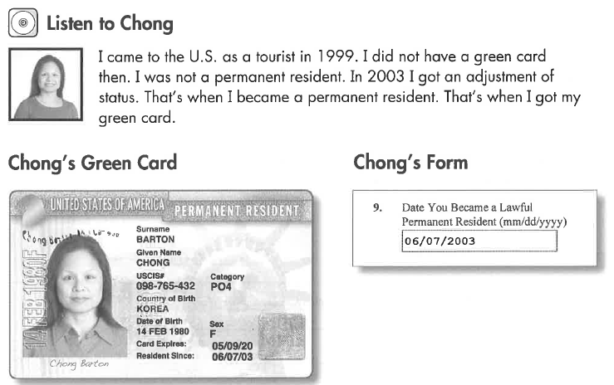
Listen to Chong
Key Vocab:
Tourist

Slide 25
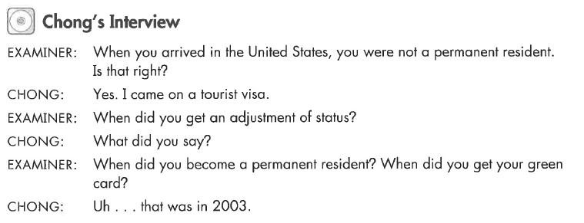
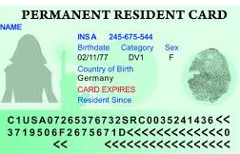
Chong’s Interview
Key Vocab:
Tourist visa
Adjustment of status

Slide 26
What Will YOU Say?
Do you know your Social Security Number?
What is your Social Security Number?
What’s your date of birth?
When were you born?
When did you become a permanent resident?
What date did you become a permanent resident?
My Social Security Number is …
My date of birth is month, day, year.
I became a permanent resident on month, day, year.

Slide 27
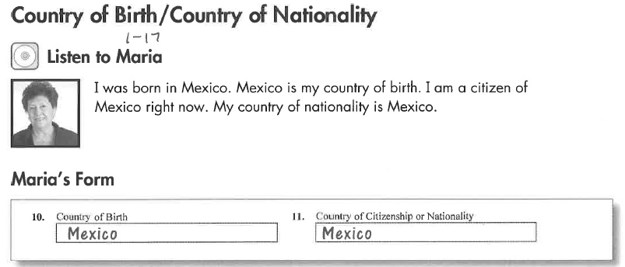
Listen to Maria
Key Vocab:
Country of birth
Country of nationality (your passport)

Slide 28
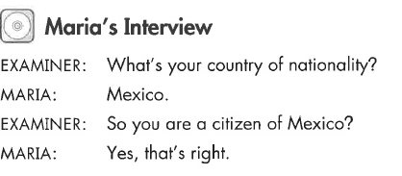
Maria’s Interview
Key Vocab:
Country of nationality
Citizen (of Mexico)

Slide 29
Listen to Nick
Key Vocab:
Citizen (of Thailand)
Country of nationality (your passport)

Slide 30
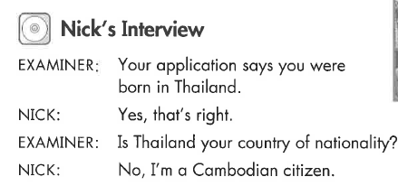
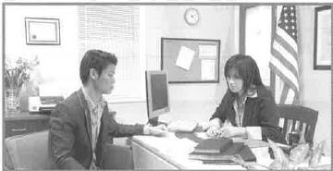
Nick’s Interview
Key Vocab:
You were born (in Thailand)

Slide 31
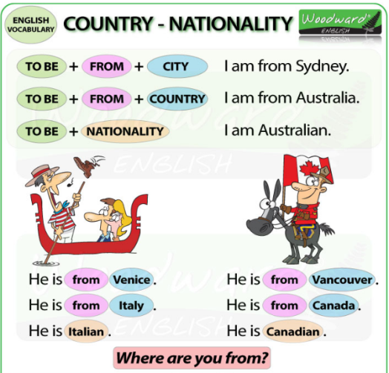
What Will YOU Say?
Country of Birth:
What is your country of birth?
Where were you born?
In which country were you born?
Country of Nationality:
What is your country of nationality?
Are you a citizen of any other country?
My country of birth is (country).
My country of nationality is (country).

