Slide 1
Ready for the Interview
N-400 Part 6: Information About Your Parents

Slide 2
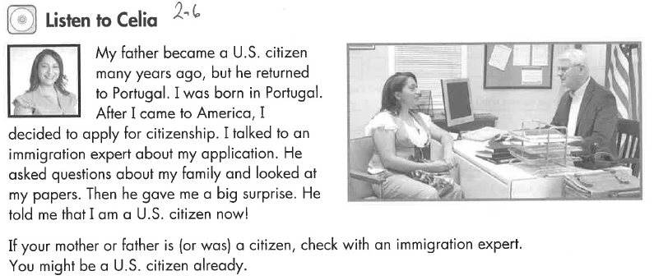
Listen to Celia (2-7)

Slide 3
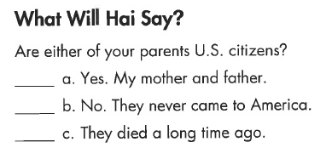
Listen to Hai (2-)

Slide 4
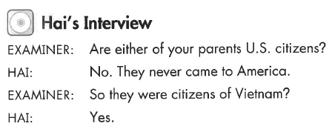
Hai’s Interview (2-)
Key Vocab:
Either of your parents US citizens?

Slide 5
What Will YOU Say?
Were your parents married before your 18th birthday?
Yes
No
Is your mother a US citizen?
Is your father a US citizen?
Are either of your parents US citizens?
No OR
Yes
S/he was born in the US
S/he married a US citizen
S/he was a permanent resident for 5 years.
S/he became a US citizen on (date) in (City, state)
How was s/he eligible to become a US citizen?
When and where did s/he become a US citizen?

