Slide 1
Ready for the Interview
N-400 Part 7: Biographic Information

Slide 2
Listen to Hai (2-8)

Slide 3
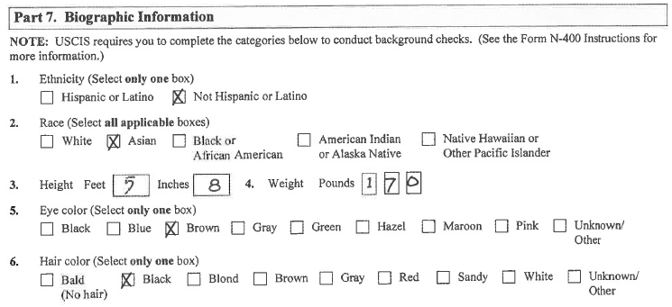
Hai’s Form
Key Vocab:
Race Ethnicity Eye color
Weigh Tall Hair Color

Slide 4
What Will YOU Say?
White
Asian
Latino
African American
Native American or Alaska Native
Native Hawaiian or Pacific Islander
What race are you?
What ethnicity are you?

