Slide 1
Ready for the Interview
N-400 Part 8: Employment & Schools

Slide 2
Listen to Maria (2-9)
Key Vocab:
Employer
Job

Slide 3
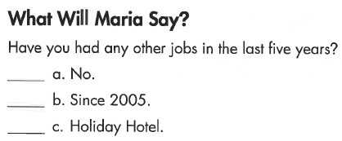
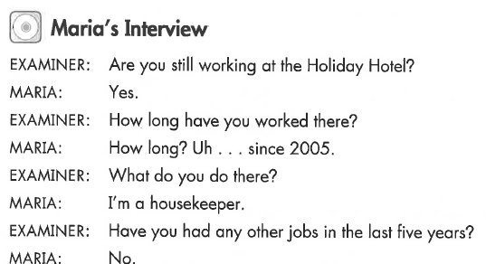
Maria’s Interview (2-)
Key Vocab:
Working/worked

Slide 4
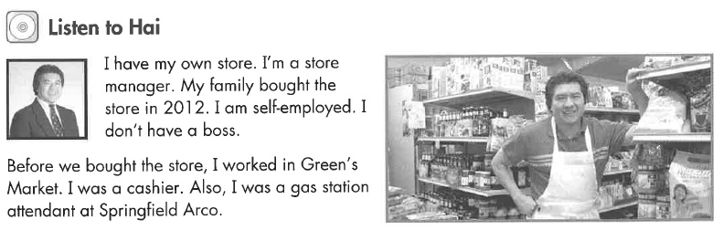
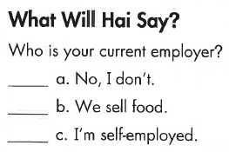
Listen to Hai (2-)
Key Vocab:
Employer
Job
Self-employed

Slide 5
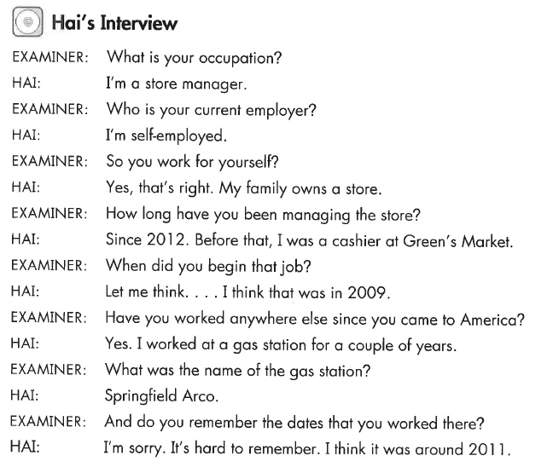
Hai’s Interview (2-)
Key Vocab:
Occupation
Self-employed

Slide 6
Listen to Otto (2-)
Key Vocab:
Retired
Stopped working

Slide 7
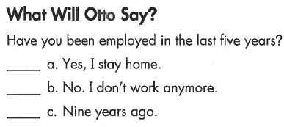
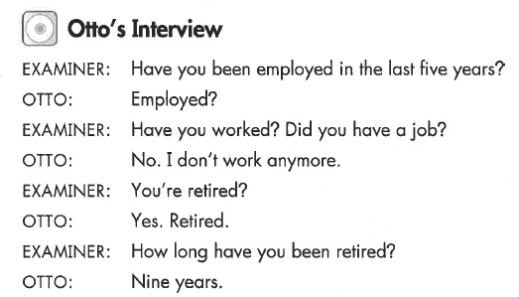
Otto’s Interview (2-)
Key Vocab:
Employed
Retired

Slide 8
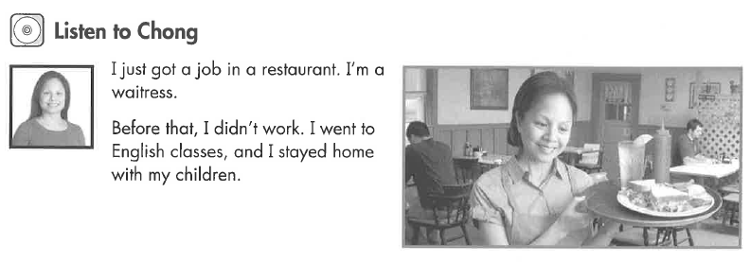
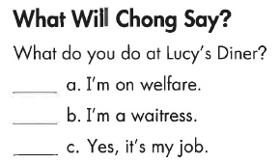
Listen to Chong (2-)
Key Vocab:
A job
Stayed home

Slide 9
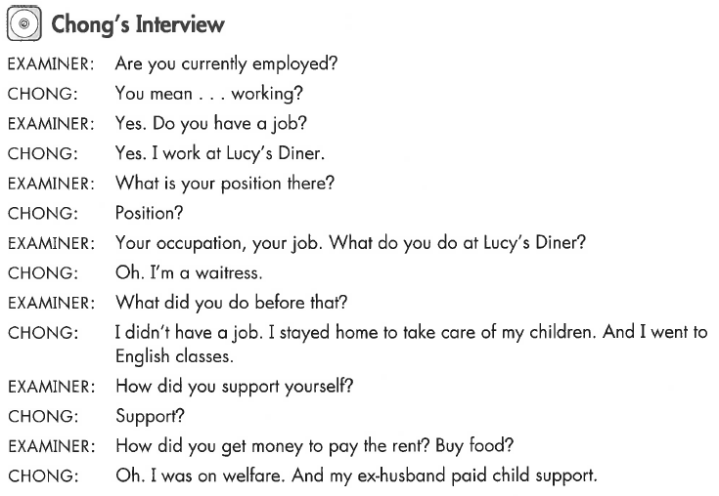
Chong’s Interview (2-)
Key Vocab:
Position (job)
Support ($$$)
Welfare

Slide 10
What Will YOU Say?
Do you work?
Do you have a job right now?
Are you currently employed?
Are you currently working?
Yes – I am a (teacher)
No – I’m retired / I take care of my family.
Who is your current employer?
Where do you work?
What is your employer’s address?
I work for (Costco).
How long have you worked there?
When did you begin working there?
How long have you been working there?
How long have you had that job?
I started working there in (July, 2017).

Slide 11
What Will YOU Say?
What do you do there?
What kind of work do you do?
What is your position?
What job do you have there?
What is your occupation?
Your job now
I am a ….
Your last job
I worked as a …
Where did you work before that?
What did you do?
When did you leave that job?
How long did you work there?
Have you had any other jobs?
Have you worked anywhere else in the last 5 years?
Where else have you worked since you became a permanent resident?
I worked for …
No, nowhere else.

