Slide 1


Ready for the Interview
N-400 Part 9: Time Outside the US

Slide 2

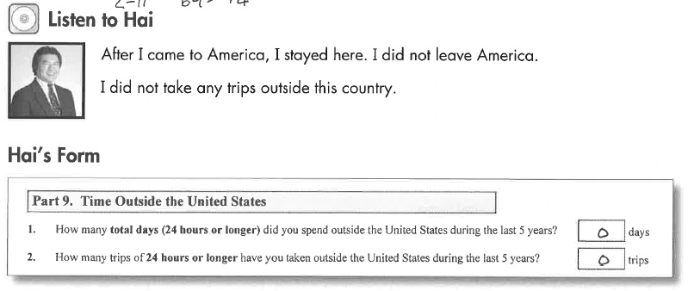
Listen to Hai
Key Vocab:
Trips = travel
Outside the country = in another country (not US)

Slide 3
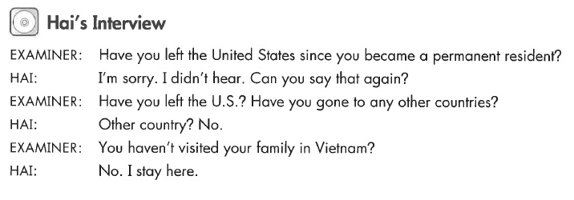
Hai’s Interview
Key Vocab:
Left the US
Gone to other countries

Slide 4
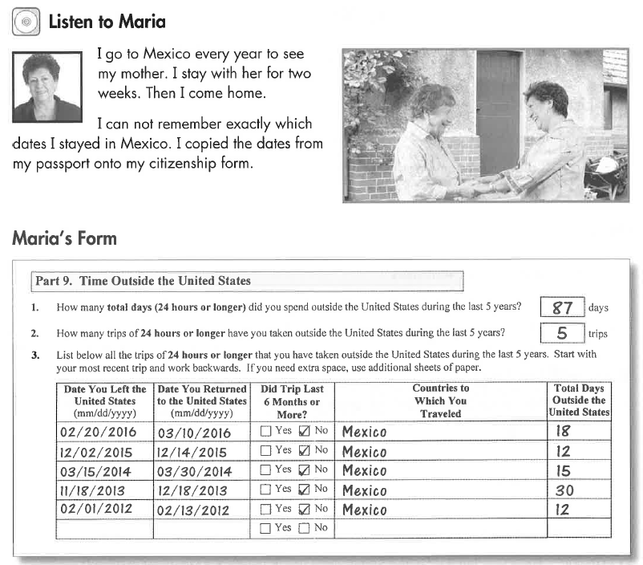
Listen to Maria

Slide 5
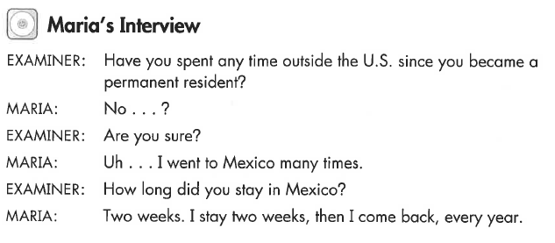
Maria’s Interview
Key Vocab:
How long did you stay?

Slide 6
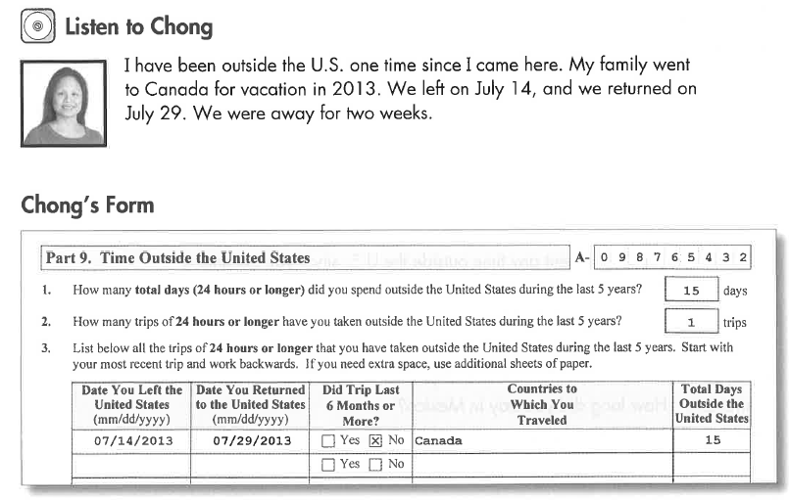
Listen to Chong

Slide 7
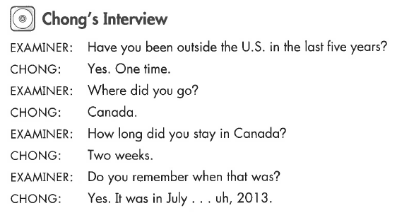
Chong’s Interview
Key Vocab:
Outside the US
In the last 5 years

Slide 8
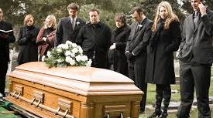
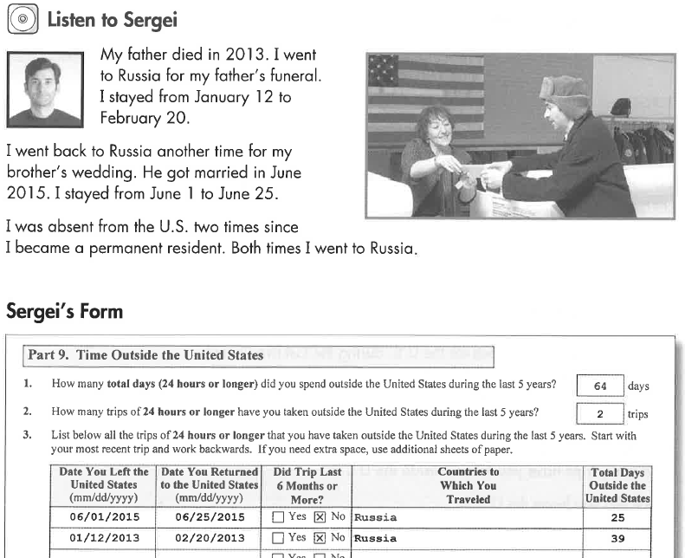
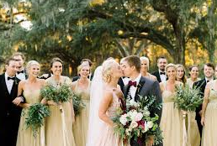
Listen to Sergei
Key Vocab:
Funeral
Wedding

Slide 9
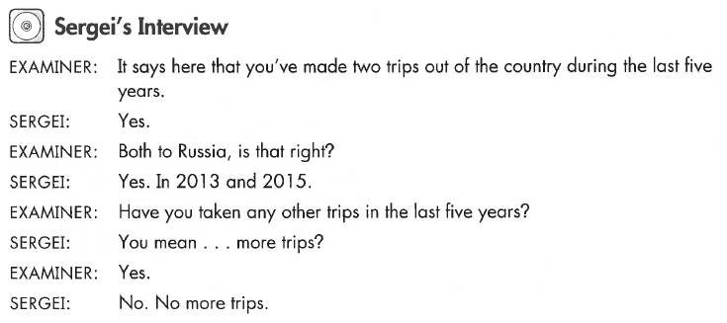
Sergei’s Interview
Key Vocab:
More trips
Other trips

Slide 10
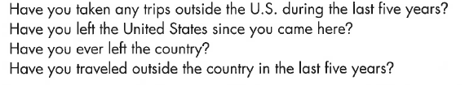


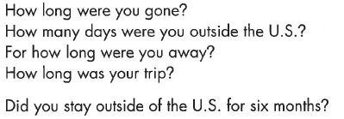


What Will YOU Say?
No, I haven’t left the US.
Yes, I have
I took 3 trips
I left on April 3, 2017.
I returned on April 20, 2017
I left for 17 days total.
I went to (Japan).
No – no more trips.
Yes, I went to … .

